Slide 1

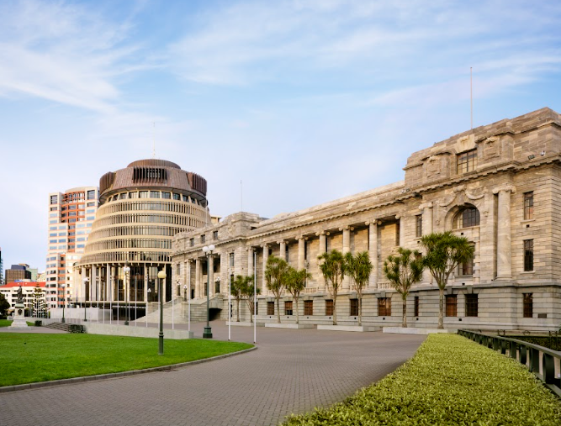
New Zealand Parliament
A guide to my trip to New Zealand's Parliament

Slide 2
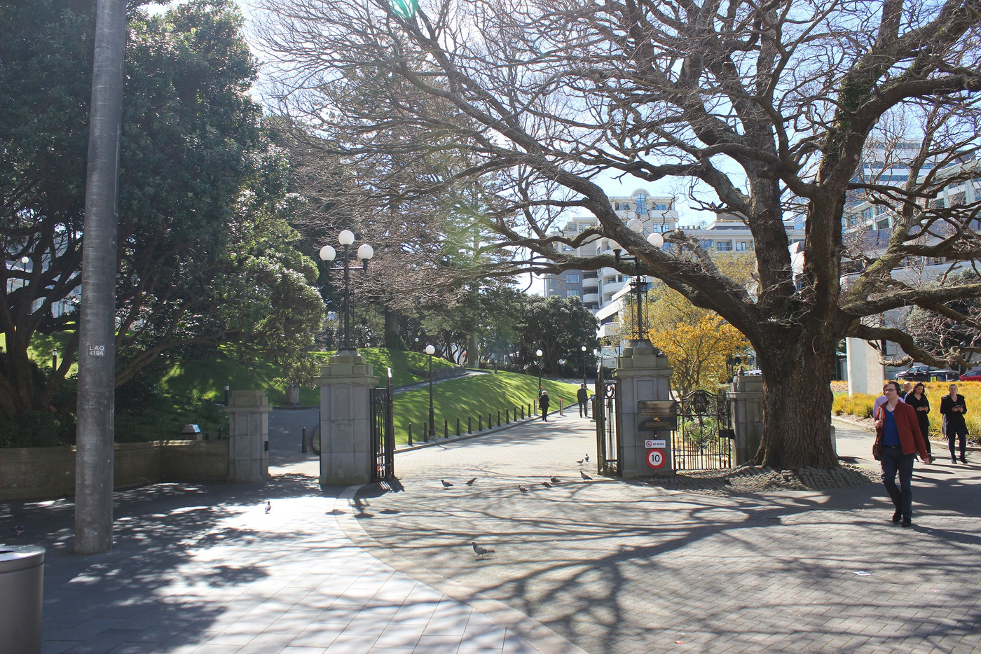
I am going on a trip to Parliament
I am going to visit Parliament in Wellington.
There are lots of interesting things to see in Parliament.
I am here to hear some facts about Parliament and what happens there.

Slide 3
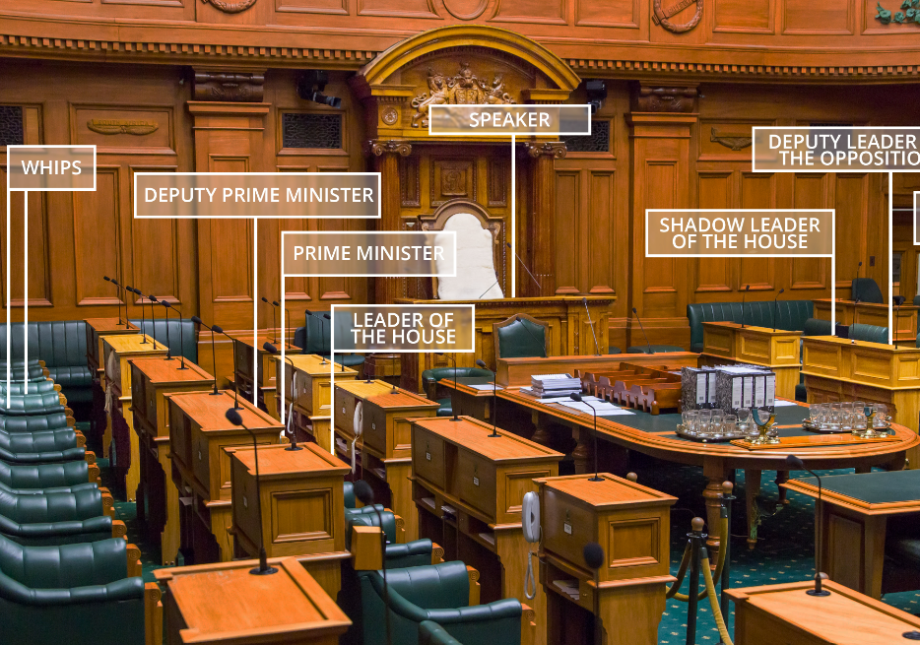
What is Parliament?
Parliament is where laws are made for New Zealand.
Laws are like rules that I follow in my classroom.
Laws help keep everyone safe. They tell me what we can and can not do.
There are lots of laws in New Zealand.

Slide 4
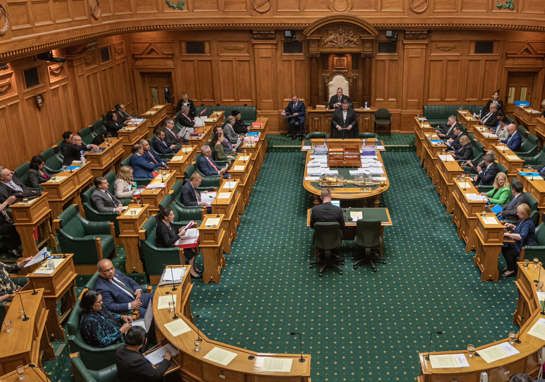
Members of Parliament
Laws are made by people called Members of Parliament.
They are often called MPs.
They are voted in by the people that live in New Zealand.
Parliament is where these MPs work.

Slide 5
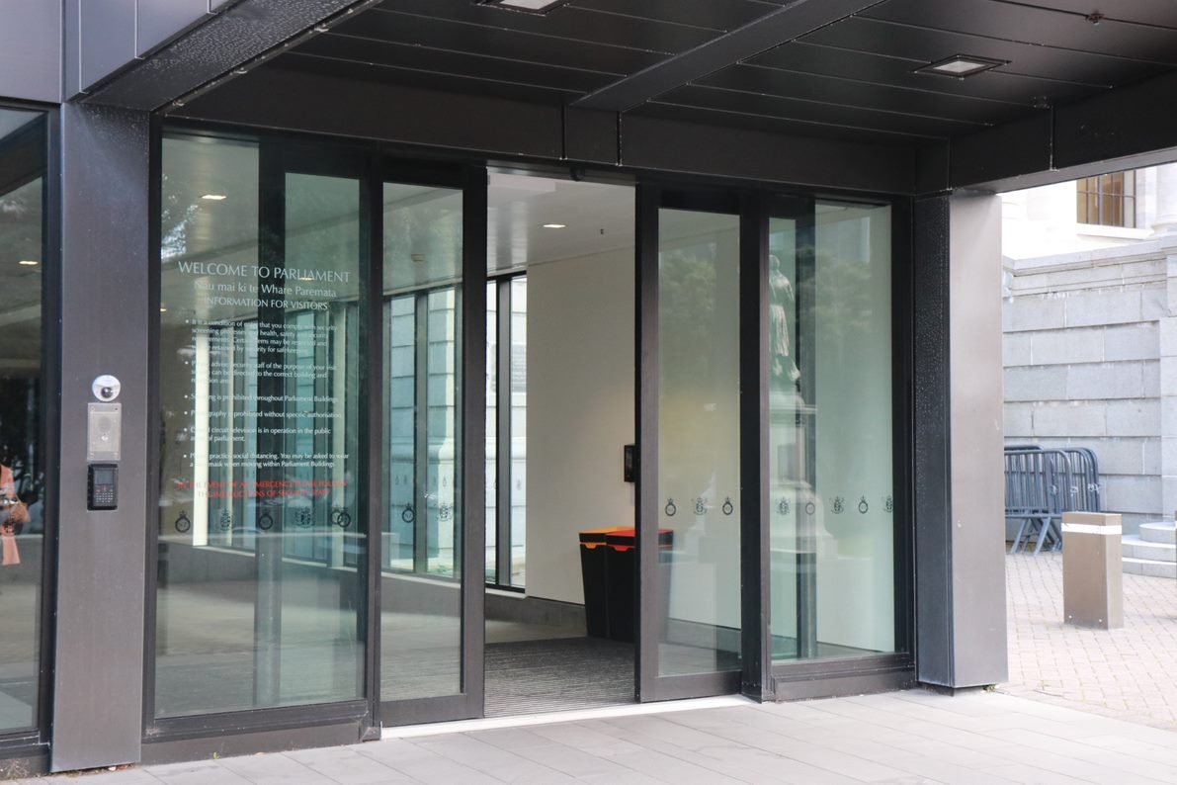
Entering Parliament
This is the entrance to the Beehive.
There might be lots of people walking in and out here.
That is ok, if I get overwhelmed, I can talk to my teacher or use my headphones if I have them.

Slide 6
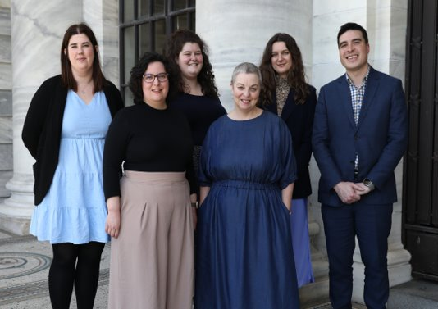
Parliament educators
An educator will meet me, they will say hello and tell me their name.
The educator is somebody who works at Parliament.
They are going to show around the buildings and tell me about Parliament.
In Parliament it is important that everyone tries their best to be quiet so that we don’t interrupt anybody.

Slide 7
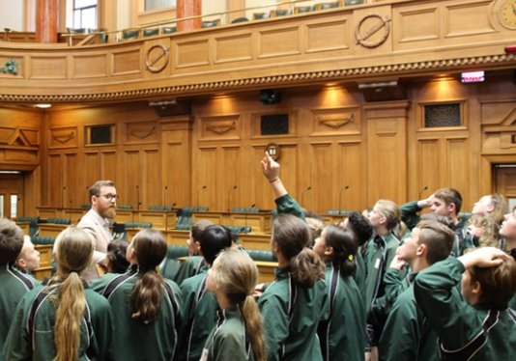
Parliament educators
It is important everyone stays together as a group so that nobody gets lost.
I might have a question. That is cool.
If I raise my hand and wait the educator will happily answer it.
Educators enjoy answering questions about Parliament.

Slide 8
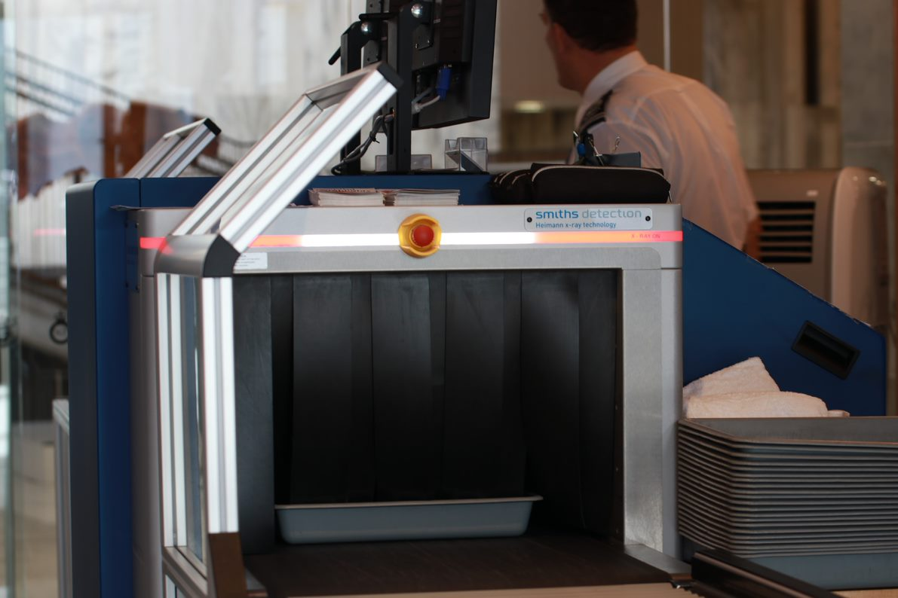
Security check
Before the tour starts, everyone will go through a security check. This is because Parliament is an important place where important people work.
Security is there to keep everybody safe and make sure everyone is following the rules.
Everyone will put their bags and any belongings they have into a box that will be scanned.

Slide 9
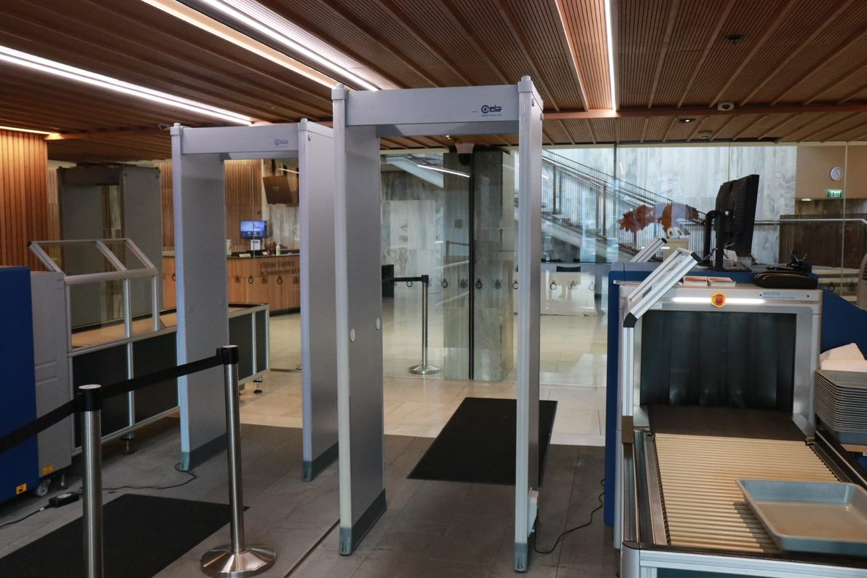
Security check
Everyone will need to empty their pockets.
Everyone will walk through a scanner that looks like a big gate.
I might feel nervous, that is ok.
The security officers are here to keep us safe.
The security staff will give me all my things back.

Slide 10

If the scanner beeps
The scanner beeps if it finds metal.
If the scanner beeps at me it is ok, I am not in trouble.
The security guards might scan me again with a special wand.
They might ask me if I am wearing any metal.

Slide 11
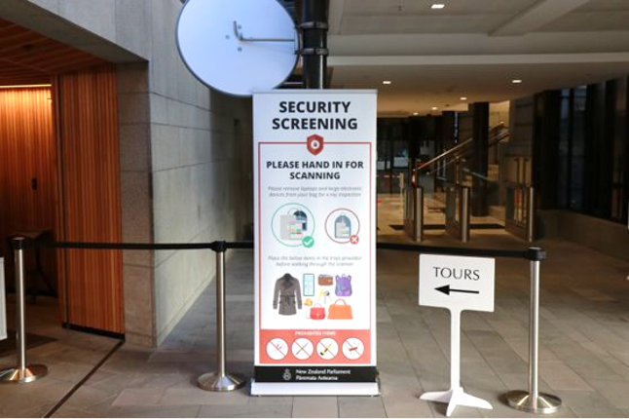
Things I can't take into Parliament
Nobody can bring sharp or dangerous things into Parliament. This is to keep people safe.
If I have some of these things on me, that is ok.
I will leave them with the security guards.

Slide 12
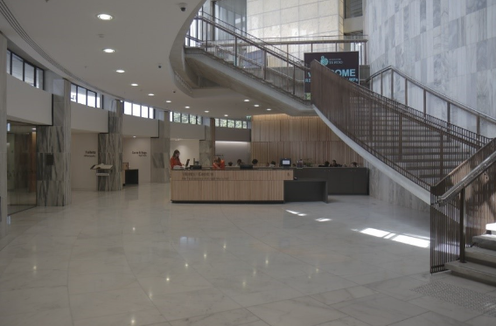
Parliament Foyer
This is the foyer where everyone will wait after passing through security.
Everyone in my group needs to pass through security so this might take some time.
Sometimes there are lots of people walking around the foyer.
That is ok, if I get overwhelmed, I can talk to my teacher or use my headphones if I have them.

Slide 13
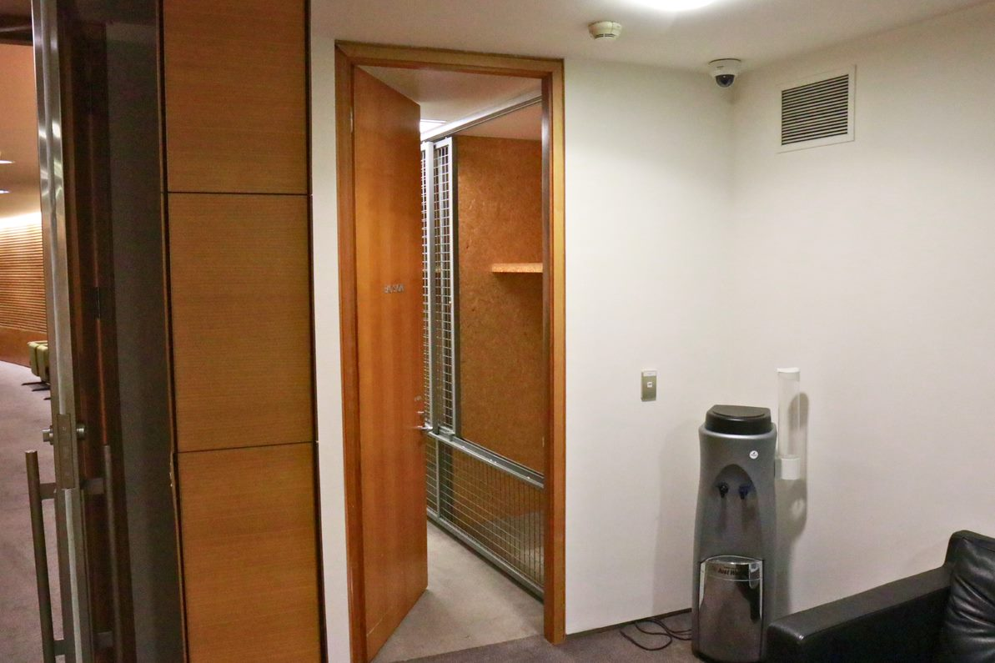
Putting my bag away
Visitors to Parliaments are not allowed to carry their bags while walking around Parliament. This is for security reasons.
The educator will lock everybody's bags in a small room.
My bag will be safe here. Nobody else can get into this room.
At the end of my visit, everyone will get their bag back.

Slide 14
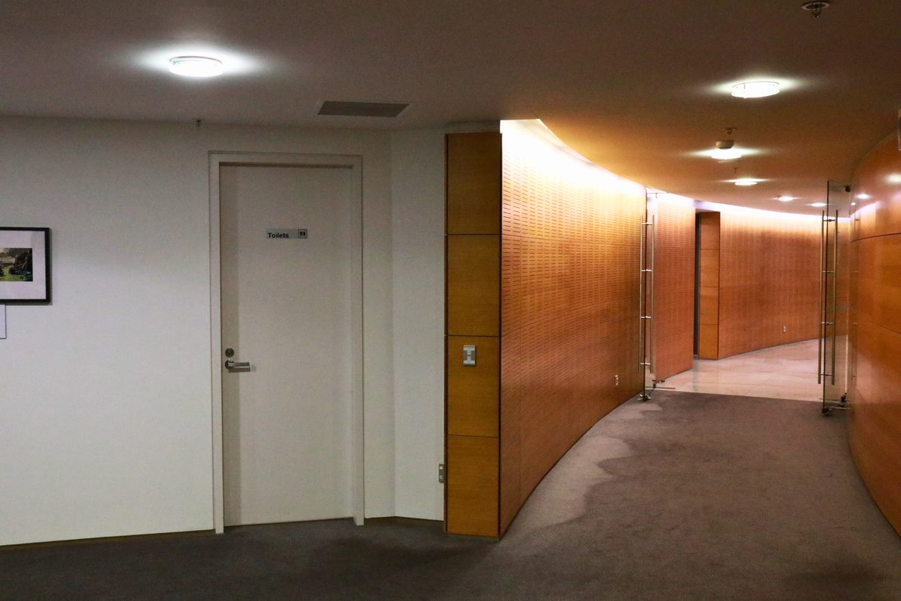
Toilets
These are the toilets.
Everyone can go to the toilet before or after the tour.
The educator will show me where the toilets are.
They can also take me to an accessible toilet if I need.

Slide 15
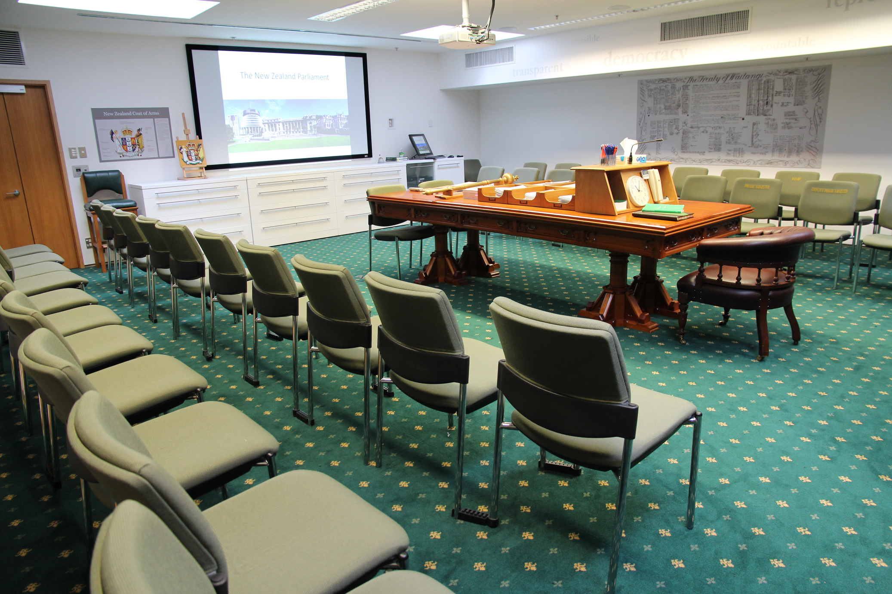
The education center
This is the education center.
I can choose any seat in this room.
The educator will talk a little bit about Parliament.
The educator might ask some questions. If I don’t know the answers, that is ok.

Slide 16
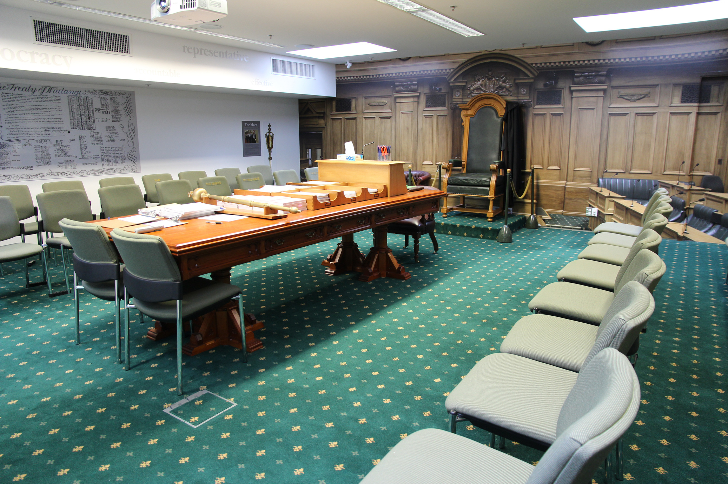
The education center
An MP might come and talk to us here about their job.
I might have a question for the MP. If I put my hand up and wait, they will be happy to answer it.
Before we leave the education center the educator will ask me to put a sticker on my top.
This is so other people know I am on a tour.

Slide 17
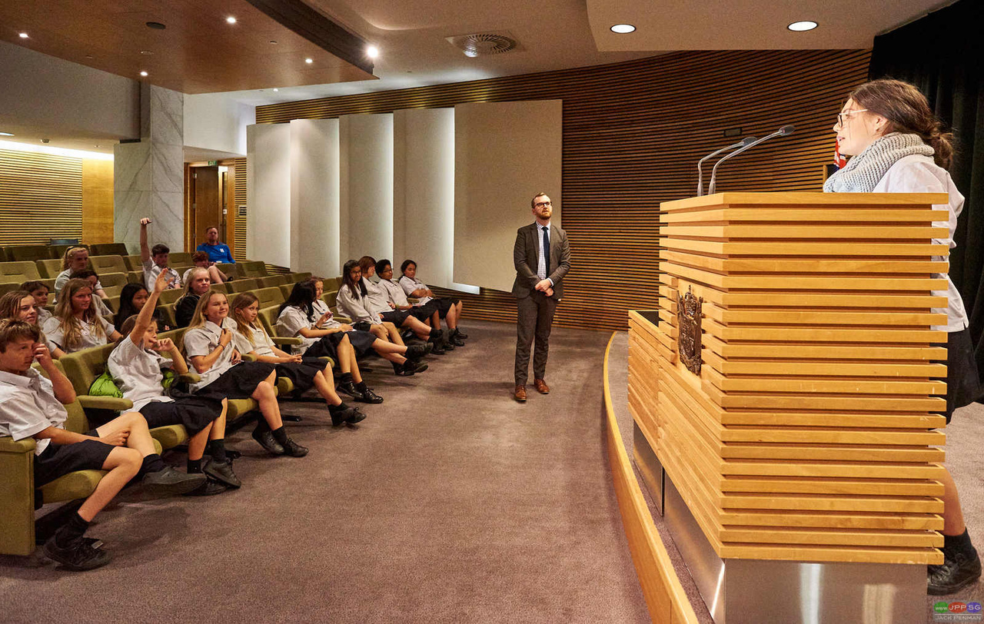
The tour
The tour of Parliament will be 60minutes*.
On the tour the educator will take us to a few different rooms.
Sometimes other people are using these rooms and we can’t go into them.
I might like some rooms more than others, that is ok.
*or 90mins depending on program.

Slide 18
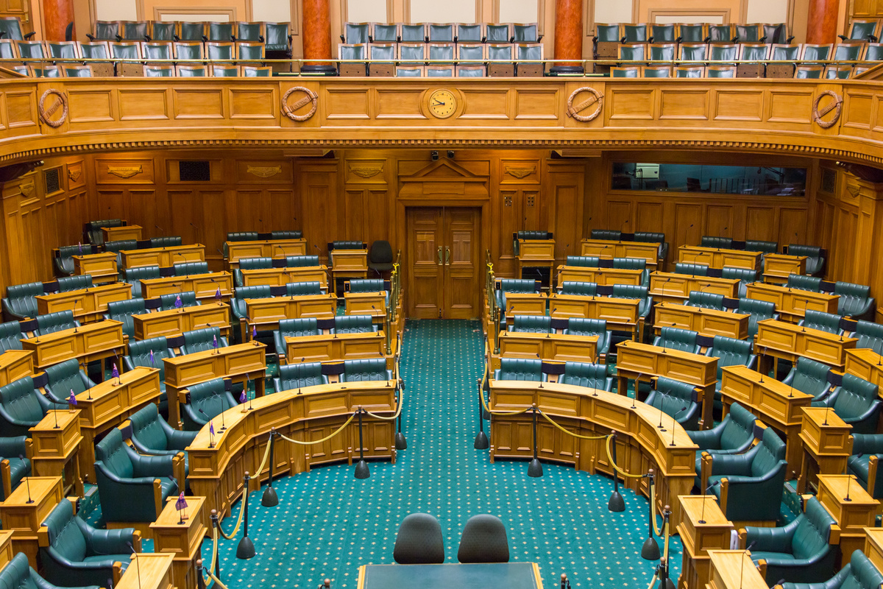
Debating Chamber
My group will probably go into the Debating Chamber.
This room has green carpet and big green chairs.
This is where all the MPs make and talk about laws.
These chairs are where important people sit so; we can’t sit down here.
My group will stand in the middle of the room to listen to the educator.

Slide 19
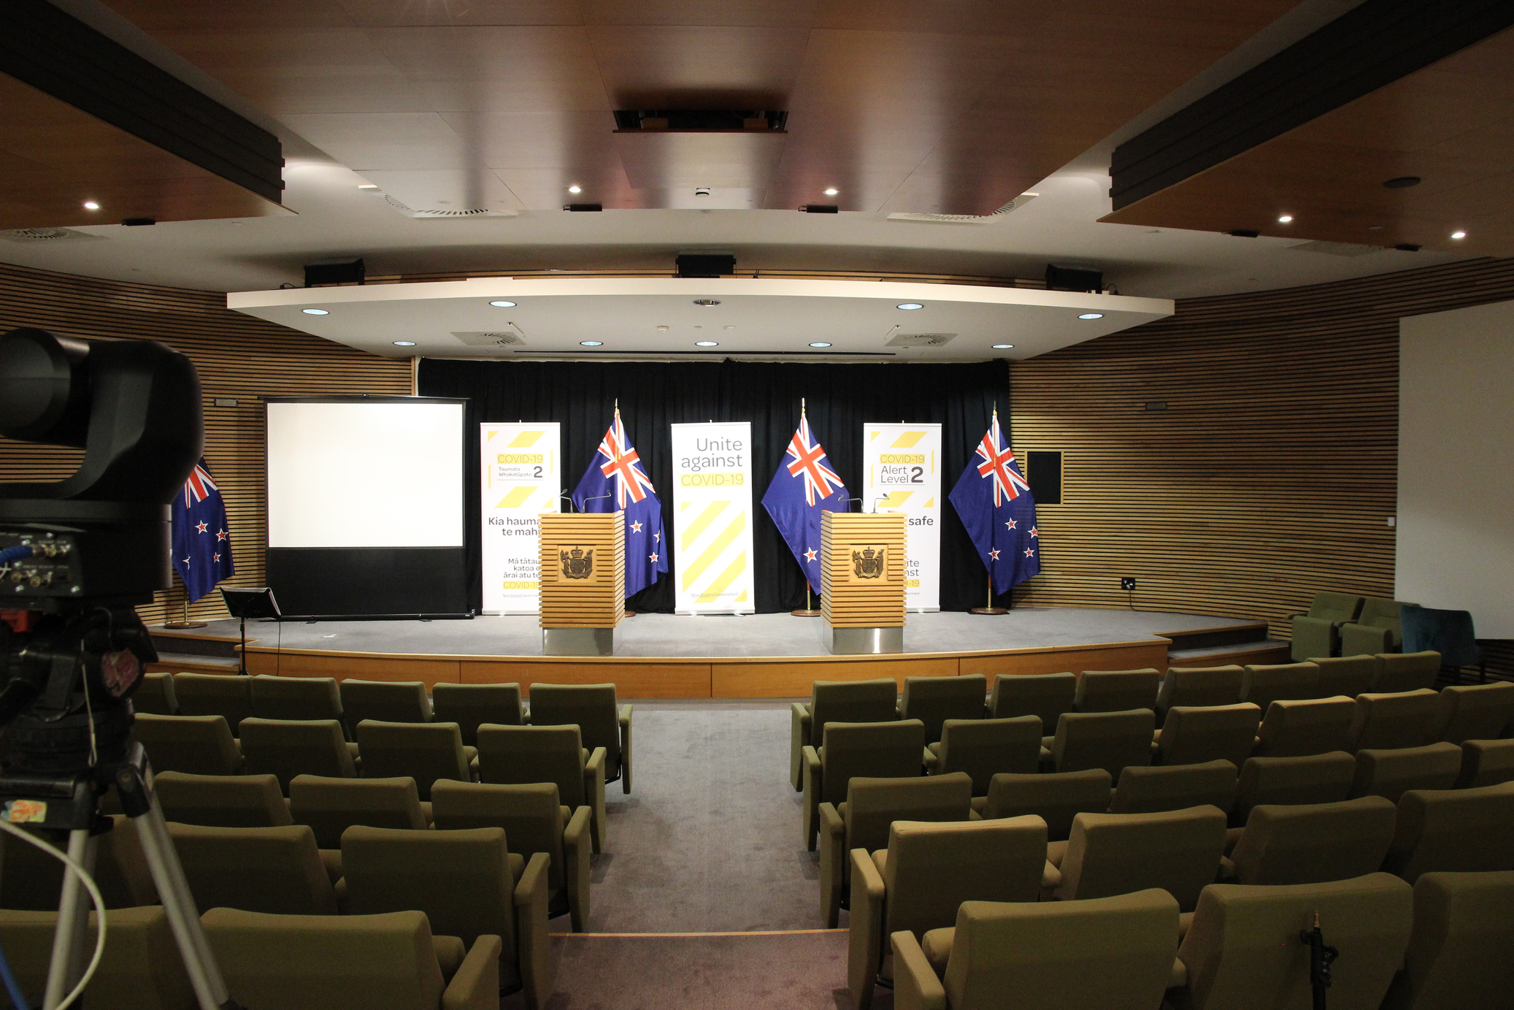
Theatrette
My group will probably go into the Theatrette.
This rooms has lots of rows of light green chairs and a little stage.
This is where the Government gives press conferences.
My group will sit in the front two rows of chairs.
This is so we are close enough to hear the educator.

Slide 20
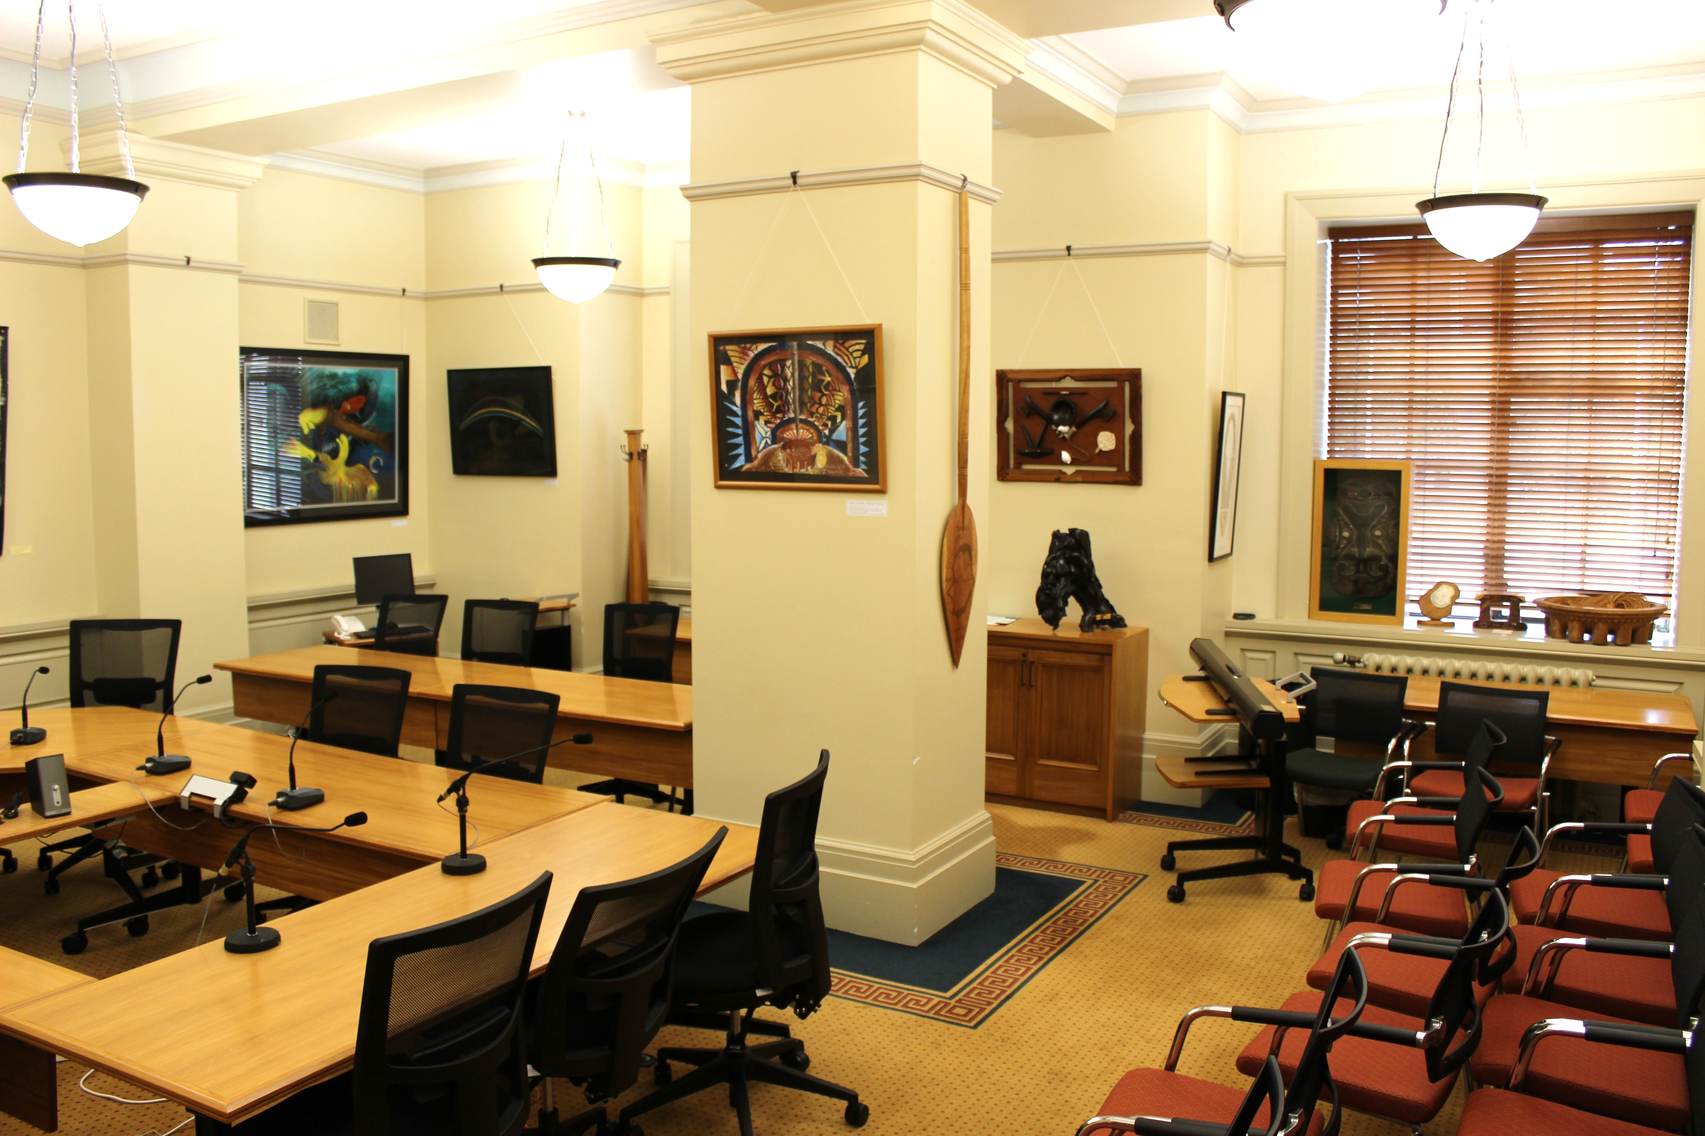
Select Committee room
My group will probably go into a Select Committee room.
This is where MPs have important meetings about laws.
There are 12 different Select Committee rooms. The room my group goes into might look slightly different.
My group will sit down in this room so that we can talk about how laws are created.

Slide 21
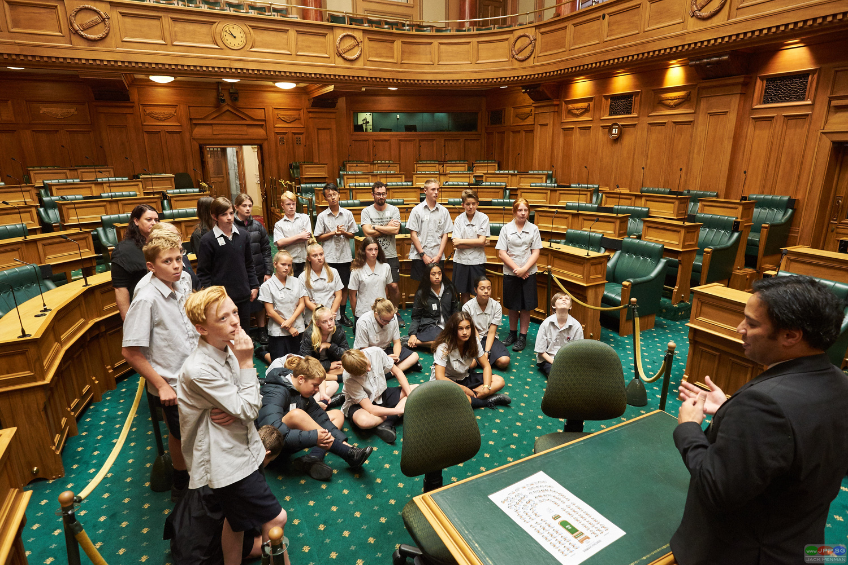
Things to know on my tour
Parliament is a busy place where lots of people work.
So we don’t take up too much space my group will walk in one or two lines.
If my group walks quietly on the left-hand side of hallways and stairwells it will make it easier for other people to get past.

Slide 22

Ringing Bells in Parliament
Sometimes bells ring in Parliament.
These are not emergency bells. I am safe.
They tell the MPs when they need to go to the Debating Chamber.

Slide 23
The public gallery
I might go and sit in the public gallery This is above the Debating Chamber.
This is where I can watch the MPs make laws.
Before going into the public gallery, I will walk through another scanner.
If the scanner beeps at me, I am not in trouble.
Note: This is only for visits booked in to watch Parliament in action.

Slide 24
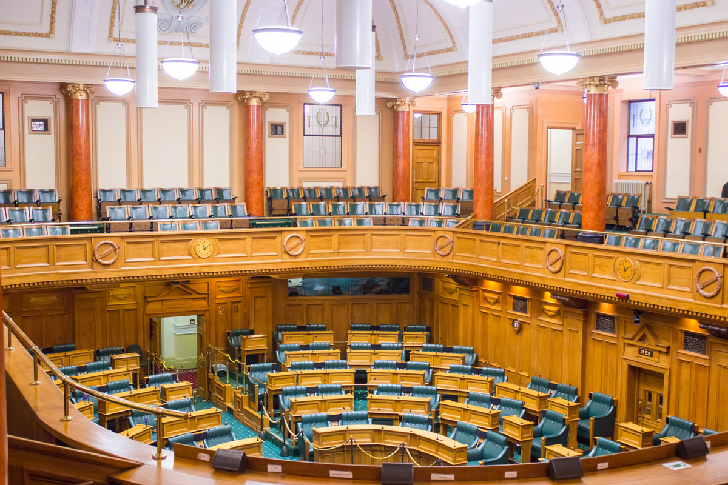
The public gallery
The educator will show me the chairs that are for my group to sit in.
If everybody sits quietly the MPs can do their job.
Sometimes it can get loud. Sometimes people might yell out.
They are not mad at me.
Note: This is only for visits booked in to watch Parliament in action.

Slide 25

Leaving Parliament
When my tour is finished, I will go back to the education center to get my bag.
I can go to the toilet if I need to.
The educator will say goodbye to me.

Slide 26
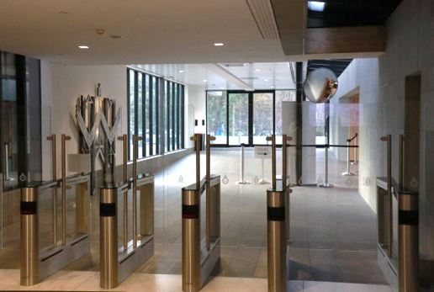
Using the exit gates
When I leave Parliament, I will go out some special gates.
The gates open when I walk up to them.
If I am confused that is ok. Somebody can show me.

Slide 27
We look forward to seeing you in Parliament.

