Slide 1
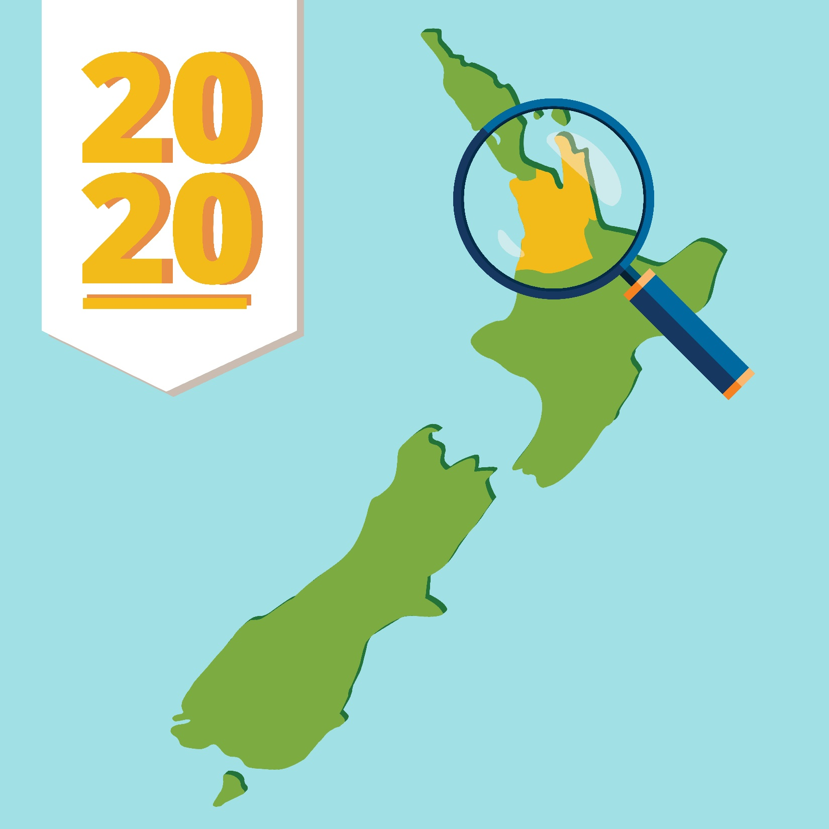

Māori Electorates and the Māori Electoral Roll
Join us to learn how the Māori Electorates were formed, and how the Māori Electoral Roll works!

Slide 2
Karakia
Karanga, karanga kia Ranginui e te tū nei
Karanga, karanga kia Papa e takoto
Huakina atu rā te tatau o tēnei whare kōrero
Uhia te kōrero
Uhia te whakaaro
Uhia ki a te ao marama
E Rongo whakairihia ki runga Hui e...Taiki e
Call, summon universal space
Call and summon solid matter
Open the doors of the house of dialogue
Lay out the dialogue
Lay out the thought
Lay out to gain enlightenment
Rongo uplift these words Gather...affirm!

Slide 3
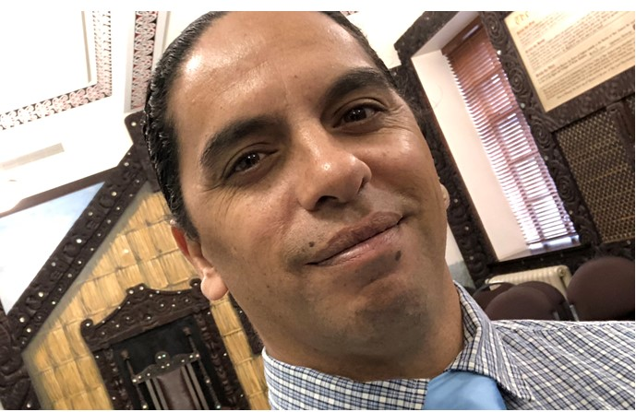
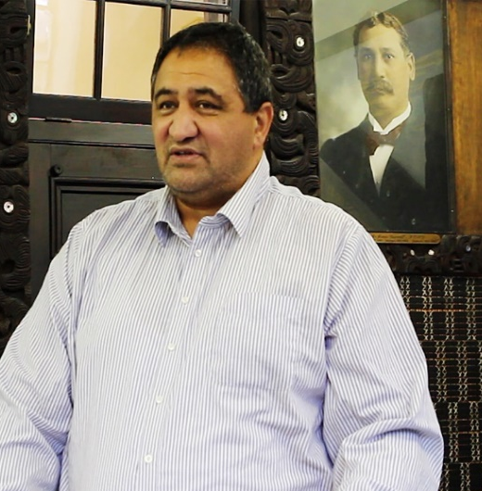
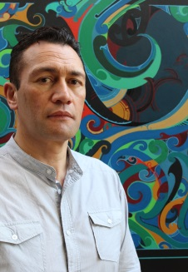
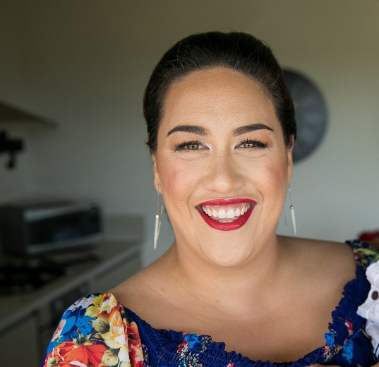
Introducing your host and panellists
Maika Te Amo
Kaiwhakawhiti Reo
New Zealand Parliament
Pāremata Aotearoa
Kura Moeahu
Tumu Whakarae
New Zealand Parliament
Pāremata Aotearoa
Dr Paerau Warbrick
Senior Lecturer
University of Otago
Te Whare Wānanga o Otāgo
Mona-Pauline Mangakāhia
Senior Project Manager-Community Engagement
The Electoral Commission
Te Kaitiaki Take Kōwhiri

Slide 4
What will we cover tonight?
History of the Māori Electorates
The Māori Electoral Roll
Q + A

Slide 5
Tiriti o Waitangi

Slide 6
1846 New Zealand Constitution Act
- Adult males
- who occupied a tenement and
- could read and write English could vote
1852 New Zealand Constitution Act
-Males over 21
-who occupied an estate or tenement.
Māori communal property not considered eligible to be an estate or tenement.
1857 New Zealand Constitution Amendment Act
Allowed amendments of most of the 1852 NZ Constitution Act

Slide 7
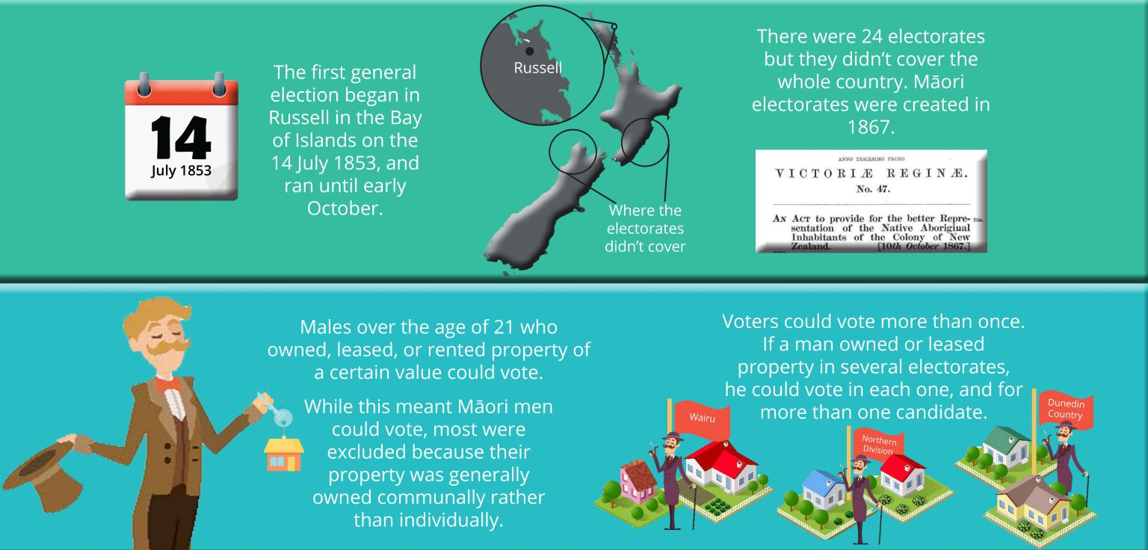

Slide 8
1860s
Responsibility for native affairs transferred from British to Colonial Government in NZ
1862 & 1865
Native Lands Acts provided for registration of Māori land Title
1867 Māori Representation Act
Introduced three Māori seats in the North Island and one in the South

Slide 9
1896
The privilege to vote in general seats where Māori also held land was abolished, but European men continued to have dual votes
Māori Representation Act was renewed indefinitely
1872
The 1867 Māori Representation Act was renewed for another five years

Slide 10
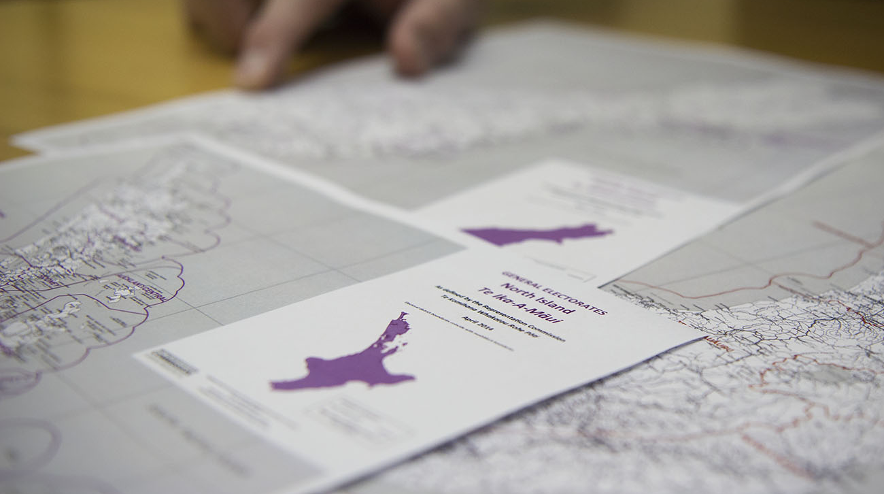
Māori in Parliament
1872 two Māori nominated to Legislative Council (abolished 1950)
All four Members sat on the Māori Affairs Committee set up in 1872
1893 Māori and Pakeha women got the vote
1949 Election Māori Electoral Roll used
1967 amendment to Electoral Act which allowed Māori to stand in European electorates and vice versa
Māori Councils Act 1900 gave Māori limited form of local government

Slide 11
7 Māori Electorates

Slide 12
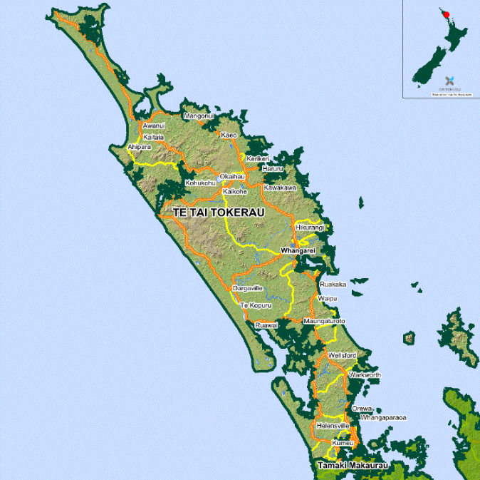
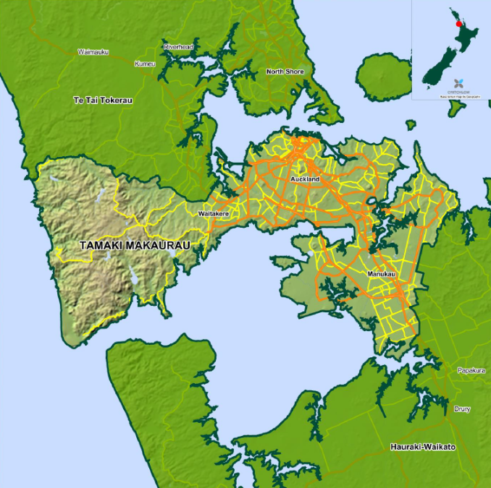

Slide 13
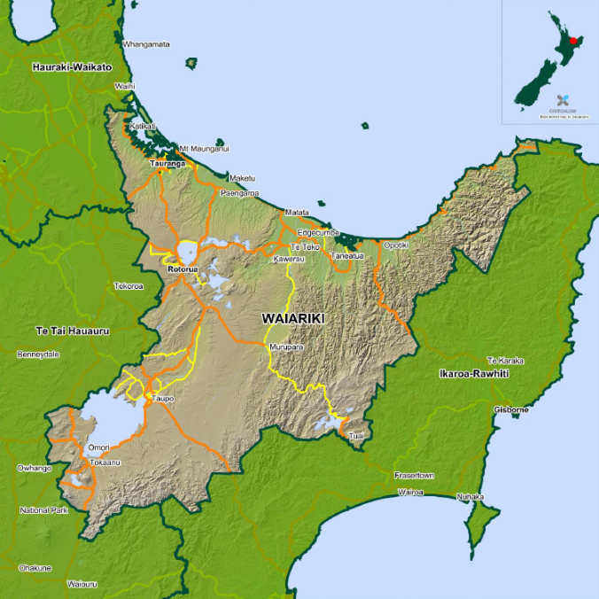
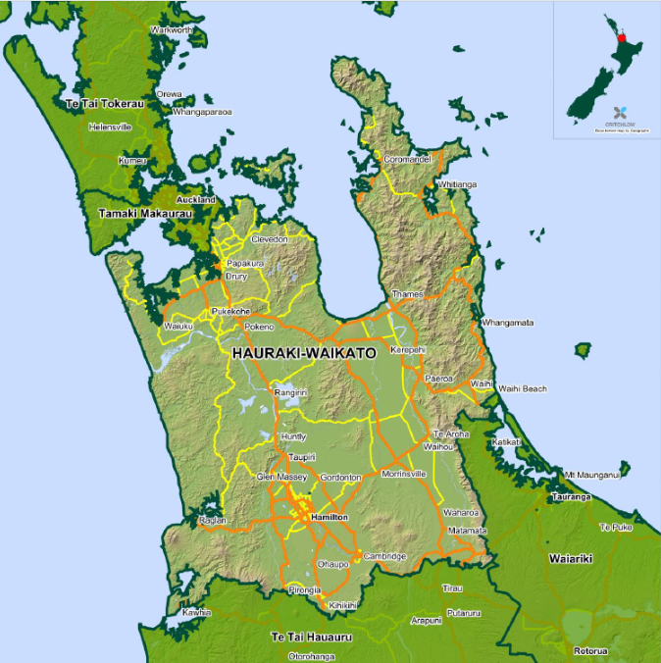

Slide 14
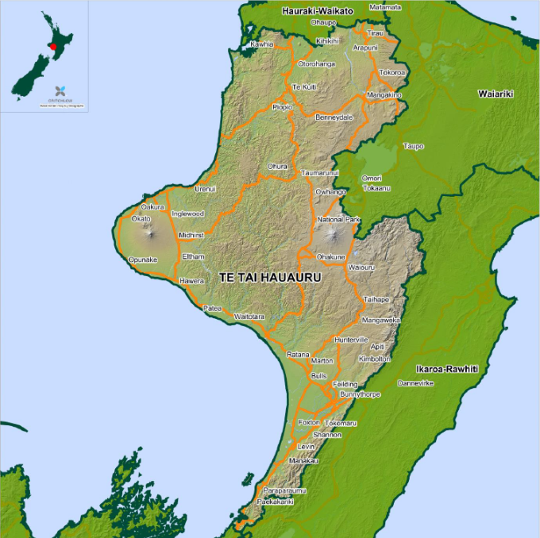
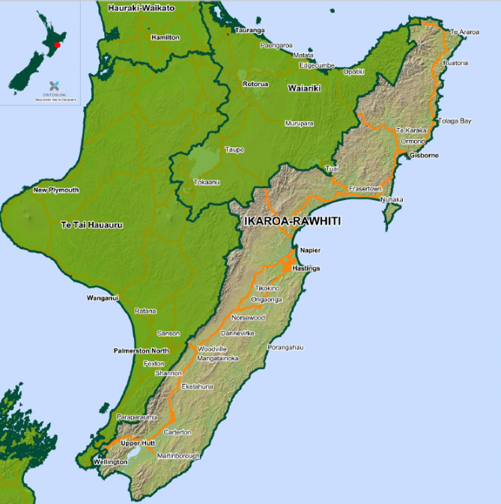

Slide 15
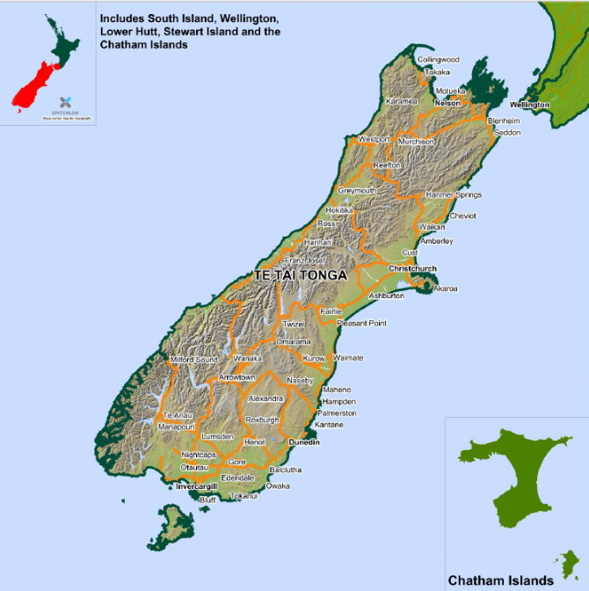
Summary
Hauraki-Waikato – (North Western North Island, includes Hamilton and Papakura)
Ikaroa-Rāwhiti – (East and South North Island, includes Gisborne and Masterton)
Tāmaki Makaurau – (Roughly equivalent to greater Auckland)
Te Tai Hauāuru – (Western North Island, includes Taranaki and Manawatū-Whanganui regions)
Te Tai Tokerau – (Northernmost seat, includes Whangarei and North and West Auckland)
Te Tai Tonga – (All of South Island and nearby islands. Largest electorate by area)
Waiariki – (Includes Tauranga, Whakatane, Rotorua, Taupo)

Slide 16
Recent Developments

Slide 17
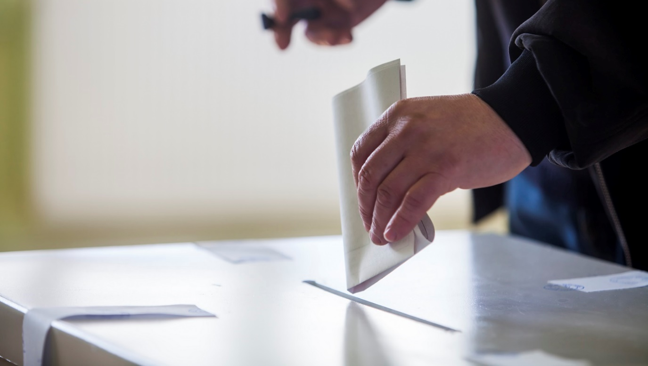
An 8th seat?
In 2007, Pita Sharples proposed the creation of an eighth seat for Māori living in Australia called Te Ao Moemoea.
In 2017, there were 170,000 (20%) Māori living in Australia.

Slide 18
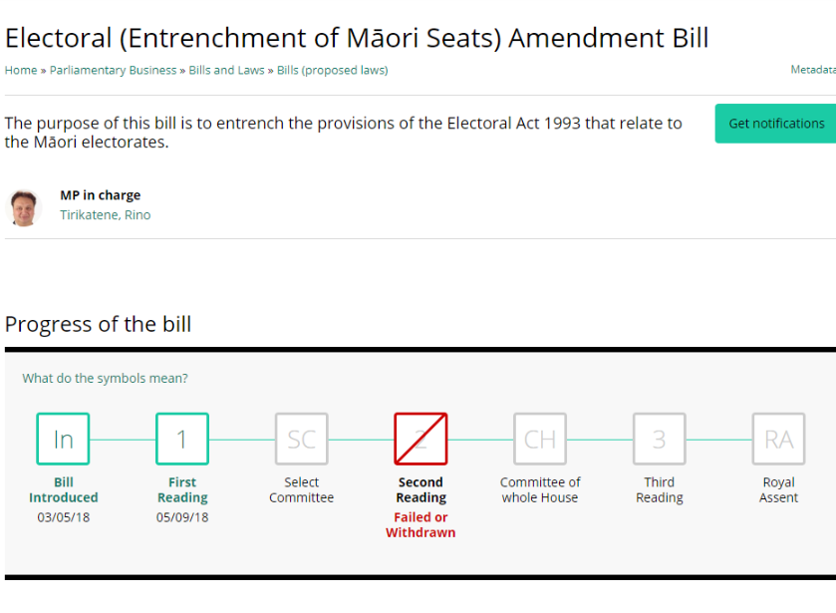
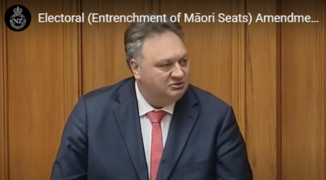

Slide 19
Māori Electoral Roll
Notes:
Article 2
Taonga
Rangatiratanga

Slide 20
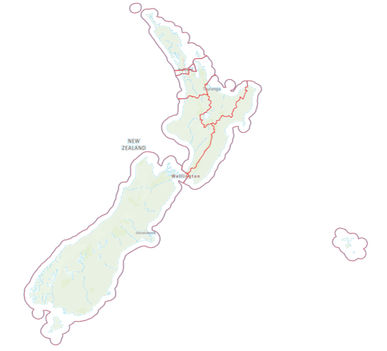
Notes:
If you’re Māori, and you’re enrolling for the first time, you can choose to go on the Māori roll or the General roll.
It’s up to you.
If you choose the Māori roll, you’ll vote for a candidate in a Māori electorate and if you choose the general roll, you’ll vote for a candidate in a general electorate.
You get to choose from the same list of political parties whether you’ve chosen the general roll or the Māori roll.
Once you choose rolls, you can only change during the Māori Electoral Option, which takes place about every 5 years – the last one was in 2018.

Slide 21
Section 3 Electoral Act ‘a person of the Māori race of New Zealand, and includes any descendant of such a person’
Residing in one of the following electorates: Te Tai Tokerau, Tāmaki Makaurau, Hauraki-Waikato, Waiariki, Te Tai Hauāuru, Ikaroa-Rāwhiti, or Te Tai Tonga.
Enrolled on the Māori Roll (can swap from the General Roll during a Māori Electoral Option)
Who can vote in the
Māori Electorates?

Slide 22
Next Māori Electoral Option is scheduled for:
2024

Slide 23
Pātai?

Slide 24

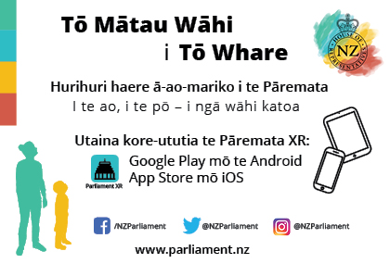
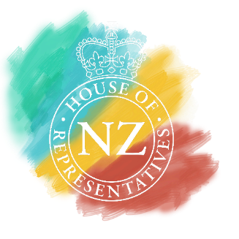
Virtual Tour of Parliament-
Parliament XR
Download for free:
Google Play- Android
App store-iOS

Slide 25
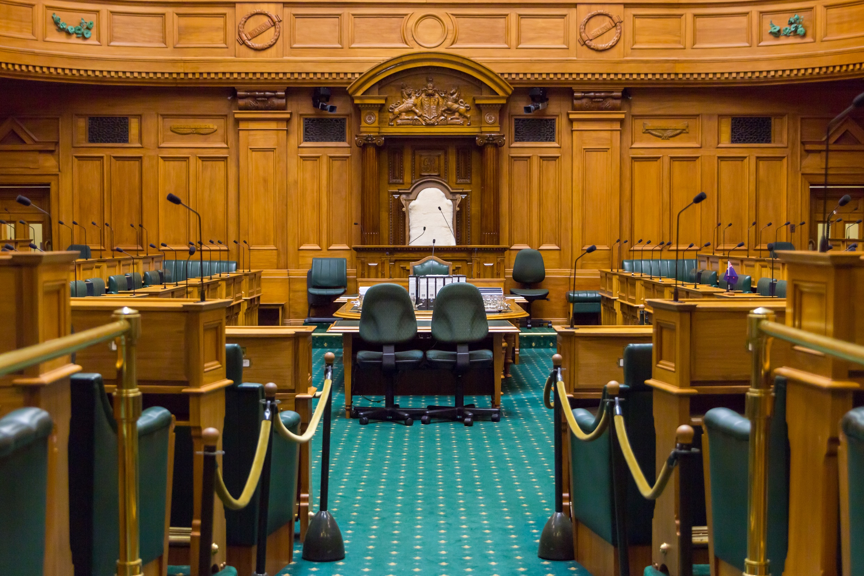

Our House is YOUR House
Find us on Twitter, Instagram, and Facebook
@nzparliament
Notes:
Remember to get in touch with the Office if you need help or want to know more.
Questions?

Slide 26
Karakia
Whakaemi mai ngā pūtoi kōrero
Haupā mai nga whakaaro
Tuia te kawe reo ki runga i ngā tuara
Whakaputa i te whare kōrero o tatou
Ki ao te marama nei
E Rongo whakairihia ki runga Hui e...Taiki e
Gather together the diverse discussions
Collect and heap thoughts together
Throw the dialogue on the backs
And exit the house of discussion
Into the world of enlightenment
Rongo uplift these words Gather...affirm!

