Slide 1
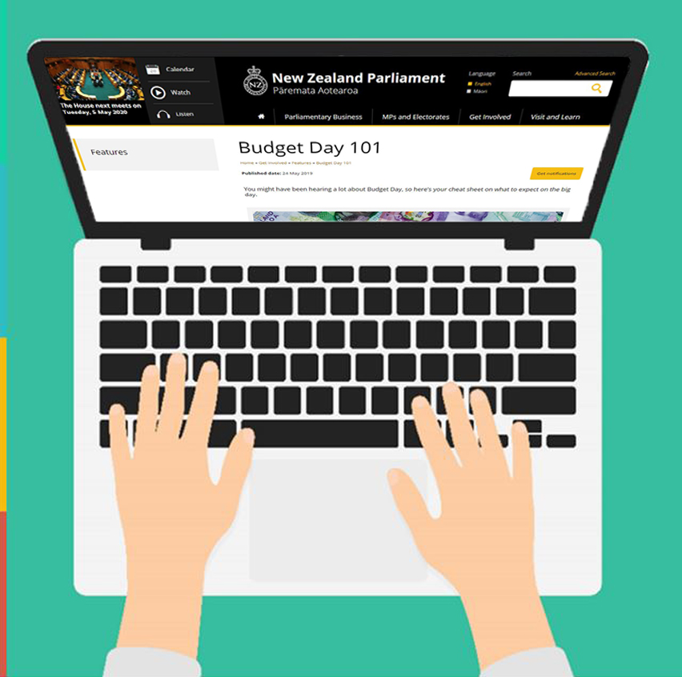

Get to know the Budget process
Join us to learn how the government spends your money, how Parliament scrutinises that process, and how you can learn more about Budget 2020

Slide 2
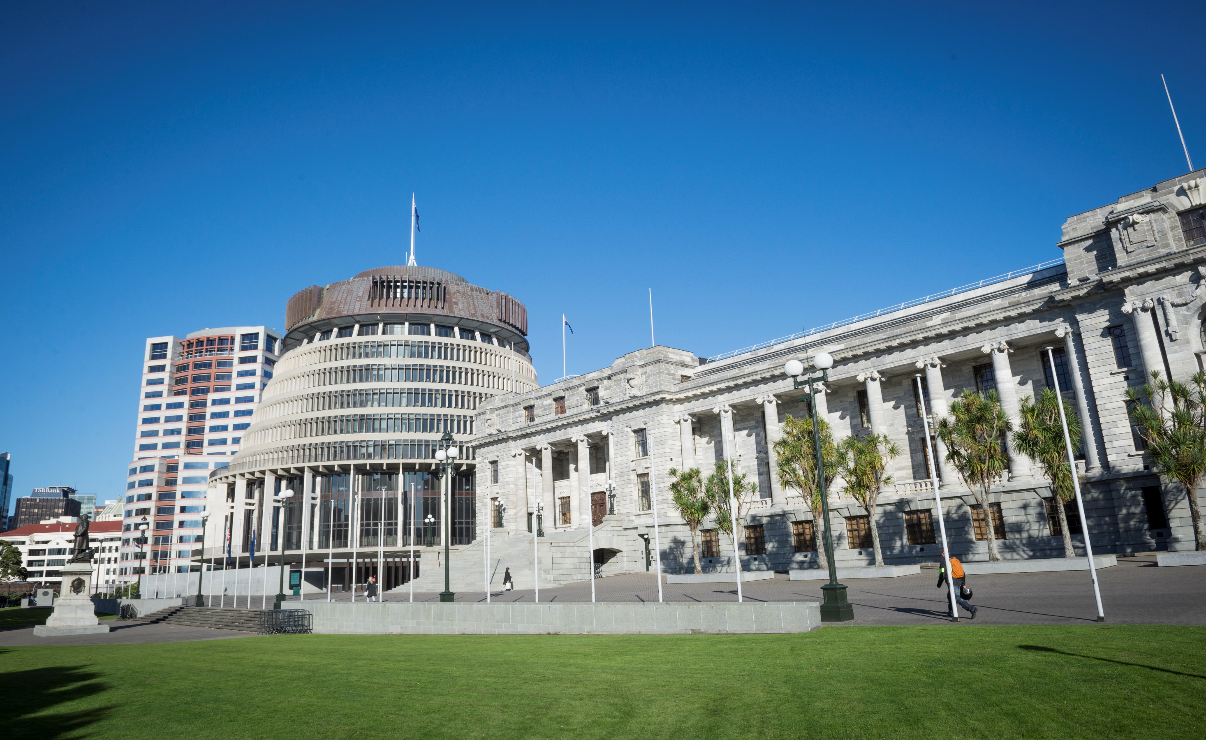

Introducing
Our expert guests
James Picker
Clerk Assistant
and
Mary Drakeford
Clerk of the Finance and Expenditure Committee
…and your host Carmen Maran
Inter-Parliamentary Relations Advisor
Notes:
Insert quick poll to gauge knowledge of audience on the Budget Process

Slide 3
What will we cover today?
The Review Process
Q & A
The Financial Cycle
The Budget Process

Slide 4
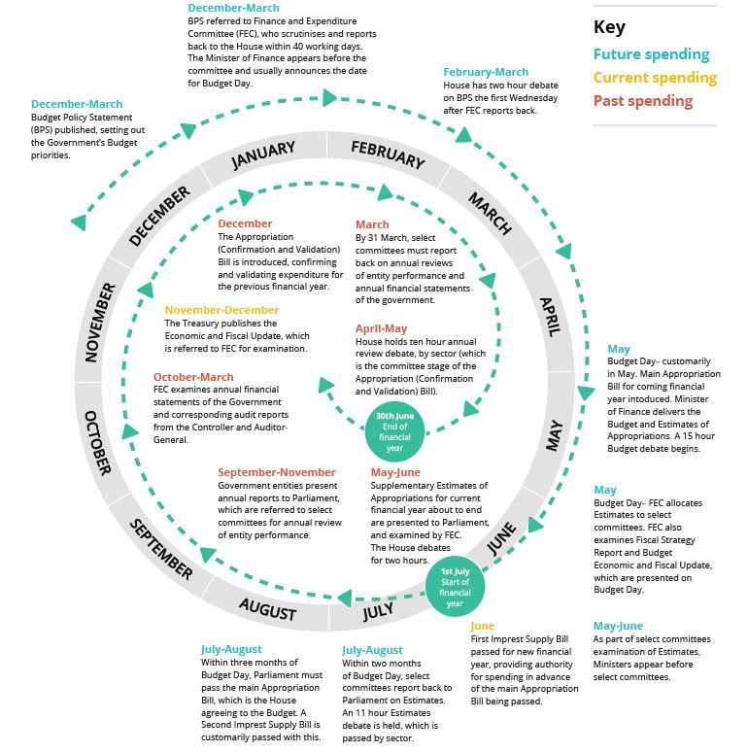
Public Finance Act 1989
Split into BUDGET and REVIEW
The Financial Cycle
Notes:
Here is the link to our Financial Cycle Resource
https://www.parliament.nz/media/6234/financialcyclepostera3_v82.pdf

Slide 5

Budget and Review
Budget Future Government spending The Government explains how much money it has to spend and how it plans to spend it | Review Past Government spending The Government explains how money was spent and its performance

Slide 6
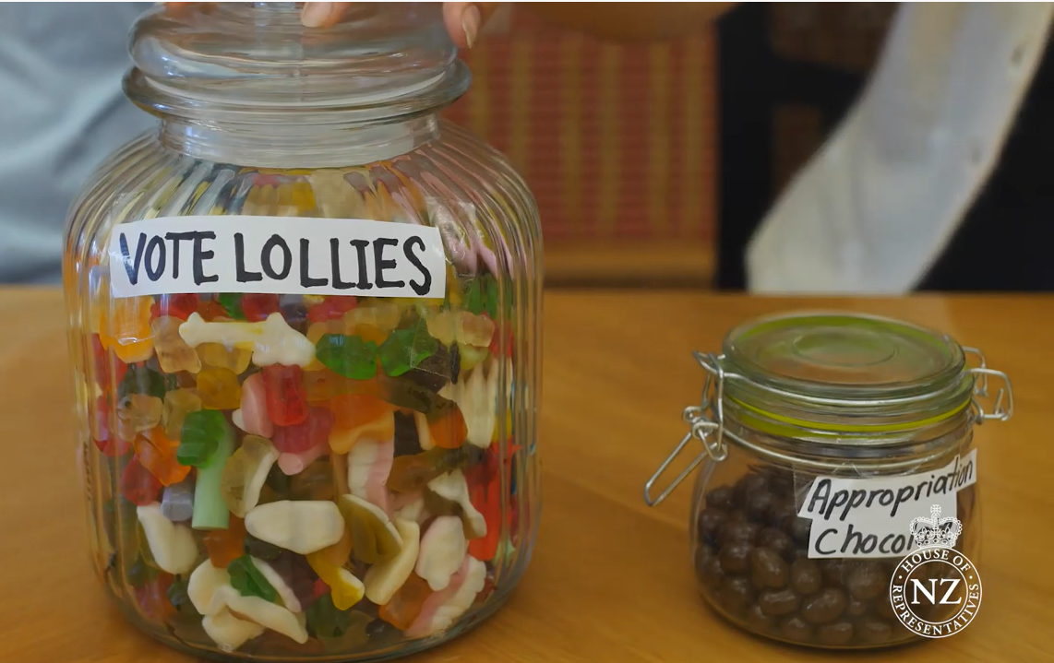
The Budget Process
  GOVERNMENT INCOME
    Taxes
  NATIONAL SERVICES
    Public Health, Education, Transport, etc.
  Made up of VOTES AND APPROPRIATIONS

Slide 7
Do you read the Budget Policy Statement?
Notes:
Poll asking “Do you read the Budget Policy Statement – Yes – No”

Slide 8
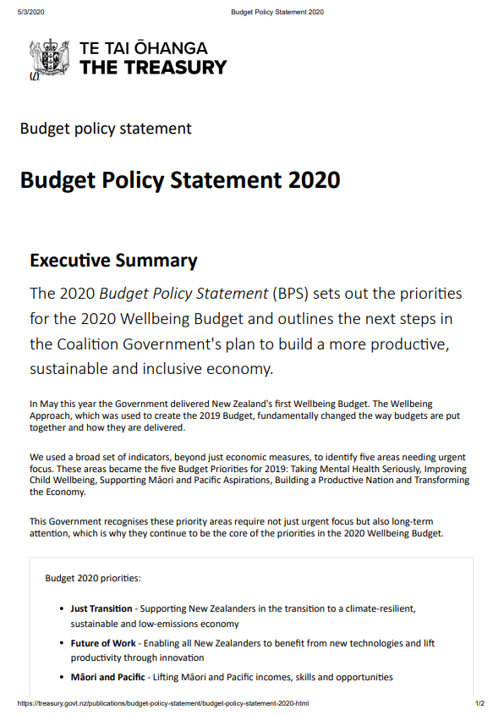
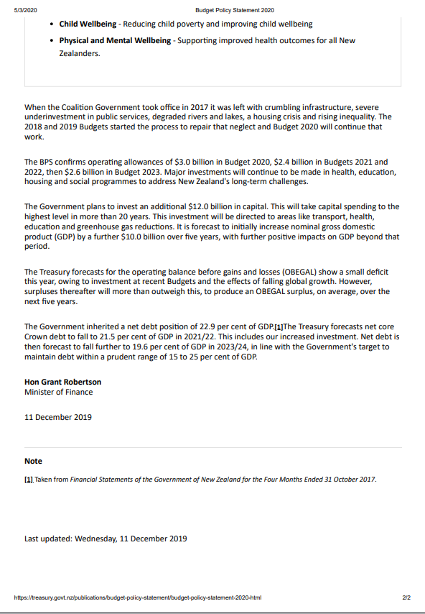
Notes:
Link to Standalone Budget website, outlines the Budget Policy Statement and provides up-to-date information on Budget 2020 and past info about Budget 2019 -
https://budget.govt.nz/

Slide 9
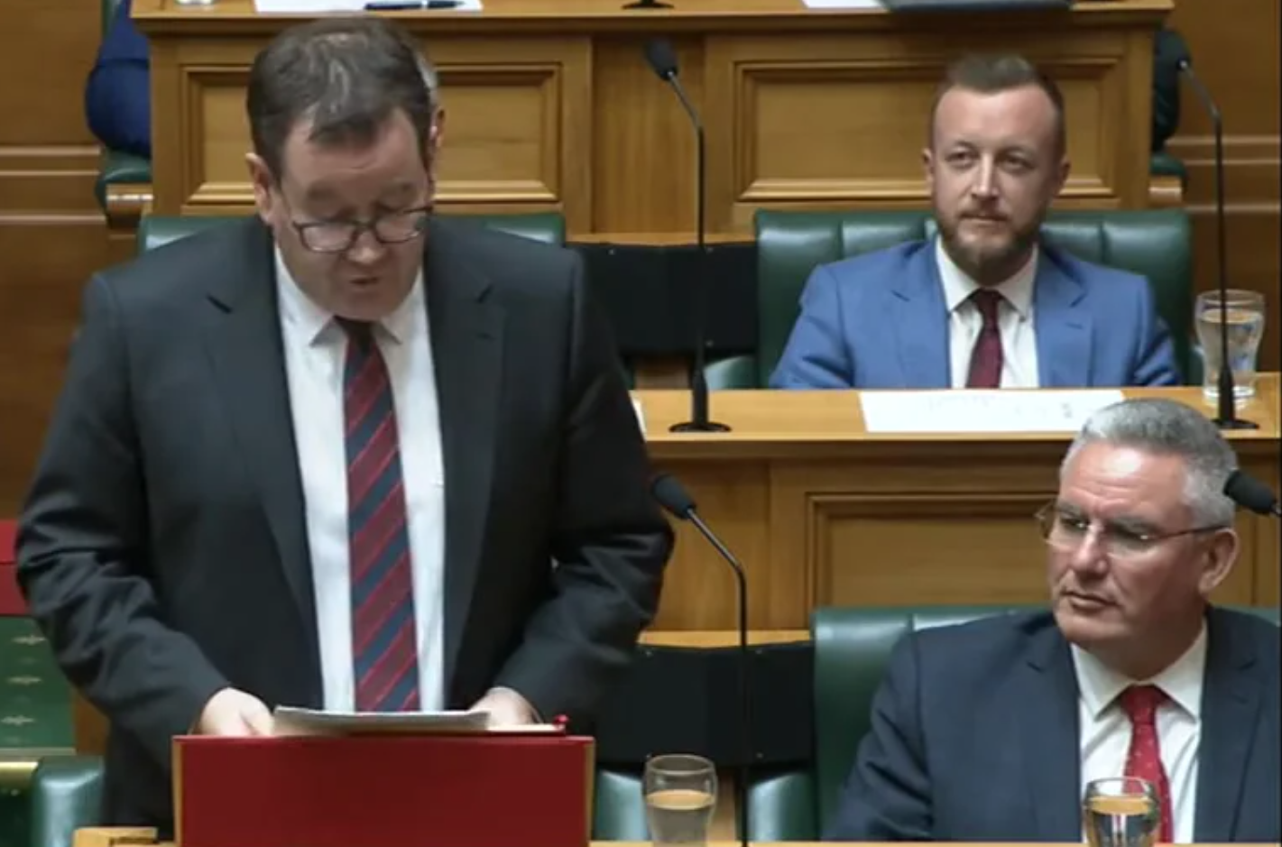
Budget Day
  BUDGET DOCUMENTS
    Arrive early in the morning
    “Locked up” with an Office of the Clerk staff member
  MINISTER OF FINANCE BRIEF
    To over 200 journalists, economists, analysts, and commentators
    “LOCK UP”
Notes:
Treasury’s website will be updated with the budget documents as they are released -
https://treasury.govt.nz/publications/budgets/budget-2020

Slide 10
Budget Day
  BUDGET STATEMENT
    Introduced to the House of Representatives
  Budget Day Legislation
    Urgency
  BUDGET DEBATE
    Lasts for 15 hours
    ESTIMATES AND APPROPRIATIONS
Notes:
https://treasury.govt.nz/publications/budgets/budget-2020 - Treasury’s website which will be updated with the budget documents as they are released

Slide 11
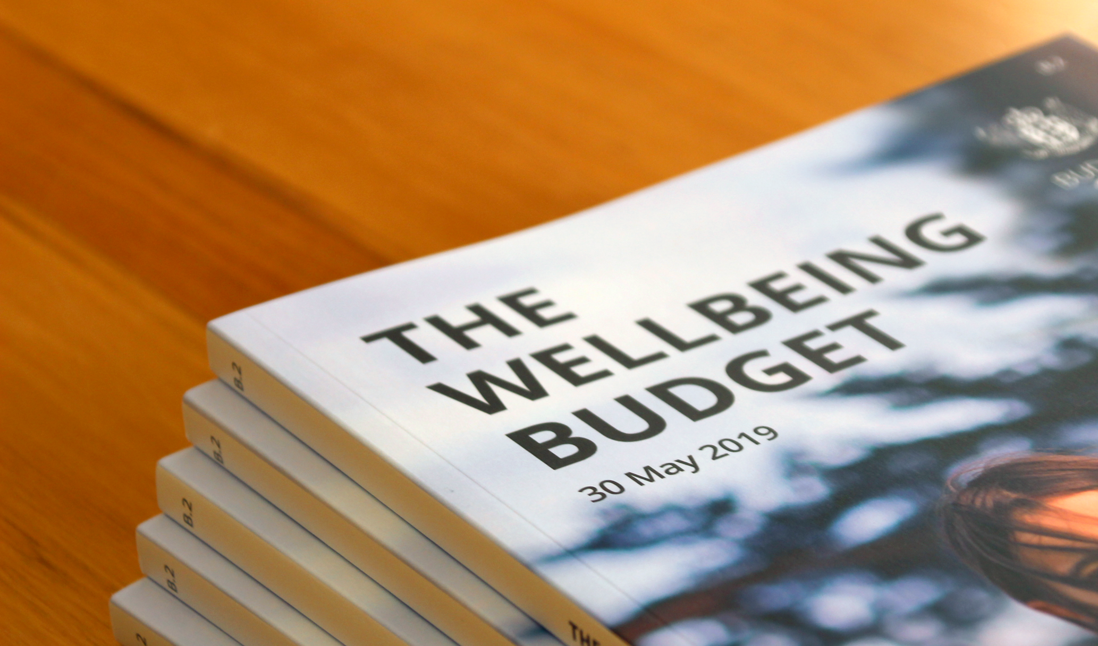
Legislative Phase
  Government must obtain the support of Parliament for their Budget Package
  Introduction of the APPROPRIATION BILL
  Must be decided within 3 months

Slide 12
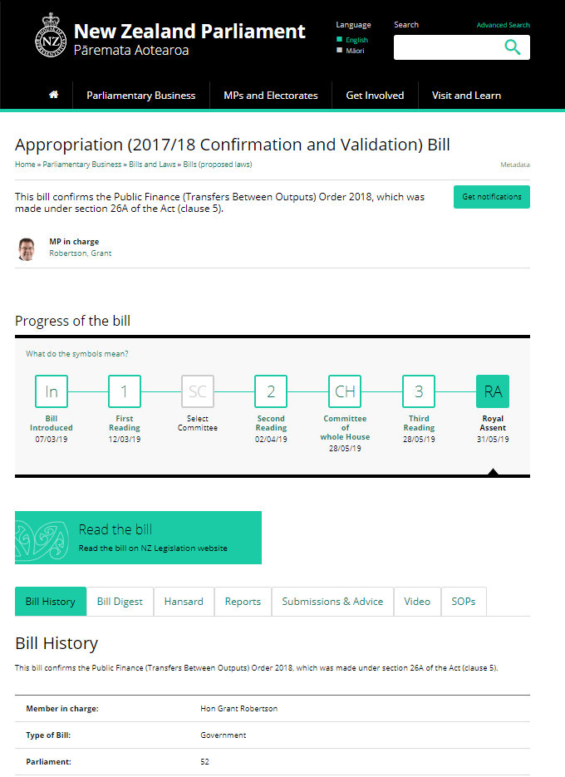
Appropriation Bill
  Contains the Government’s comprehensive annual appropriation proposals
  Introduced on Budget Day
  Must be passed within 3 months
Notes:
2020 appropriation bill will be made available on Parliament’s website - https://www.parliament.nz/en/pb/bills-and-laws/bills-proposed-laws/

Slide 13
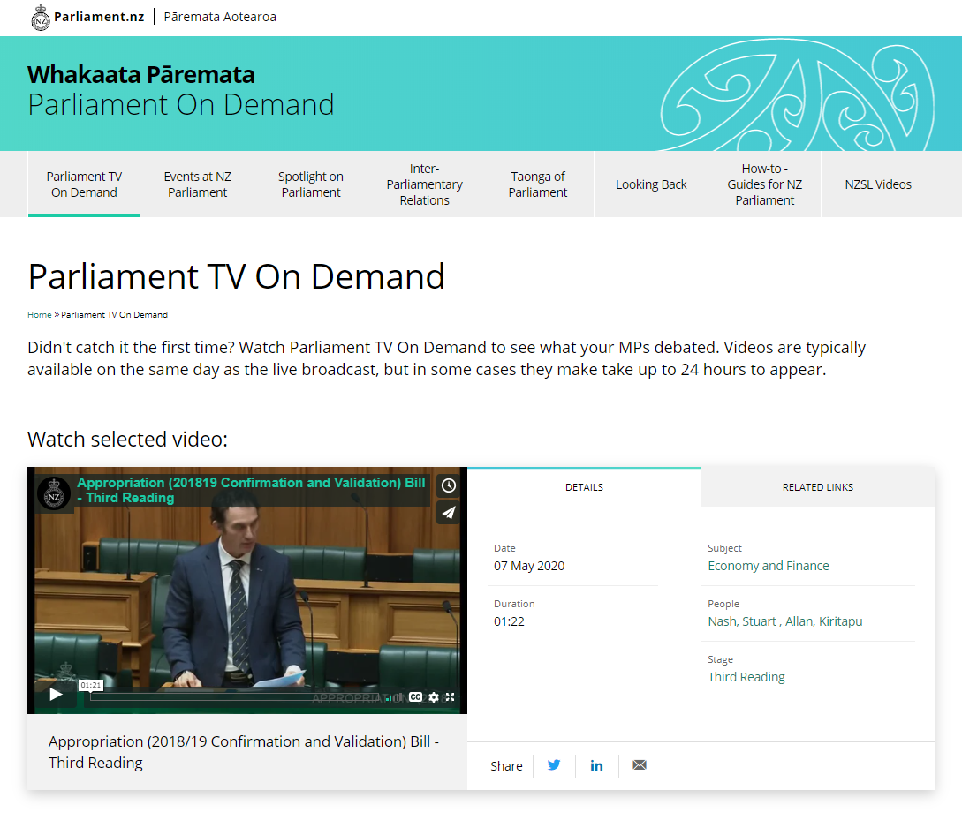
Watch the Budget Debate Live or On Demand on Parliament TV:
Notes:
While the debate lasts for 15 hours it is split into different topics so you can tune into the PTV
https://ondemand.parliament.nz/parliament-tv-on-demand/– Here you can watch the Budget debate live or on demand

Slide 14
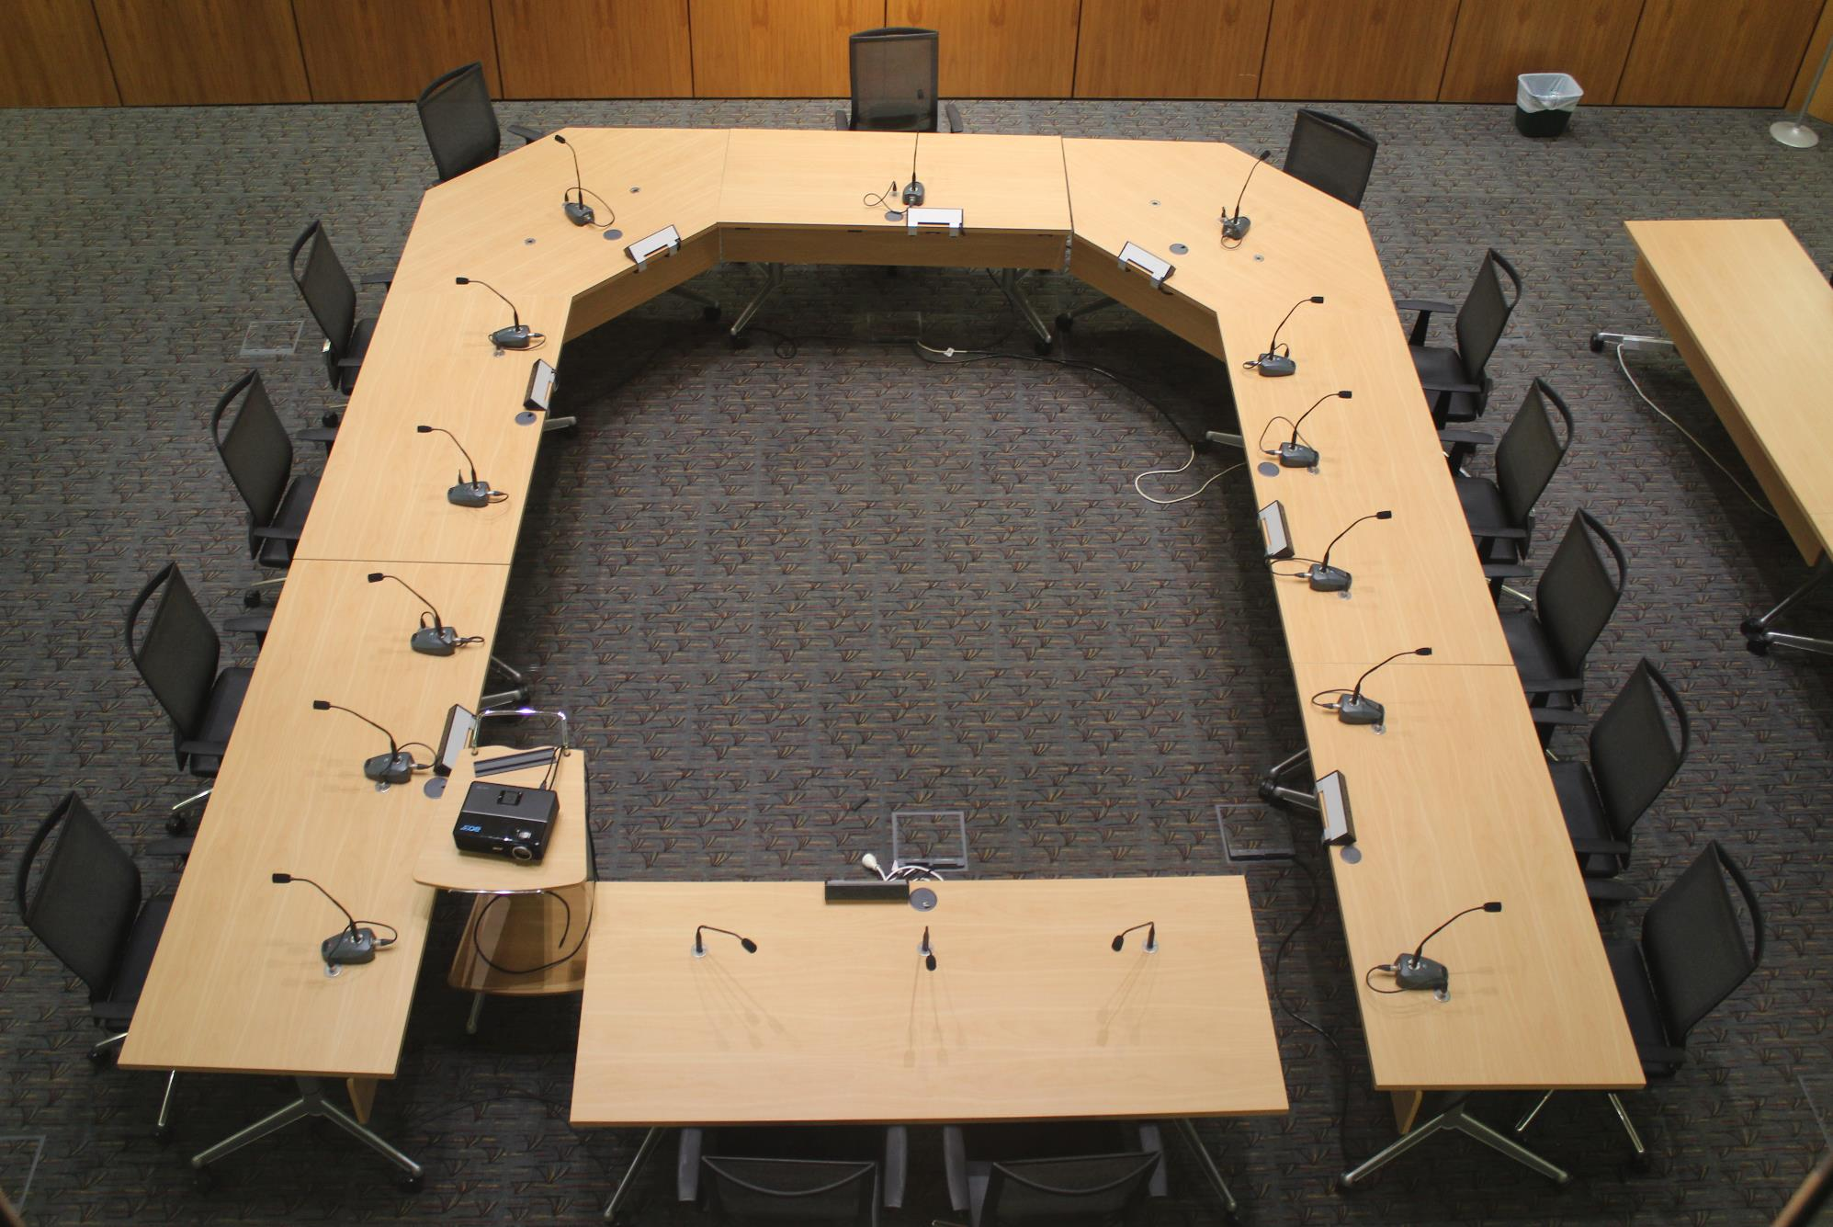
Select Committee Scrutiny
  ESTIMATES OF APPROPRIATIONS allocated to the relevant select committee by the FINANCE AND EXPENDITURE COMMITTEE
  SCRUTINY OF MINISTERS
    Ministers make their case on their spending
    One of the few times Minister comes before select committees
  Each committee has 10 weeks to report back
Notes:
You can tune into the live stream of select committees by clicking into the schedule on Parliament’s website - https://www.parliament.nz/en/pb/sc/
You can also “like” a select committee’s Facebook page, which will alert you to when they are livestreaming

Slide 15
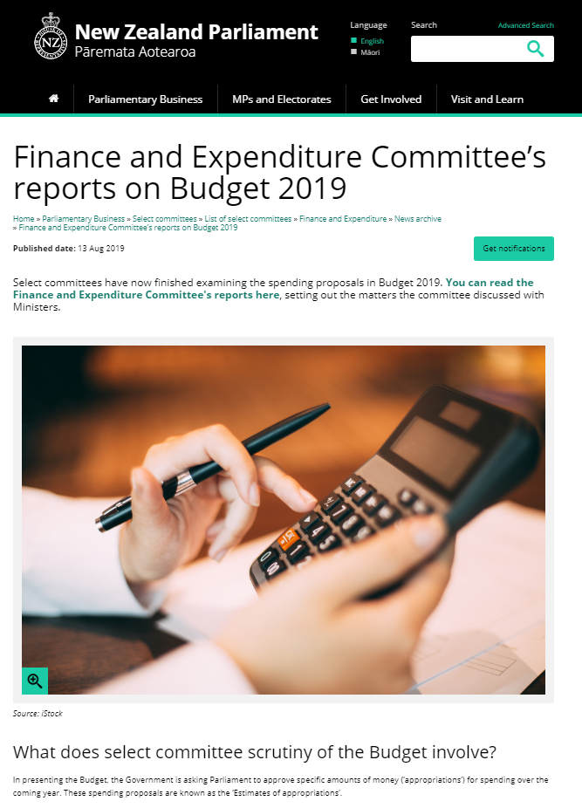
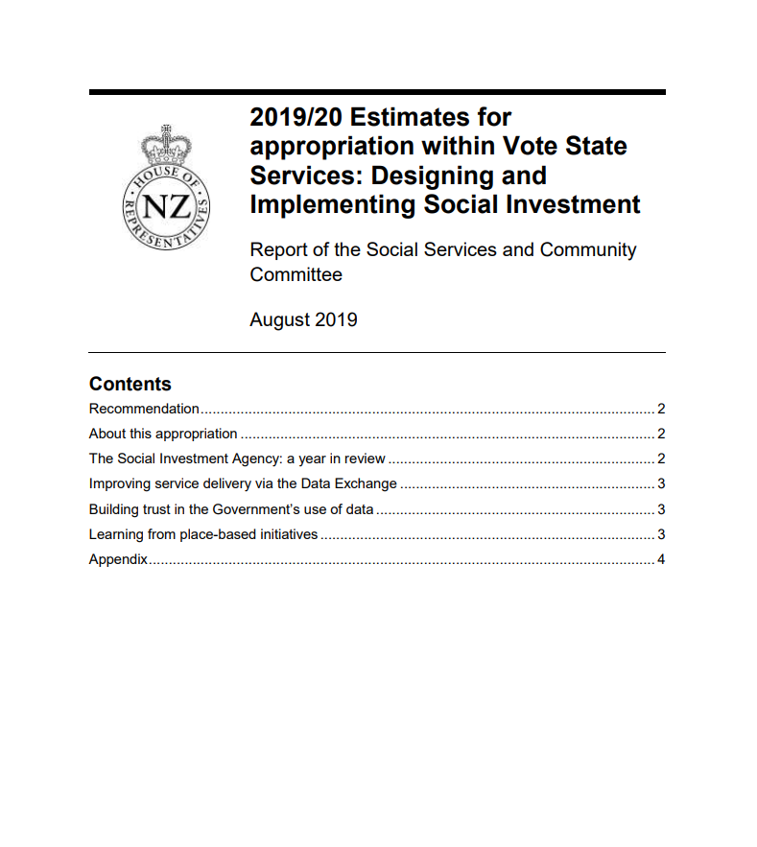
Notes:
Select Committee reports will become available on Parliament’s Website - https://www.parliament.nz/en/pb/sc/reports/

Slide 16
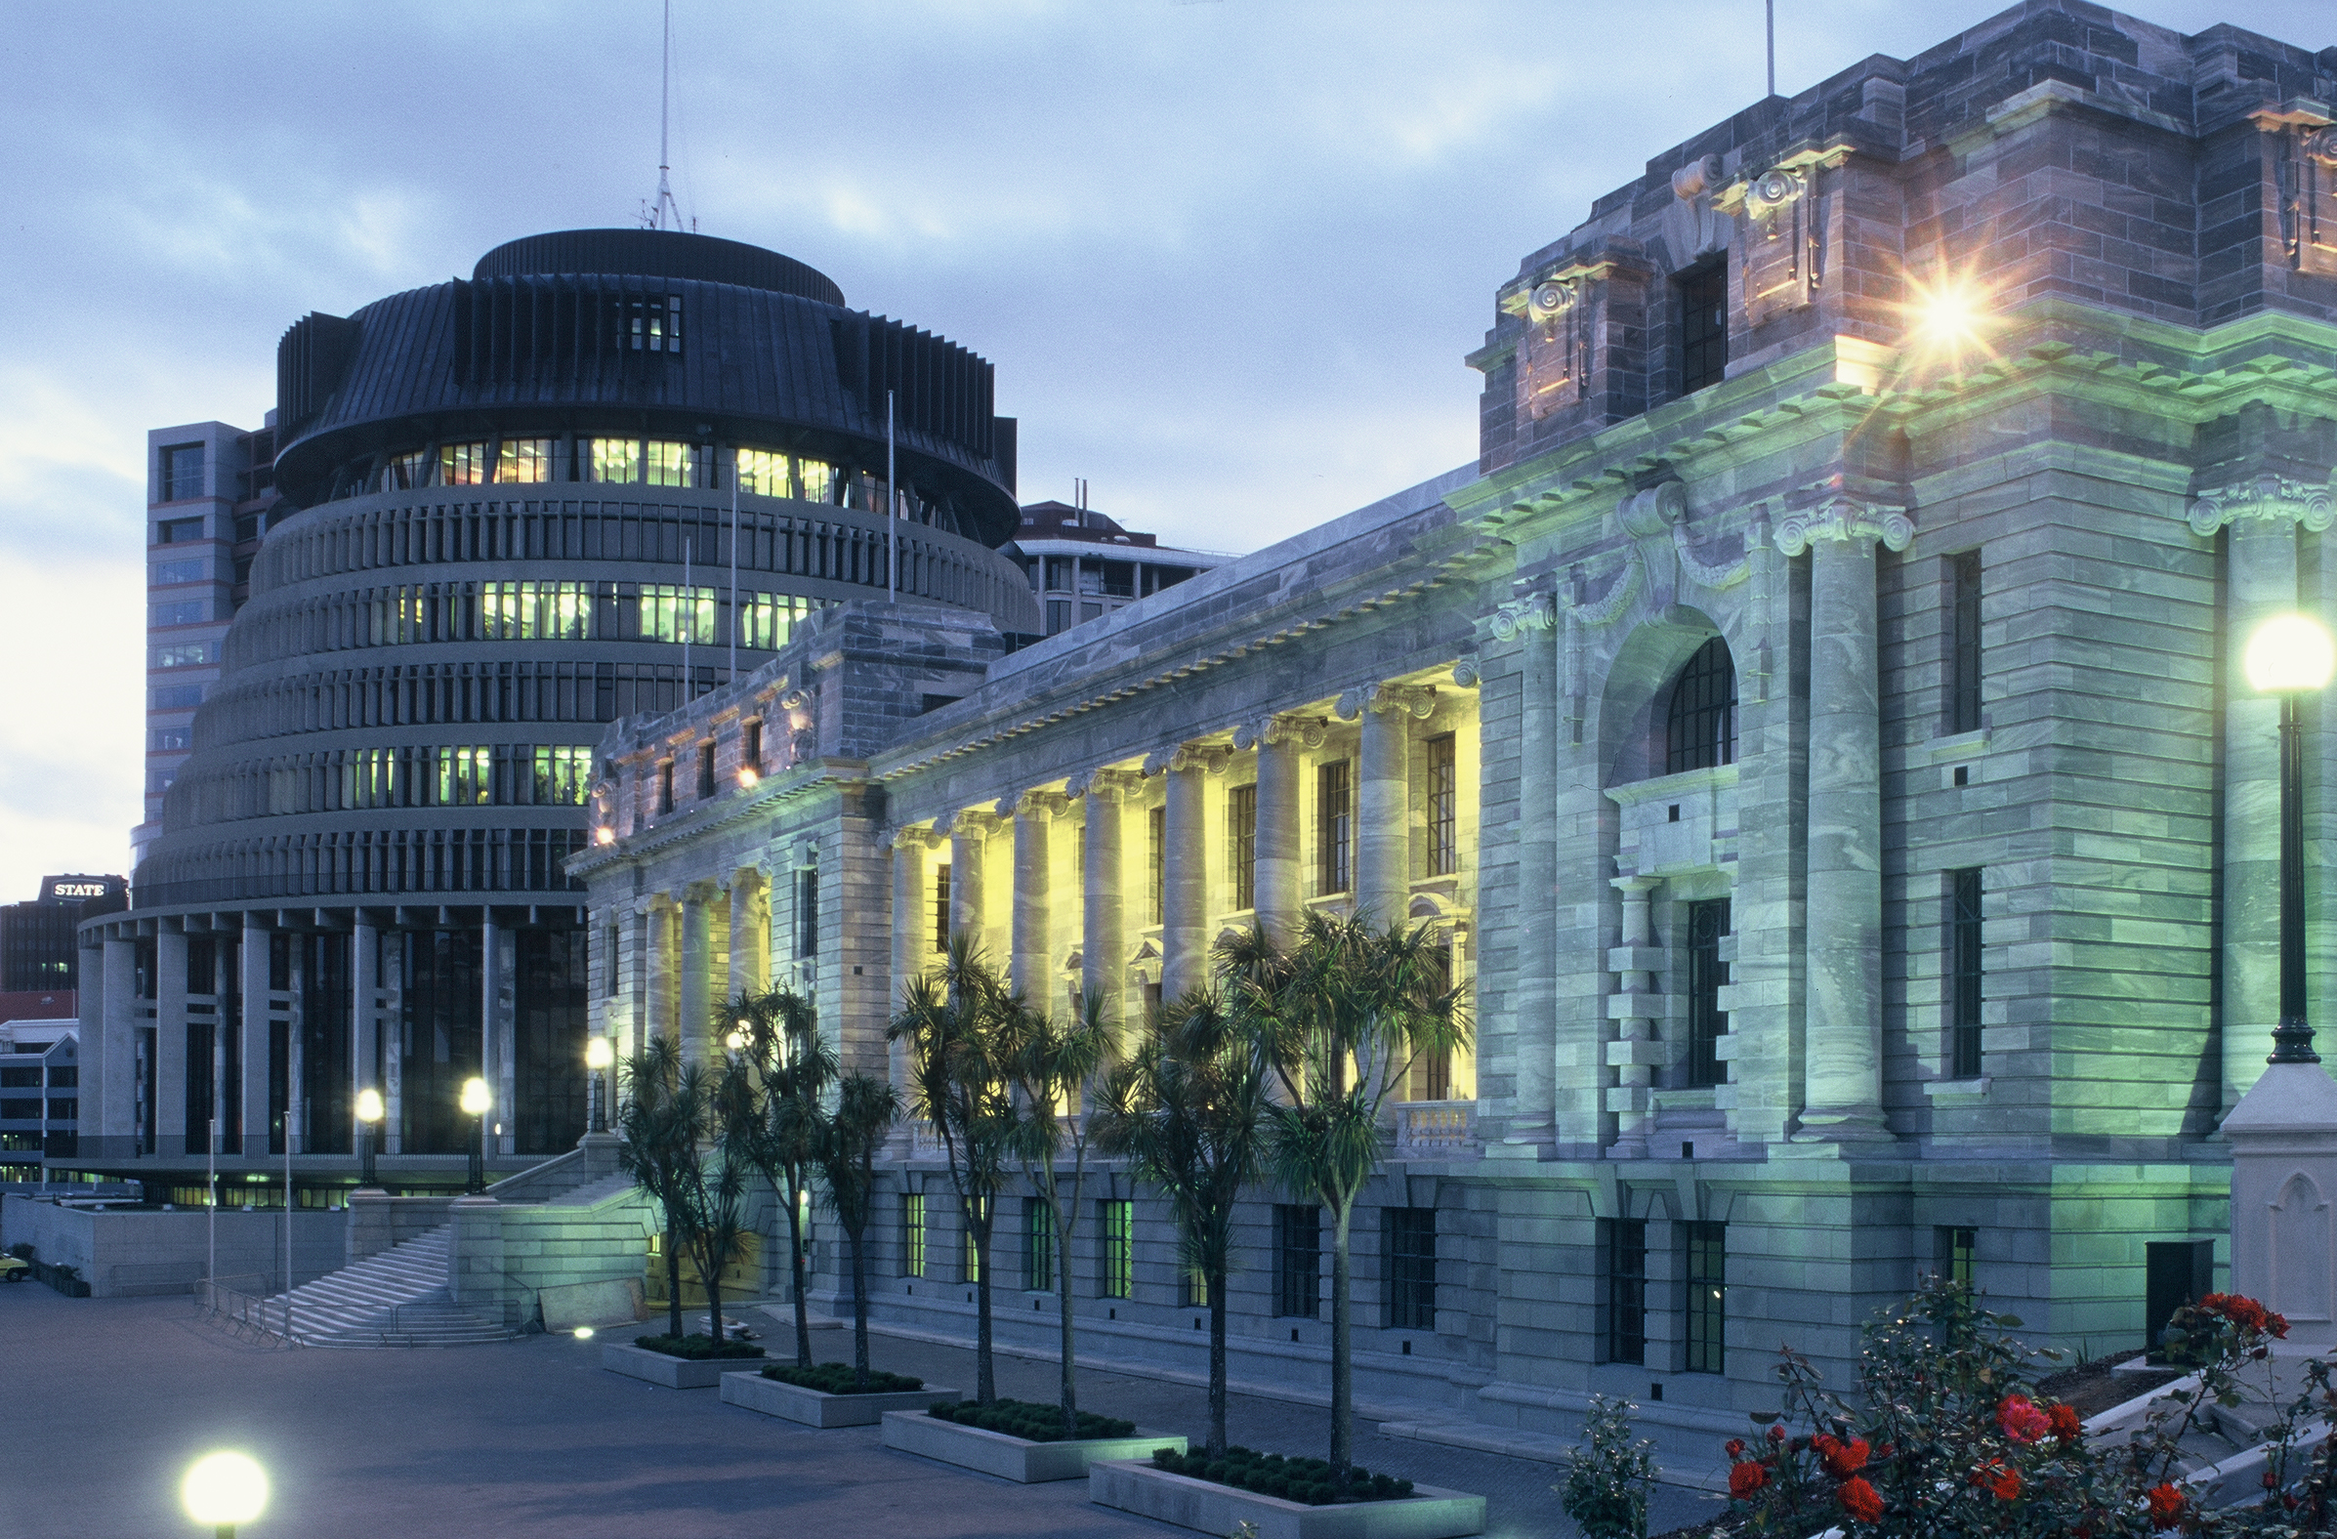
Passing the Budget
  Amendments to the Budget
  APPROPRIATION ACT
  IMPREST SUPPLY ACT
  SUPPLEMENTARY APPROPRIATIONS AND ESTIMATES

Slide 17
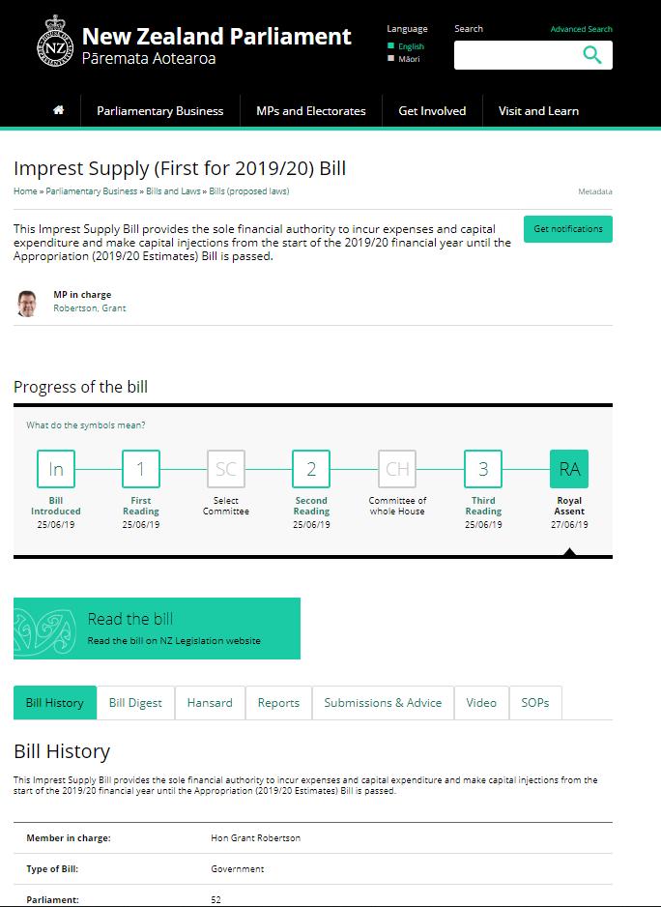
Imprest Supply Bill
  Authorises expenditure of public money or incurring of expenses or capital expenditure
  A general interim authority
  An Imprest Supply Act was passed in response to COVID-19
Notes:
2020 Imprest Supply Bill will be made available on Parliament’s website - https://www.parliament.nz/en/pb/bills-and-laws/bills-proposed-laws/

Slide 18
Passing the Budget
  Amendments to the Budget
  APPROPRIATION ACT
  IMPREST SUPPLY ACT
  SUPPLEMENTARY APPROPRIATIONS AND ESTIMATES

Slide 19
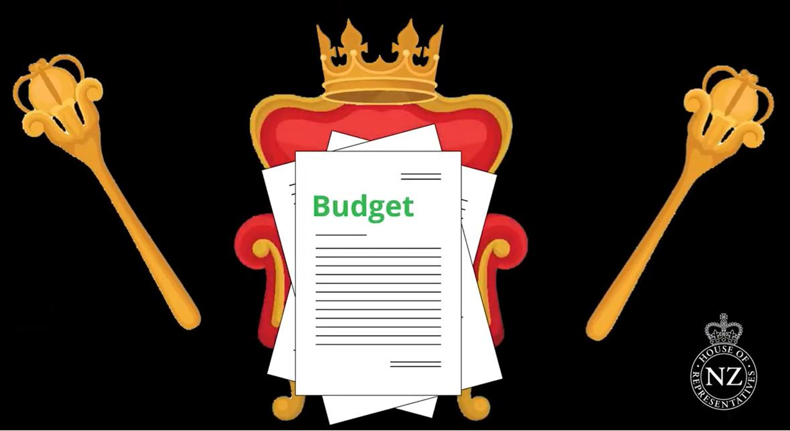
Notes:
Budget is passed when it has received Royal Assent
You can also read about the BPS and other economic indicators in the Library's Monthly economic review (https://www.parliament.nz/en/pb/library-research-papers/monthly-economic-review/)
The different votes are published on the Tsy website - total appropriations for each vote from last year's budget: https://treasury.govt.nz/publications/summary-tables/summary-tables-estimates-appropriations-2019-20-html#section-9

Slide 20
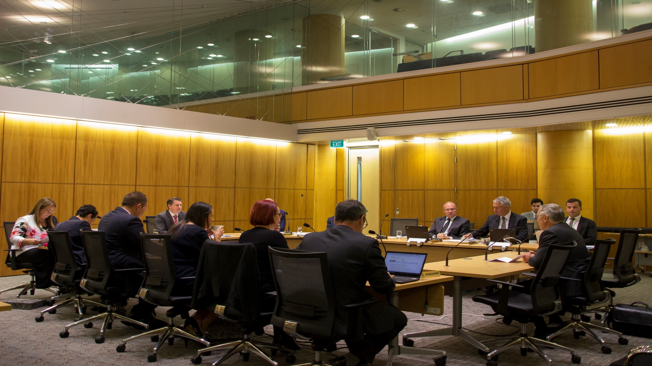
The Review Process
ANNUAL REVIEW of the financial statements and performance of Government entities
Select Committees must report back
The role of the CONTROLLER AND AUDITOR-GENERAL

Slide 21
Q + A

Slide 22



Virtual Tour of Parliament-
Parliament XR
Download for free:
Google Play- Android
App store-iOS
Notes:
Here is the link to information page about our XR app -
https://www.parliament.nz/en/visit-and-learn/visit/virtual-reality-at-parliament/

Slide 23
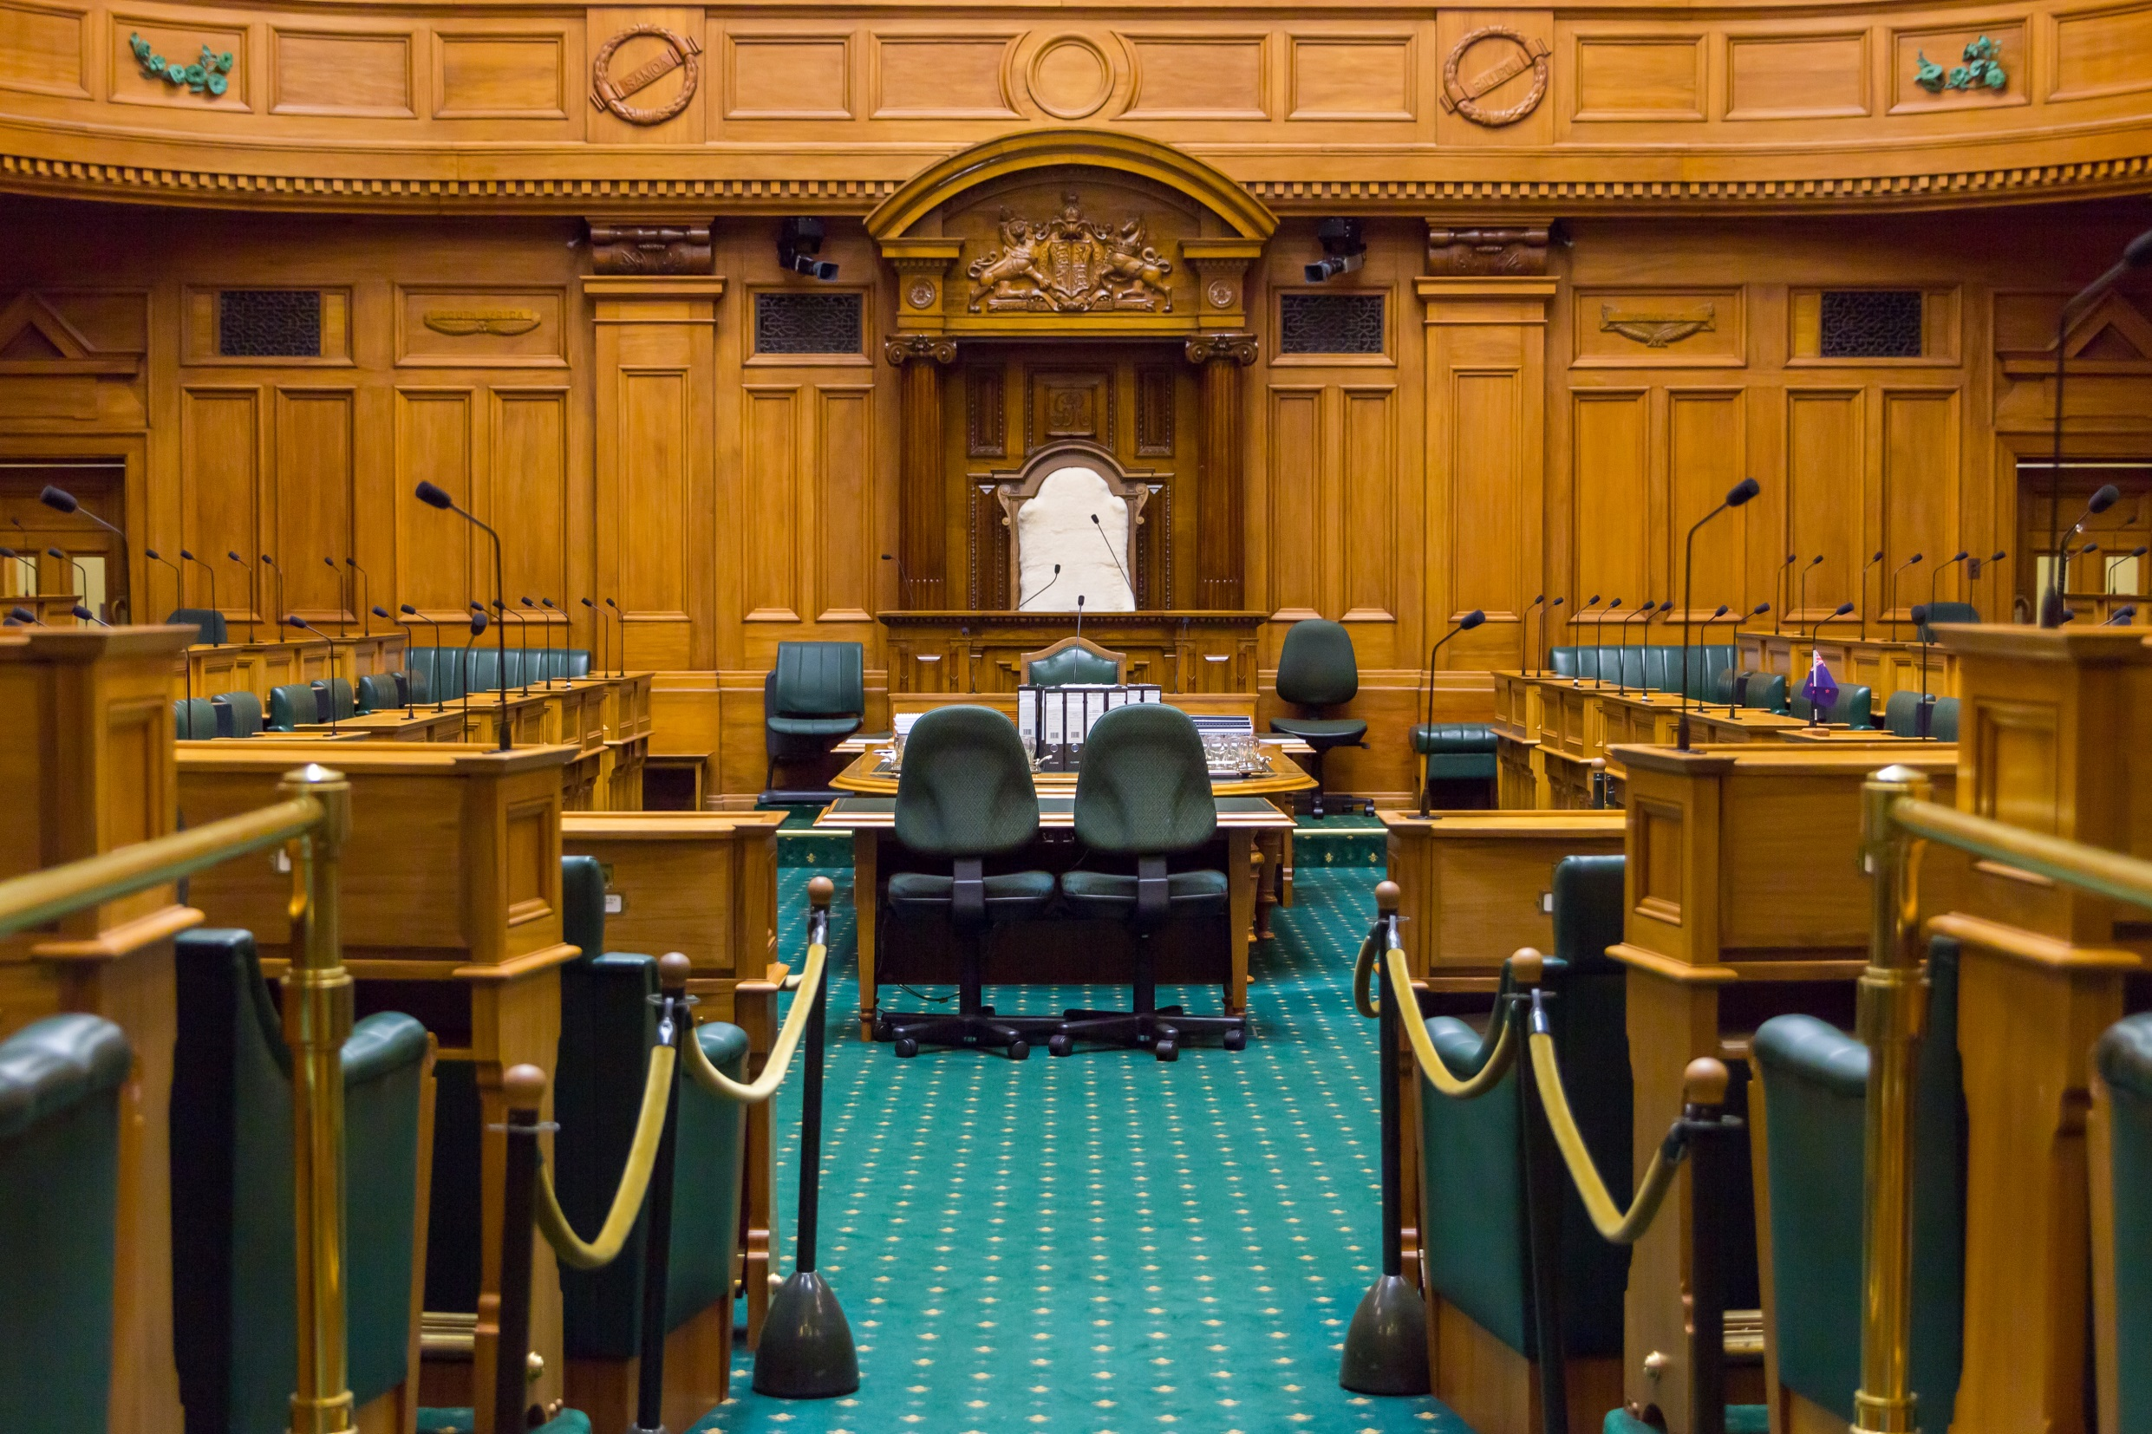
Our House is YOUR House
Find us on Twitter, Instagram, and Facebook
@nzparliament
Any further questions about this webinar please send them to: Education.Team@parliament.govt.nz
For more general enquires about Parliament get in touch with our Library Team at: parlinfo@parliament.govt.nz
Notes:
Questions on this webinar can be sent through to Education Team at education.team@parliament.govt.nz
Get in touch with the library at parlinfo@parliament.govt.nz for more general questions about Parliament

