Slide 1

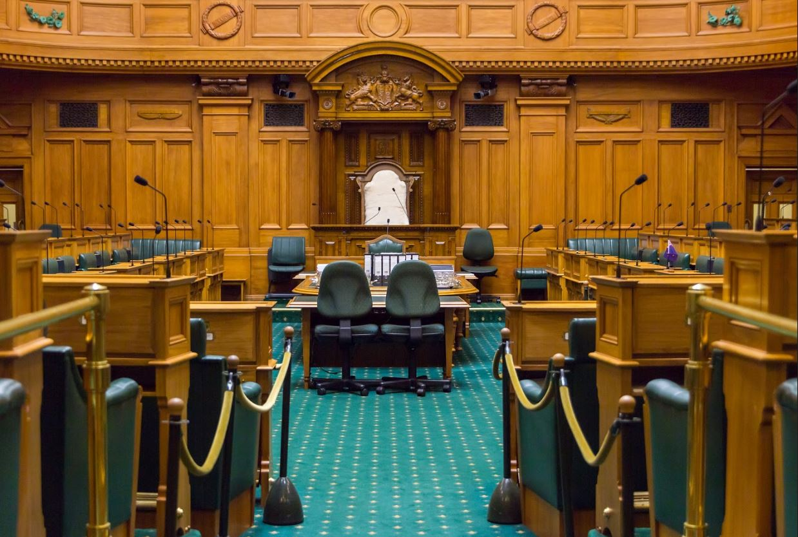
Welcome to Question Time 101
Webinar
We will launch a quick poll soon whilst people are joining…
Notes:
Poll: ‘why did you decide to join this event today’

Slide 2
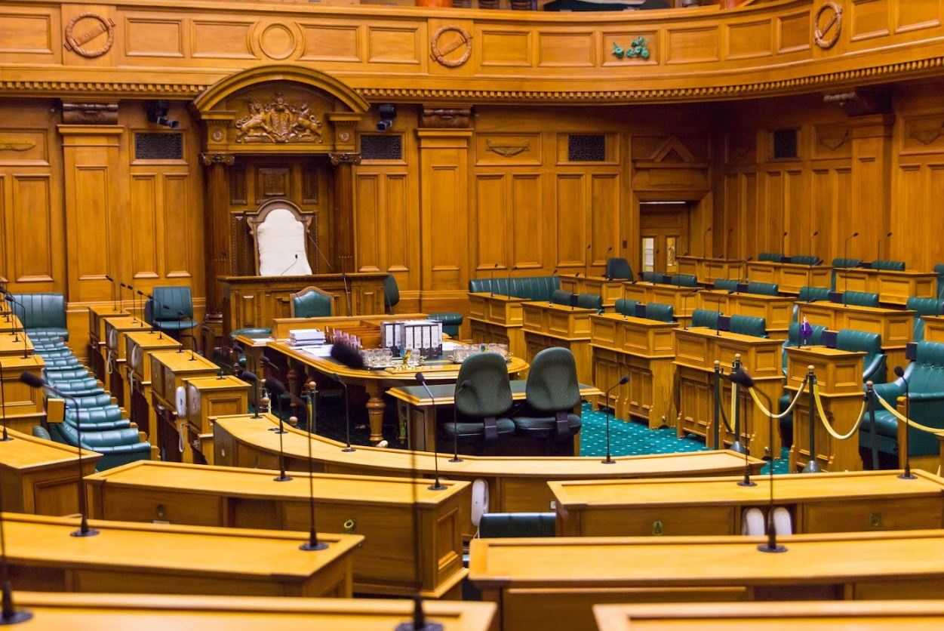
Question Time 101
Webinar
Presenters:
Ben Logan-Milne
Education Lead, Parliamentary Engagement
Rt Hon Trevor Mallard
Speaker of the House of Representatives
David Wilson
Clerk of the House of Representatives
Notes:
Poll on what people’s ideas about question time – eg ‘what’s your level of understanding about question time’

Slide 3
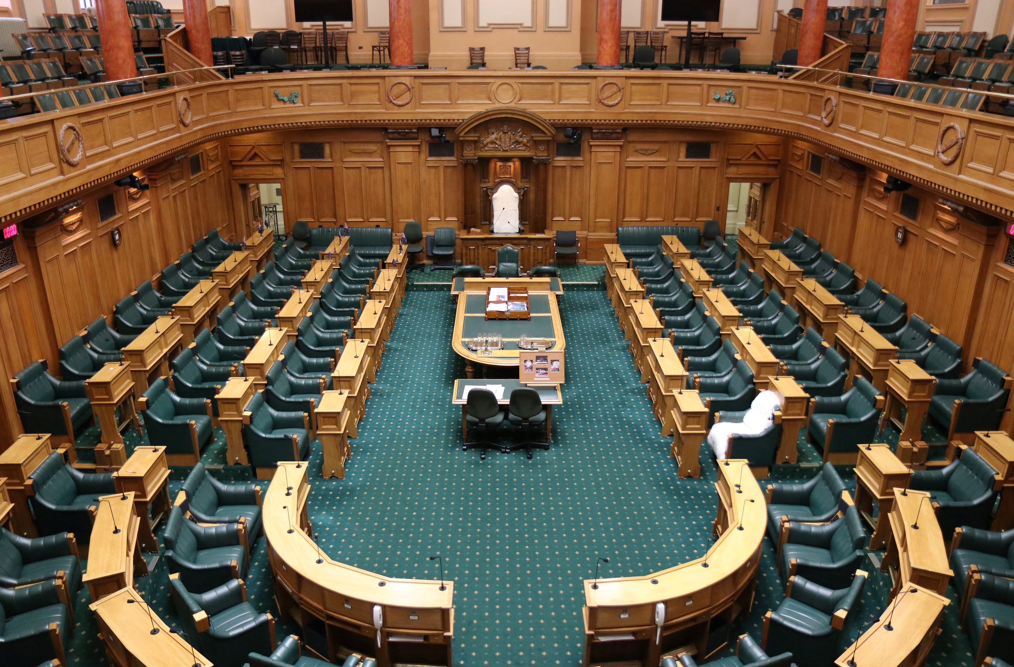
What is question time?
What happens eg who is involved, for how long?
Why do we have it?
What is the difference between question time and a debate?
Hansard
Notes:
How do oral questions work?
https://www.parliament.nz/en/visit-and-learn/how-parliament-works/fact-sheets/question-time-how-do-oral-questions-work/

Slide 4
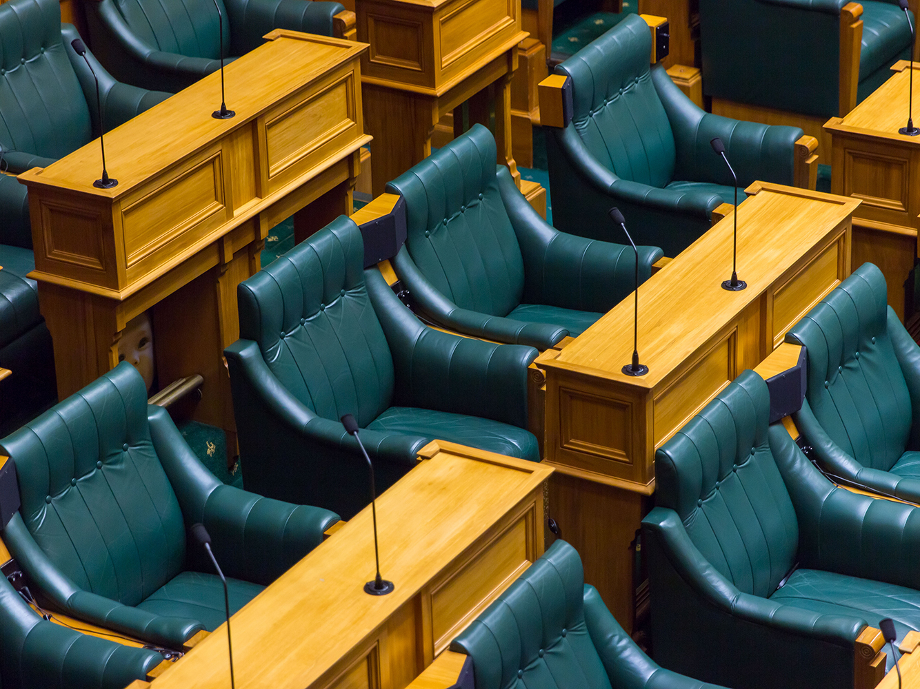

How do we get the questions?
Are the questions all prepared before hand or are some a surprise?
Are there any rules about the questions? Eg do people have to answer them?

Slide 5
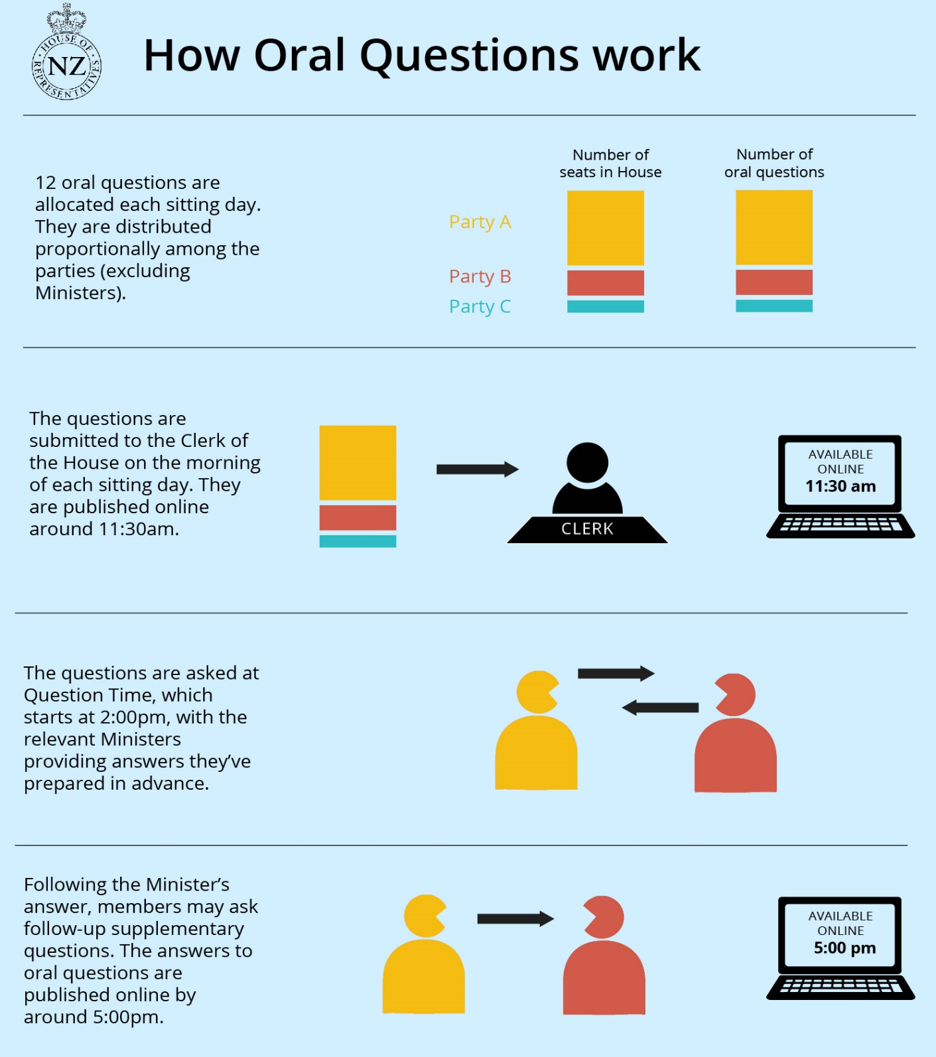
Notes:
Here’s a link to a fact sheet on the order paper and oral questions
https://www.parliament.nz/en/pb/order-paper-questions/

Slide 6
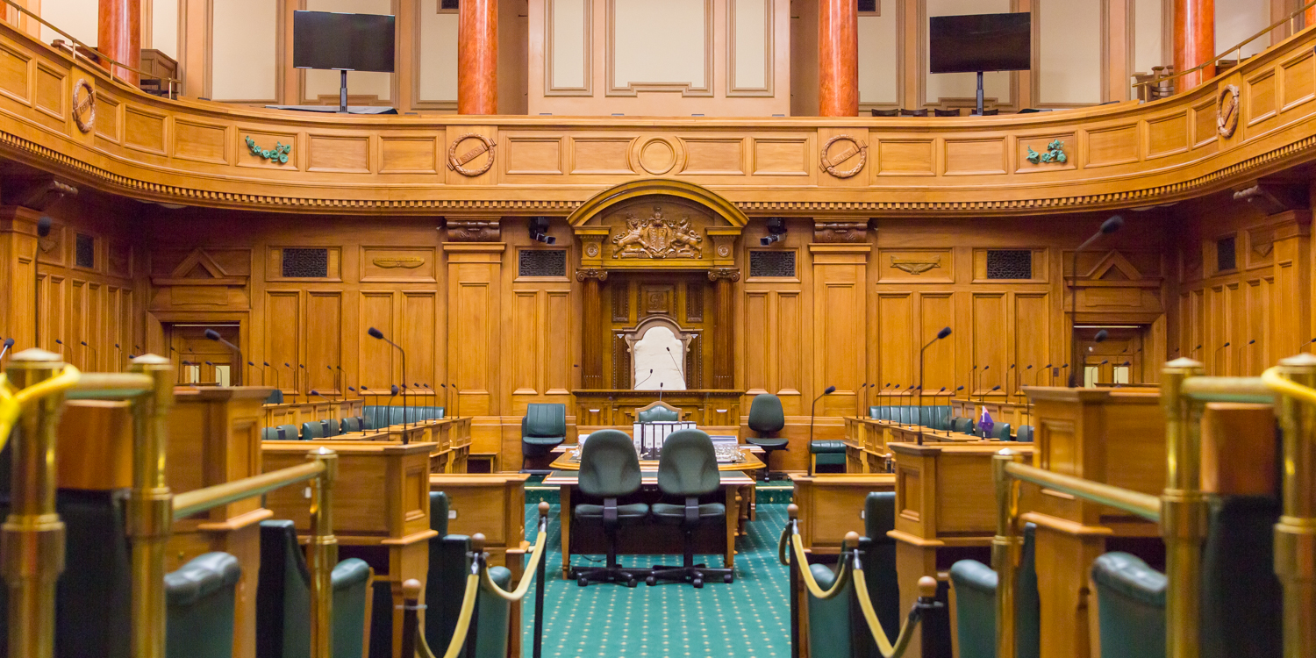
What are some rules for MP’s in question time?
Are there certain types of language that aren’t allowed?
Have some rules changed over the years?
Who actually gets to make the rules?
Notes:
Speakers Rulings
https://www.parliament.nz/media/4500/speakers-rulings-2017-final-pdf-version.pdf
Section on Questions Page 151-187
Standing Orders of Parliament
https://www.parliament.nz/en/pb/parliamentary-rules/standing-orders/
Standings Orders 378 - 388

Slide 7
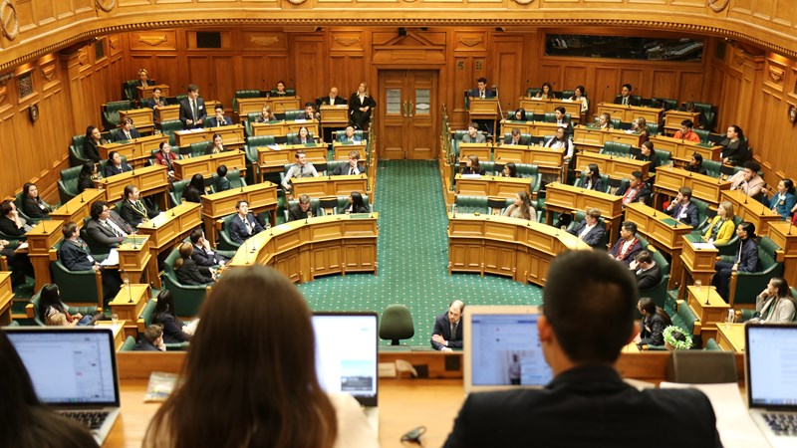
Do other Parliaments have question time like us?

Slide 8
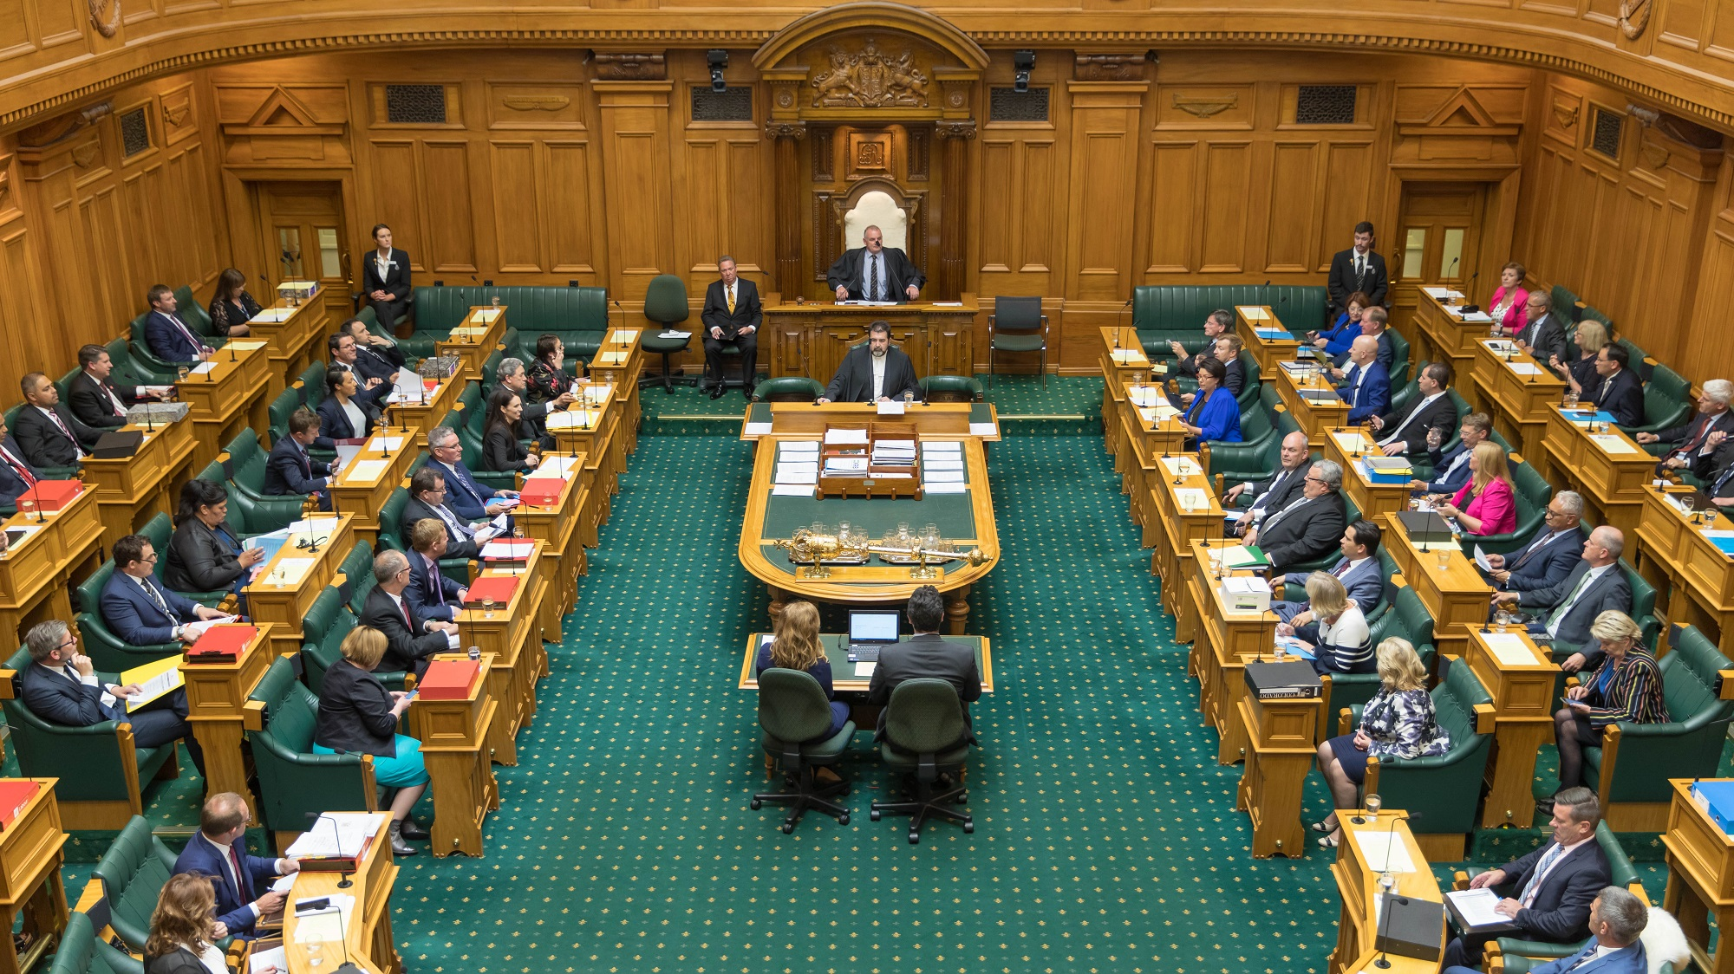
Has question time changed in any way during the course of our Parliament’s history?

Slide 9
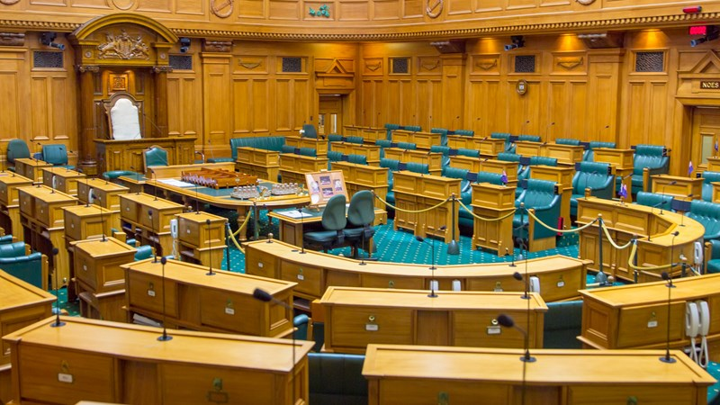
Are there any last thoughts you have about question time that you’d like to share?

Slide 10
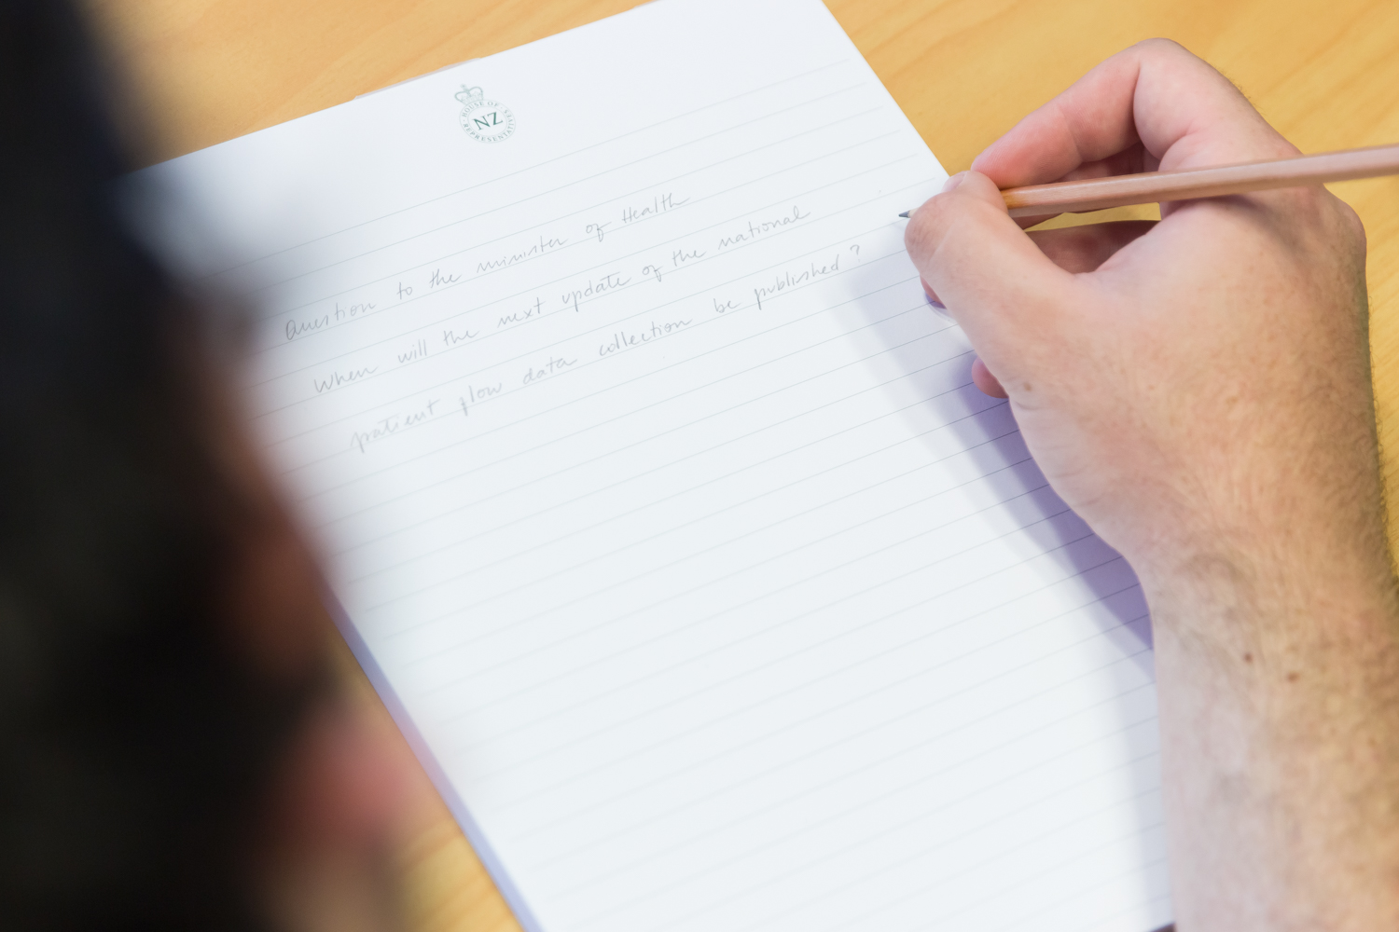

Questions?
Notes:
Any questions?
Further in depth information about Question Time from Parliamentary Practice in New Zealand
https://www.parliament.nz/en/visit-and-learn/how-parliament-works/parliamentary-practice-in-new-zealand/chapter-39-questions/
Other than oral questions in the House there are also written questions – see the following link for more information on these
https://www.parliament.nz/en/get-involved/features/hundreds-of-written-questions-asked-every-week-even-when-parliament-isn-t-meeting/
Where can you find out what people have said in question time: Hansard
https://www.parliament.nz/en/footer/website-help/where-do-i-find-the-transcripts-for-answers-to-oral-questions/

