Slide 1

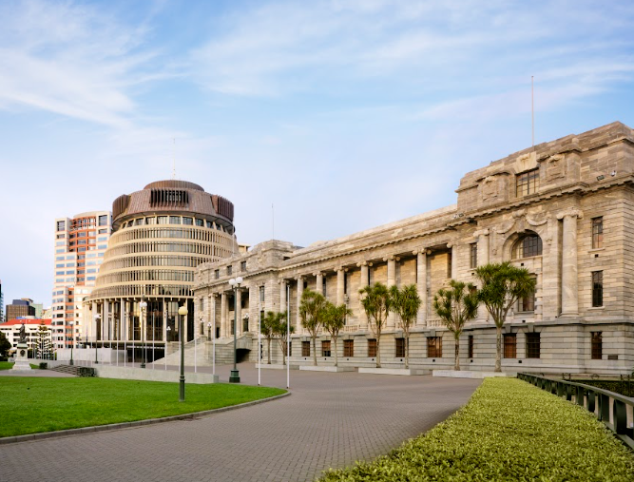
New Zealand Parliament
A guide to my trip to New Zealand's Parliament

Slide 2
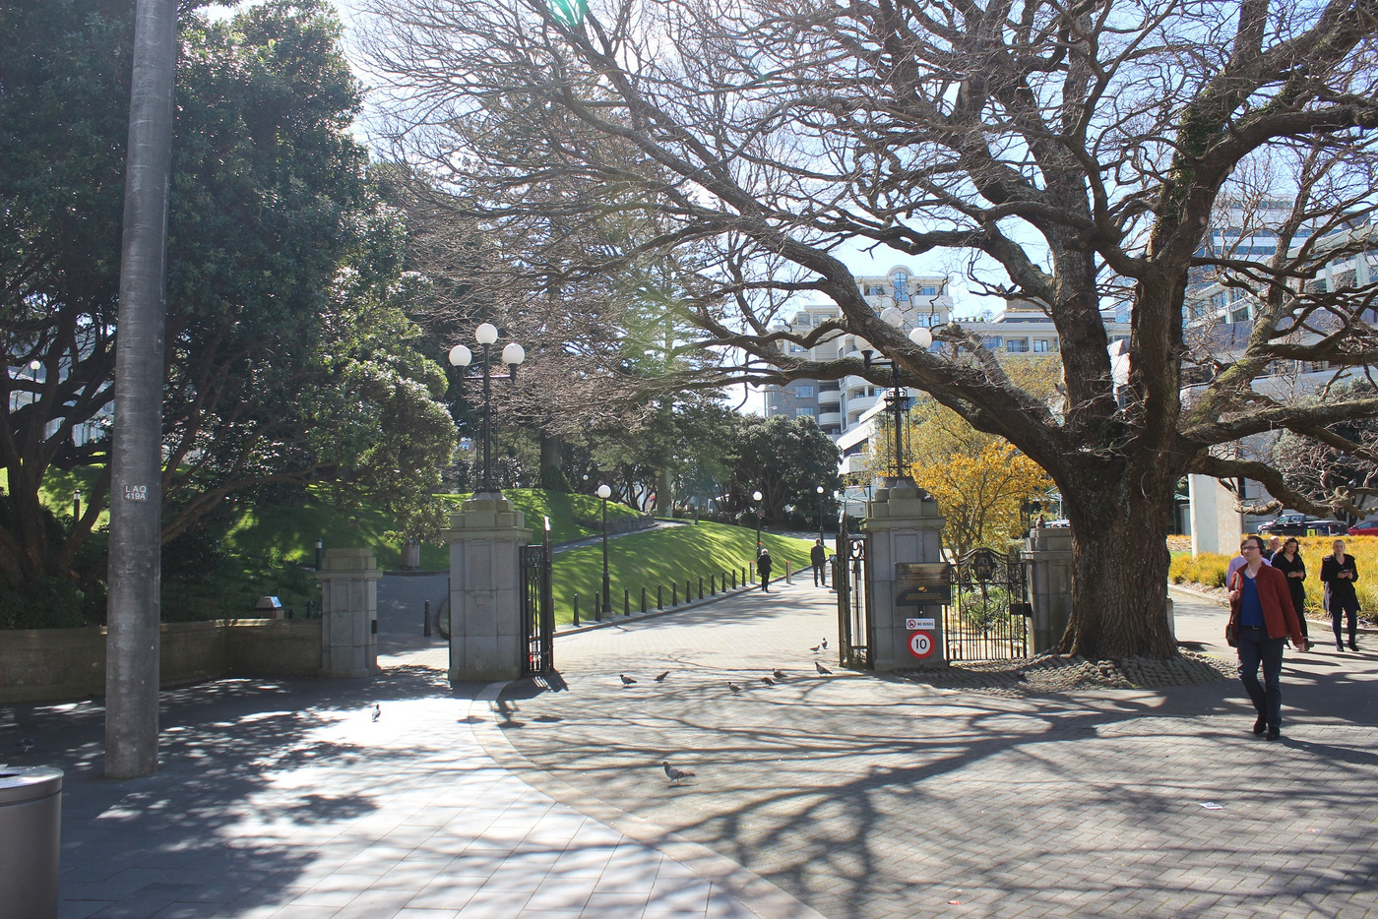
I am going to visit Parliament
I am going to visit Parliament in Wellington.
Parliament is where laws are made for New Zealand.
MPs (Members of Parliament) work here.

Slide 3
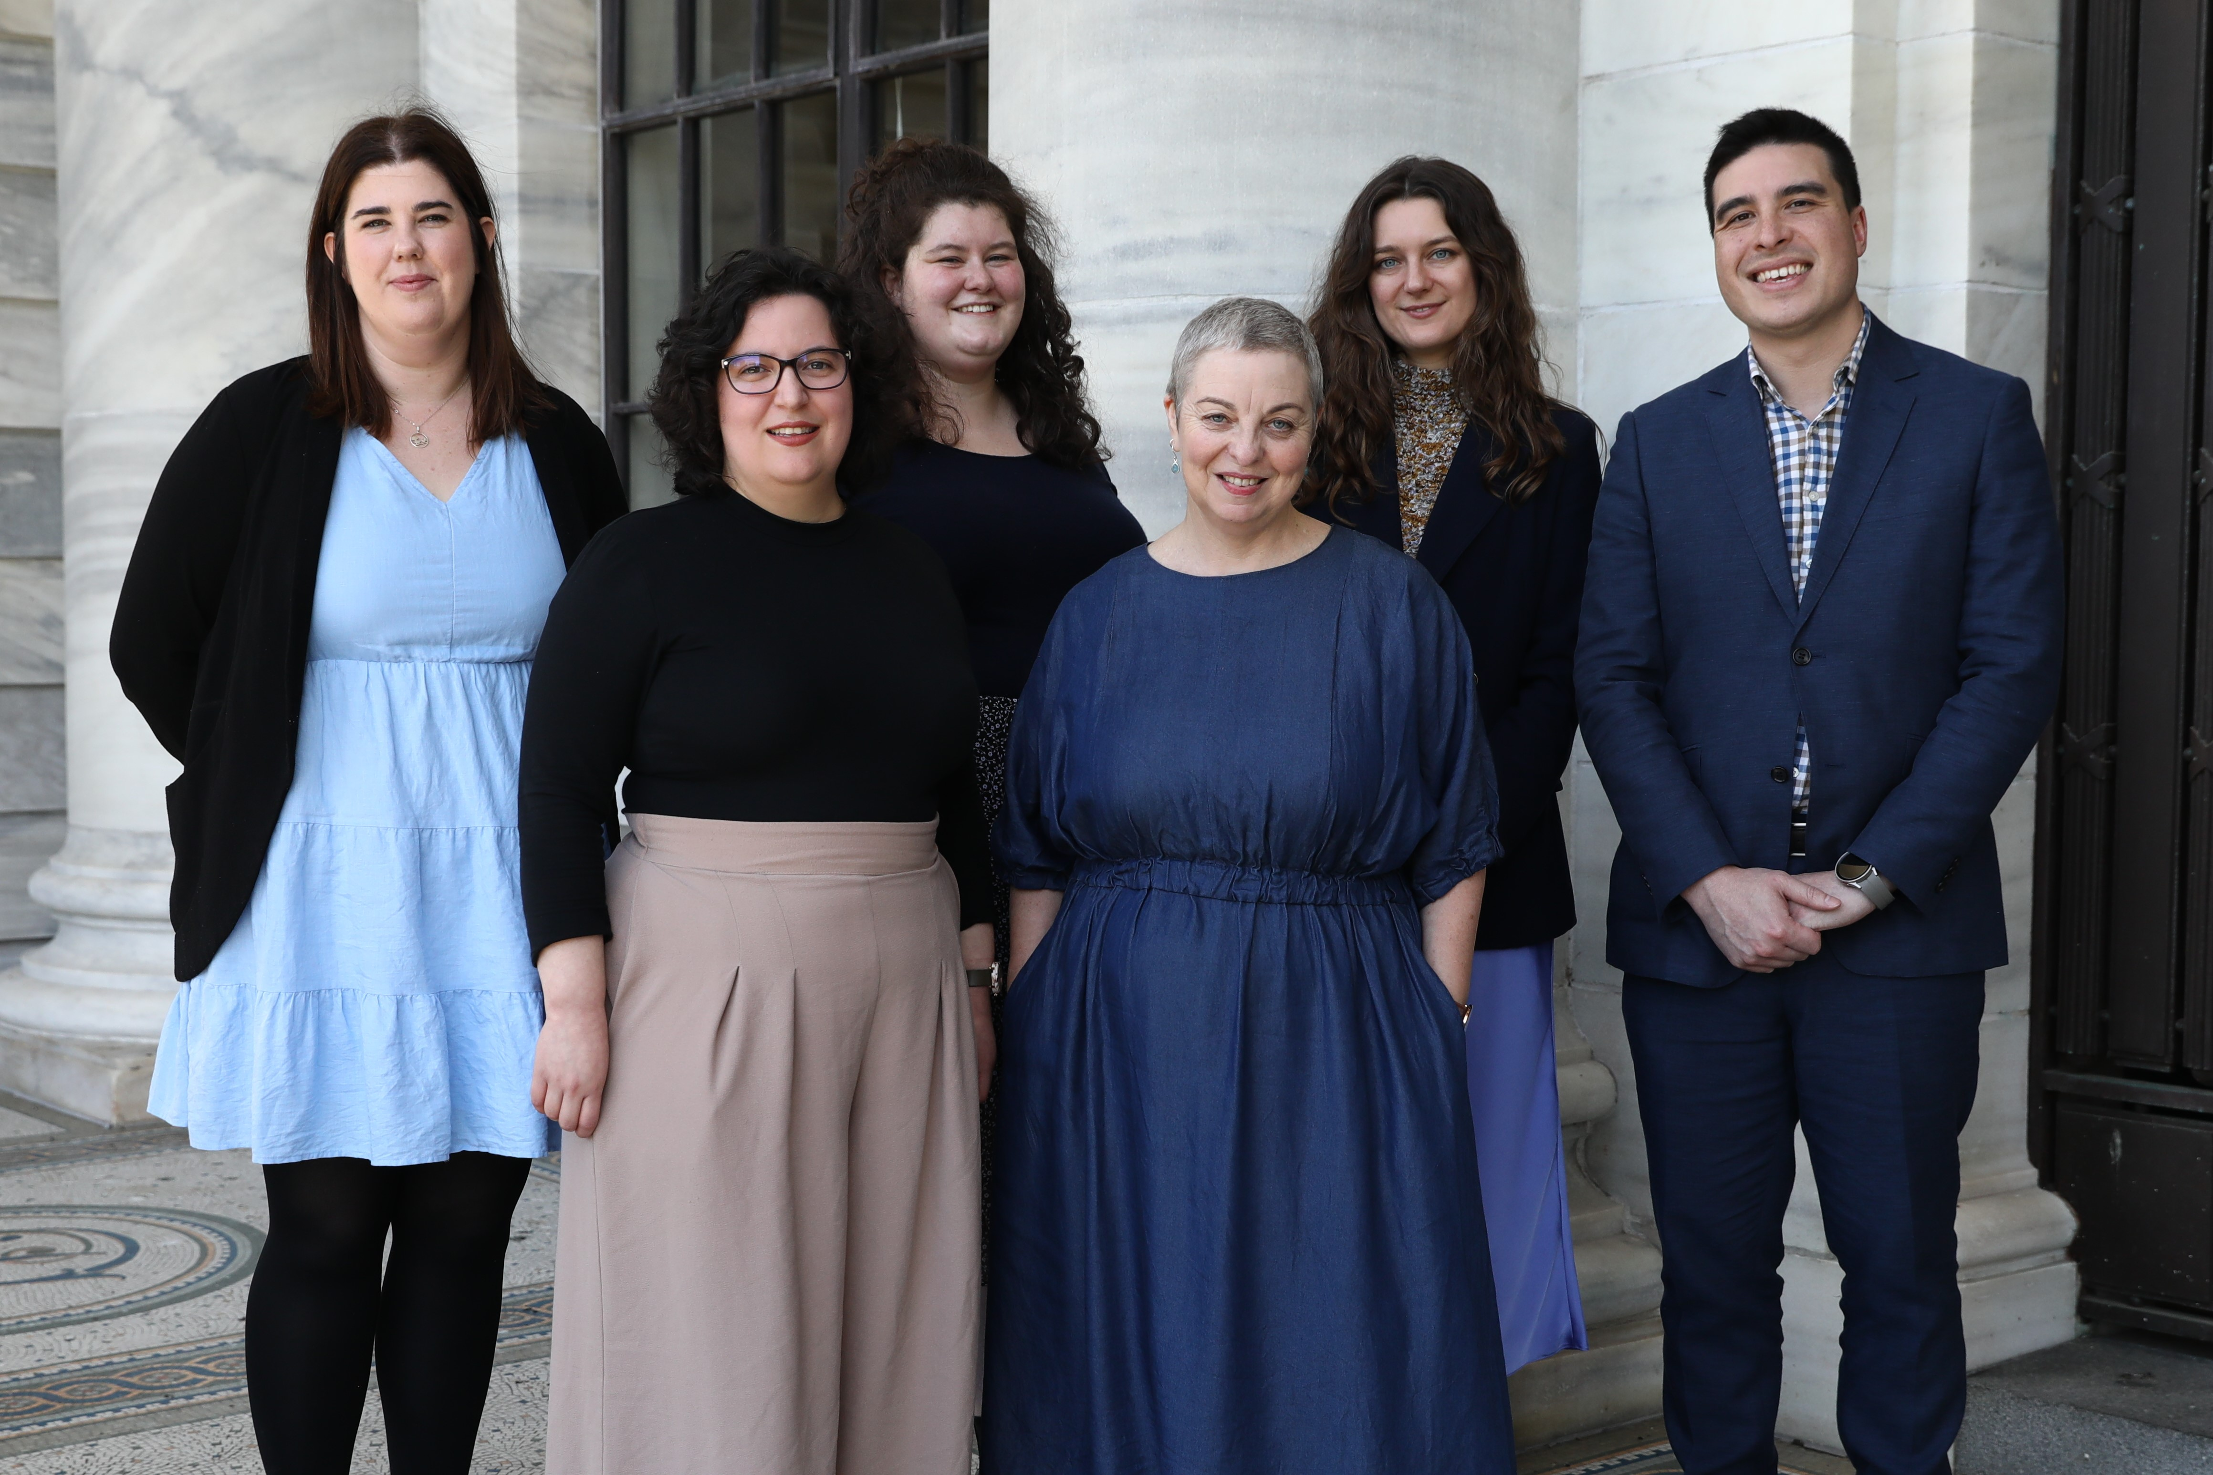
Parliament educators
An educator is going to show me and my group around Parliament.
The educator is a person who works in Parliament.

Slide 4
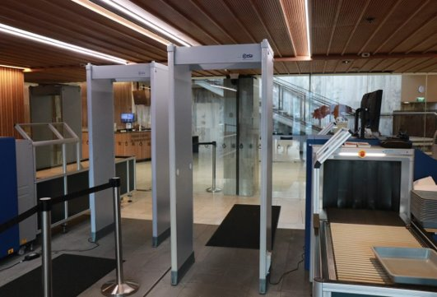
Security check
Before the tour starts everyone will go through a security check. This is to keep everyone safe.
Everyone's bags and belongings will be scanned.
Everyone will walk through a scanner doorway.

Slide 5
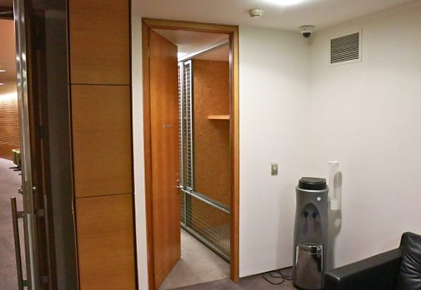
Before my tour
Visitors to Parliament are not allowed to carry their bags while walking around Parliament. This is for safety reasons.
The educator will lock everyone's bags in a small room.
I can go to the toilet before or after the tour.

Slide 6
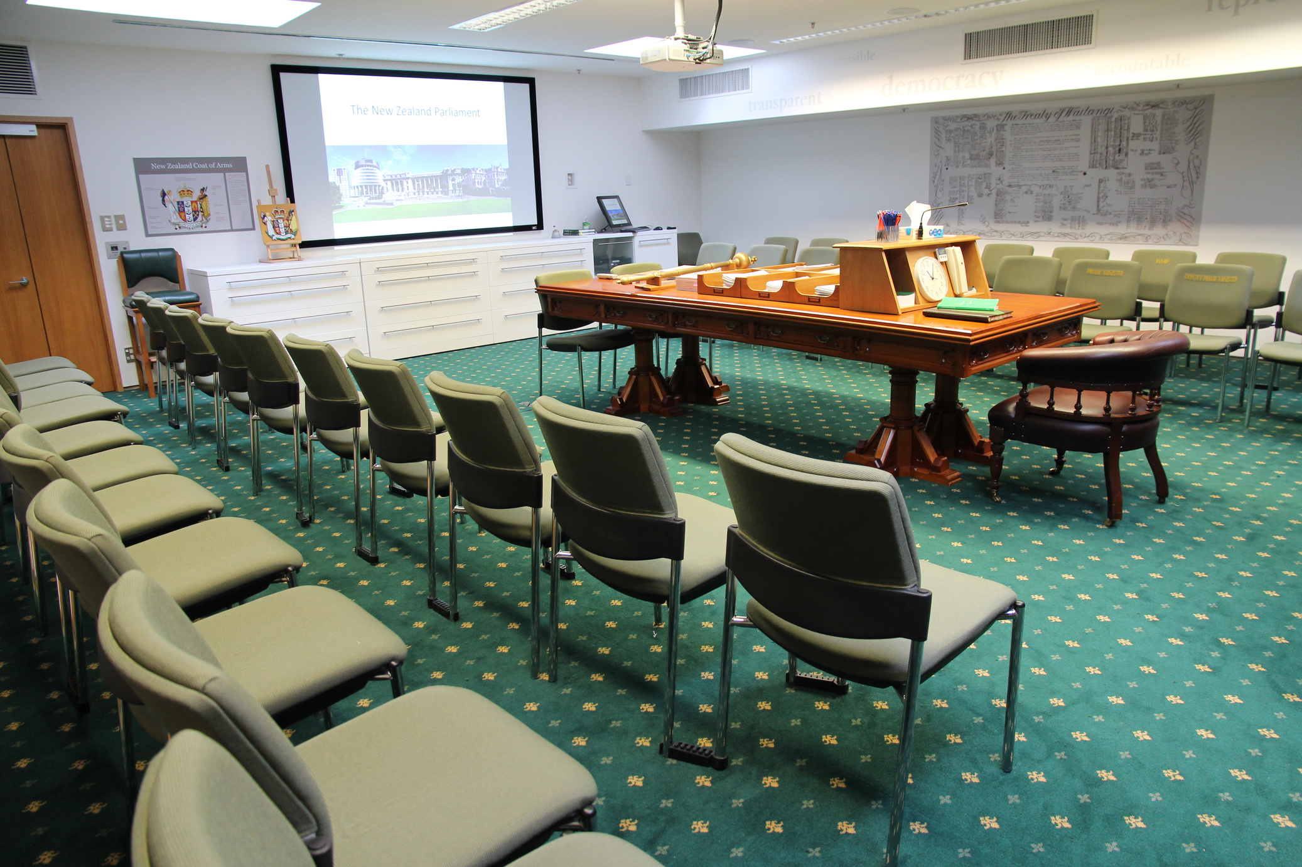
The education center
This is the education center.
The educator will talk a little bit about Parliament and ask us some questions.
An MP might come and talk to us about their job in the education center.

Slide 7
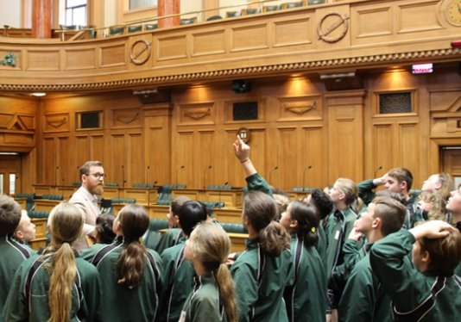
The tour
On my tour the educator will take us to a few different rooms.
Parliament is a busy place where lots of people work.
Sometimes other people are using these rooms and we can’t go into them.
If my group walks quietly on the left-hand side of hallways and stairwells it will make it easier for other people to get past.

Slide 8
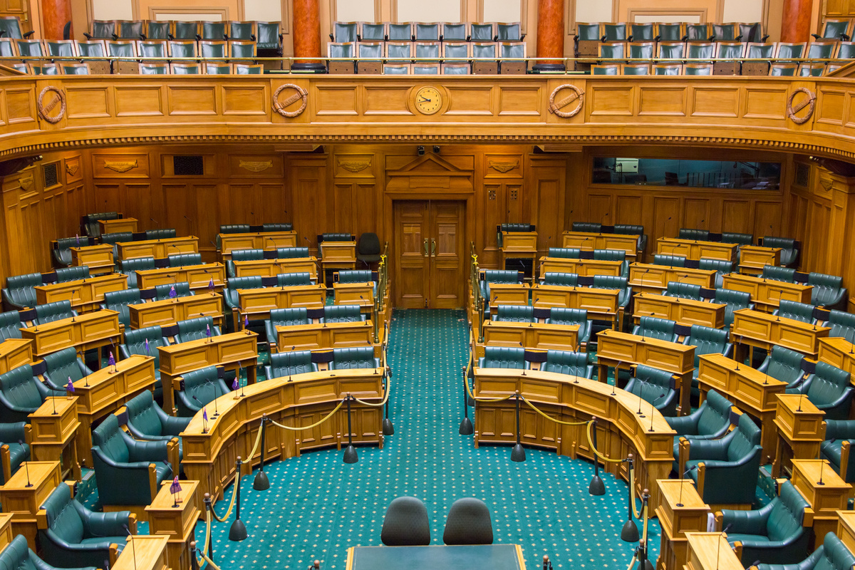
Debating Chamber
My group will probably go into the Debating Chamber.
This room has green carpet and big green chairs.
This is where all the MPs make and talk about laws.

Slide 9
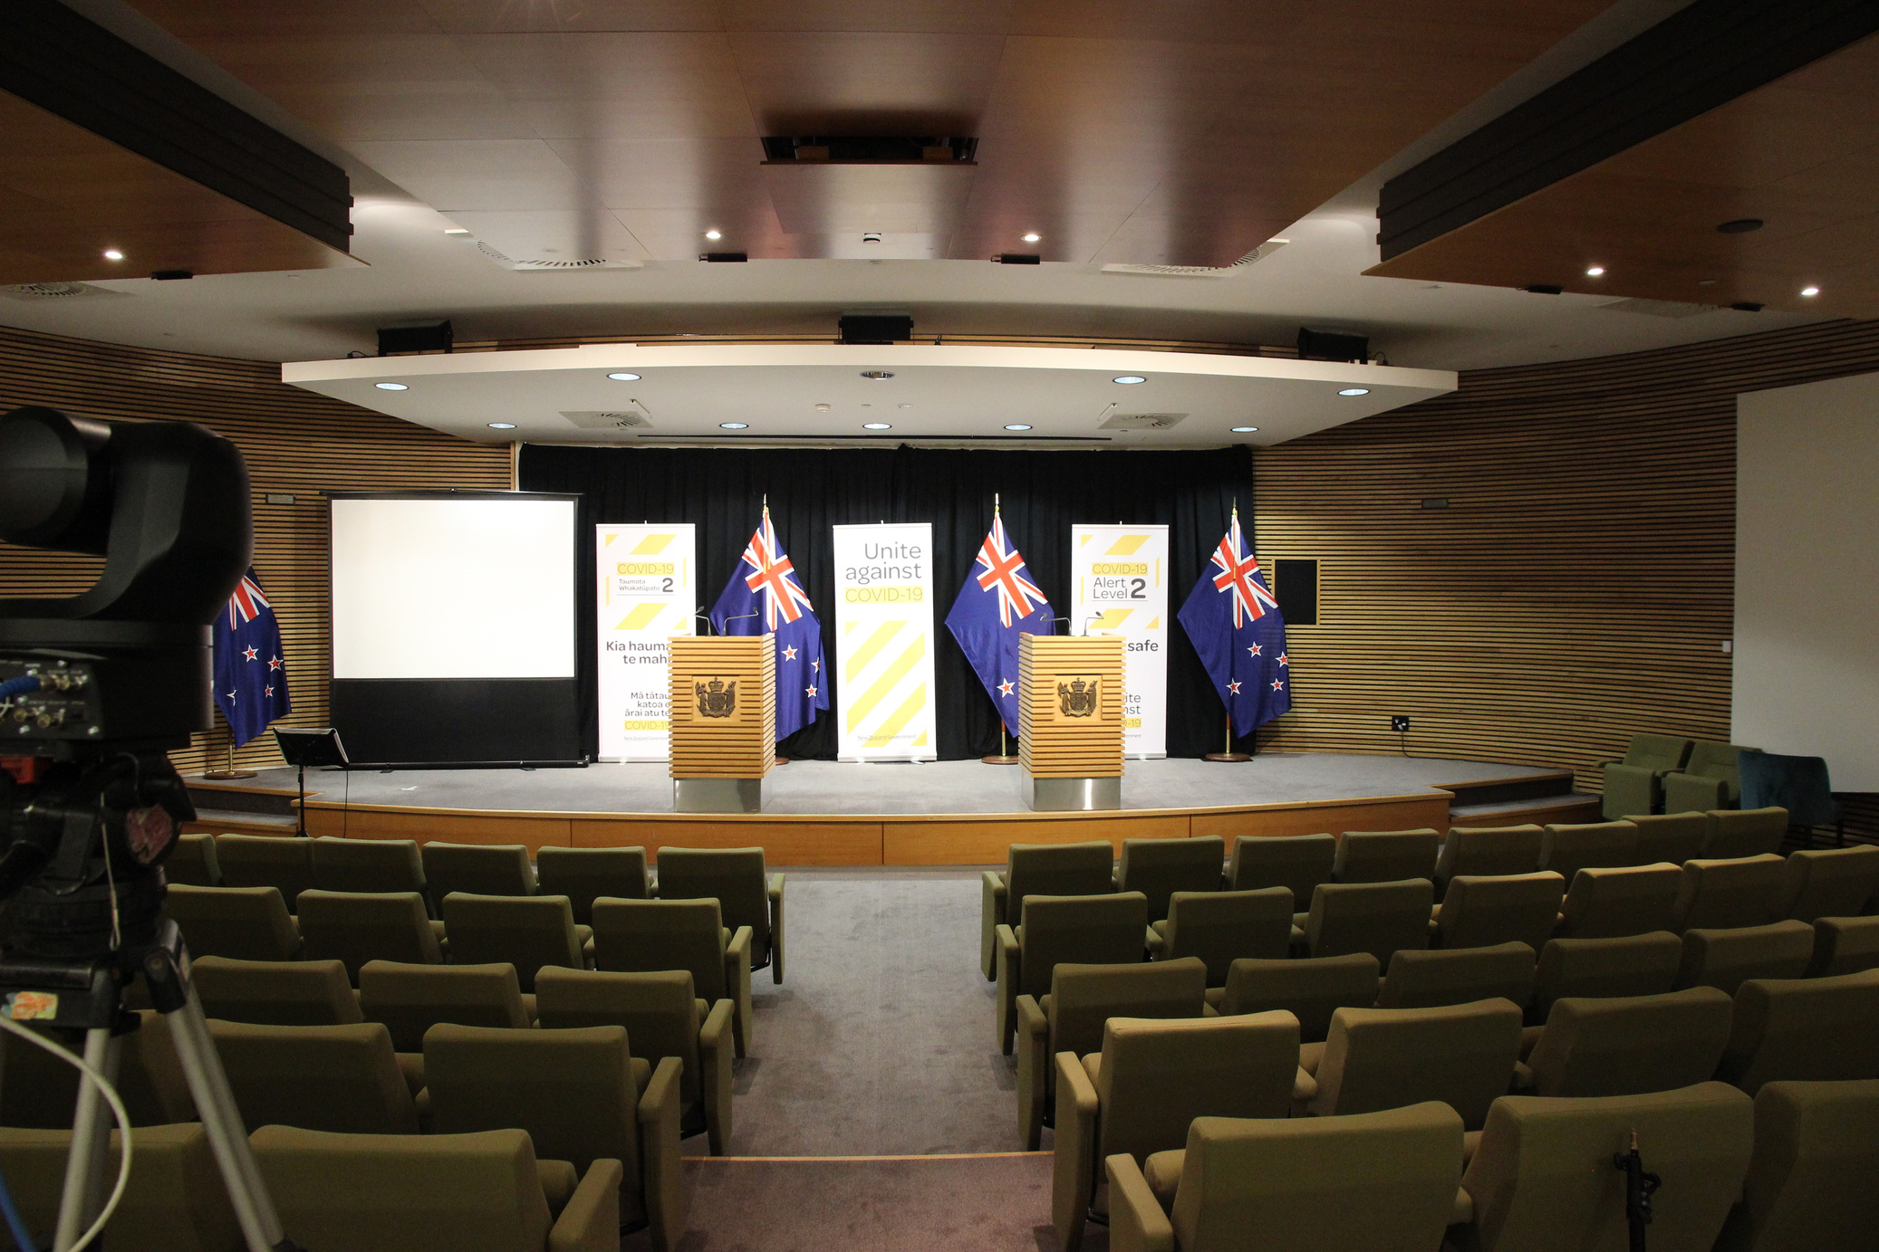
Theatrette
My group will probably go into the Theatrette.
This rooms has lots of rows of light green chairs and a little stage.
This is where the Government gives press conferences.

Slide 10
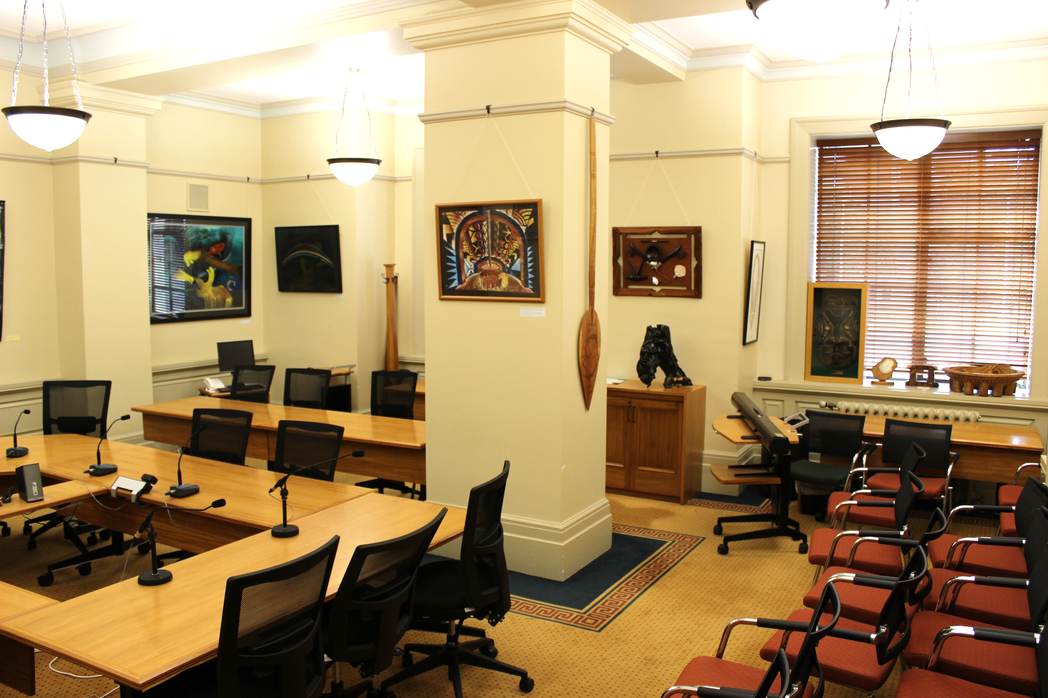
Select Committee room
My group will probably go into a Select Committee room.
This is where MPs have important meetings about laws.

Slide 11

Ringing Bells in Parliament
Sometimes bells ring in Parliament.
They tell the MPs when they need to go to the Debating Chamber.
There is not an emergency. I am safe.

Slide 12

The public gallery
I might go and sit in the public gallery. This is above the Debating Chamber.
This is where I can watch the MPs make laws.
Everyone will need to go through another security check first.
Note: This is only for visits booked in to watch Parliament in action.

Slide 13
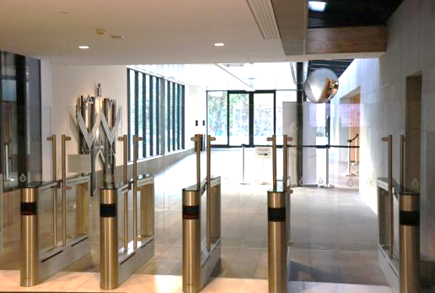
Leaving Parliament
When the tour is finished everyone will collect their bags.
I can go to the toilet if I need to.
When I leave Parliament, I will go out some special gates.

Slide 14
We look forward to seeing you in Parliament.

