Slide 1
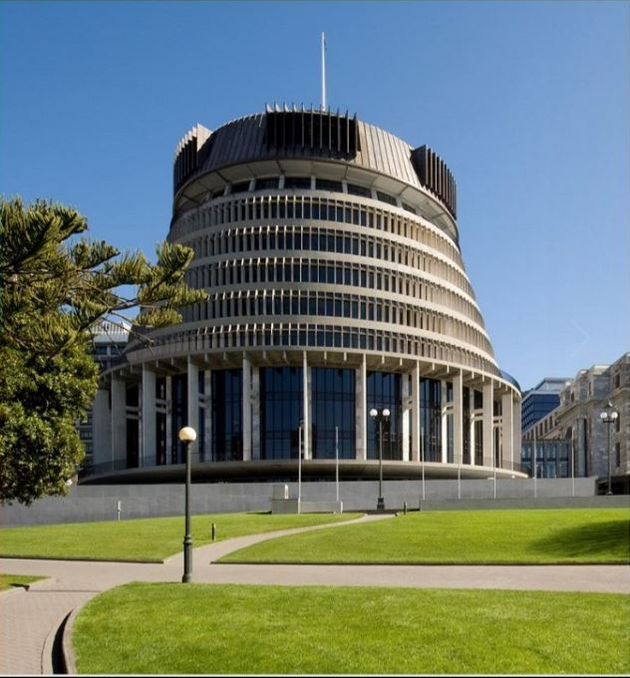

Executive and Cabinet
Insert photo relevant to webinar – see next slide for stock images that can be used.
Ever wondered what the differences are between Parliament and Government?
Keen to know more about the roles of the Cabinet and Executive?
Join us to learn all about these important parts of our democracy.
Notes:
Introduction:
“Tena koutou katoa. Welcome everyone to this webinar on the Executive and Cabinet, brought to you by the Parliamentary Engagement Team.

Slide 2
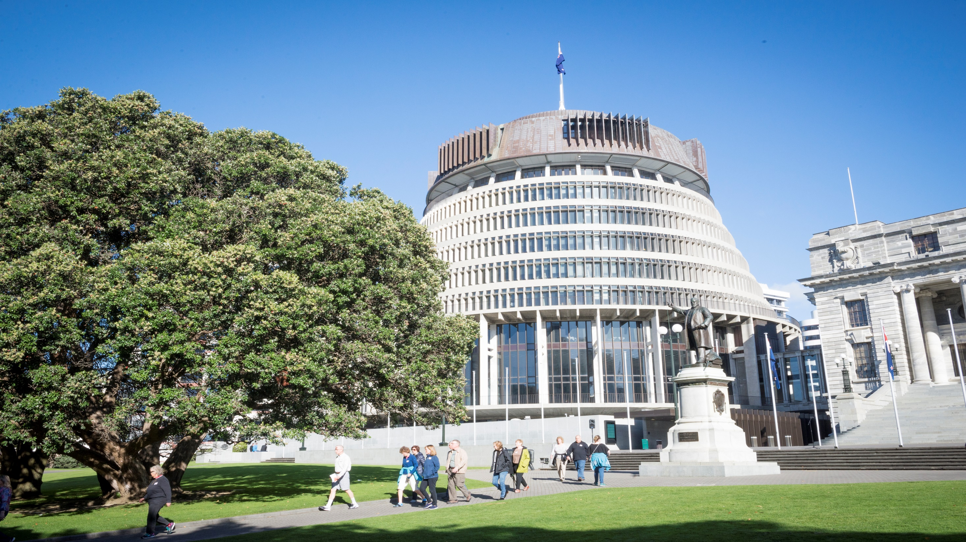

Introducing
Our expert guests
Name
Rachel Hayward
Deputy Secretary, Cabinet Office
Anna Fleming
Legal and Constitutional Adviser, Cabinet Office
…and your host Caroline Wallis,
Education Adviser from the Parliamentary Engagement team
Notes:
My name is Caroline Wallis and I am an Education Adviser at Parliament, and your host for today.
Joining me as our expert guests are Rachel Hayward Deputy Secretary of the Cabinet, and Anna Fleming, legal advisor in the Cabinet Office.
A few housekeeping rules before we get started. If you have any questions for our presenters, please write them in the chat box for our panellists. We hope that what we will cover will answer any questions you have, and if not we will address your questions at the end of the webinar.

Slide 3
What will we cover today?
What is the difference between Parliament and Government?
What are the important features of the Executive Council and the Executive?
What are the roles and responsibilities of The Prime Minister, Ministers and Cabinet Committees?
How does Cabinet make decisions?
What are key features of the Cabinet Manual?
Q and A
Notes:
So today we will cover through a mix of discussion and questions a number of features of the Executive and Cabinet in our democracy. This topic came from results from surveys at the end of previous webinars and we believe it is an important and perhaps less understood branch of our government.
To give you an overview of what we will cover here is a hopefully helpful diagram. We will start with looking at the difference between Parliament and Government (often confused terms). We’ll then move on to digging deep into the detail of what our Executive and Cabinet will do.
Rachel and Anna will help guide us through the important features of our Executive and Executive Council. We will then look at the responsibilities in the Executive as they relate to the Prime Minister, Ministers and Cabinet Committees, and then look at how Cabinet makes decisions and key features of the Cabinet manual.
So with out further ado let’s get started!

Slide 4
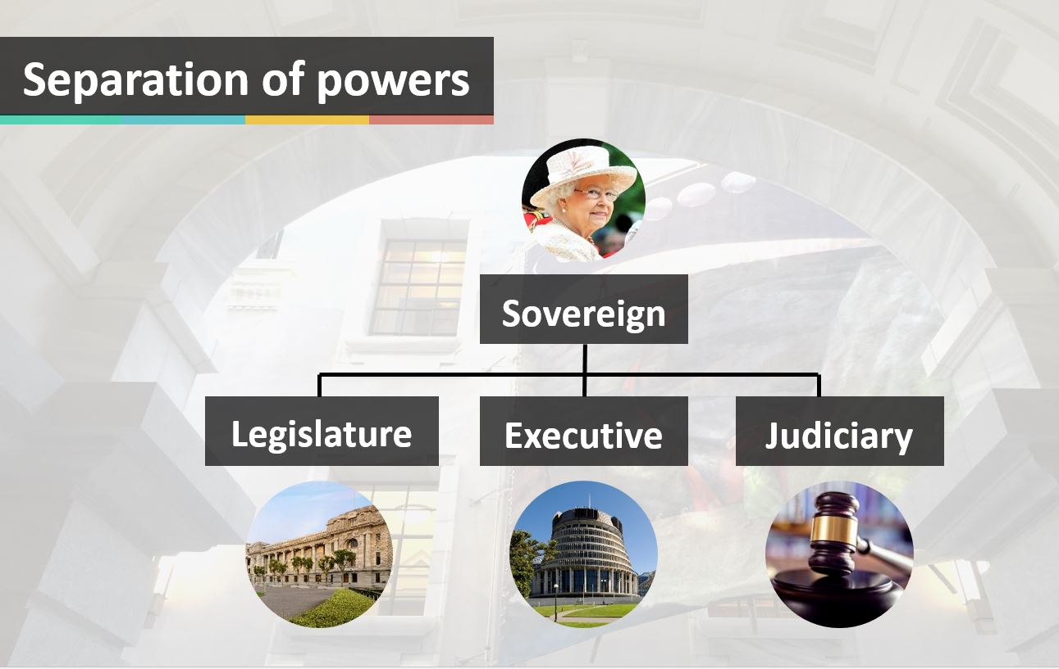
Parliament and Government
Notes:
So Parliament and Government … feel free to put up your hand in the comfort of your own space if you thought these two terms meant the same thing.
Well as we can see on this diagram they are two distinct branches in our system of Government.
Here we can see the Legislature (or Parliament) sitting separate to the Executive (or Government). The Judiciary is the third branch of our government.
In very general terms to maintain our democracy neither Parliament or the Government holds all the power. So no one can abuse its power, the functions in relation to the law are shared.
Parliament makes the law
The Government decides policies, proposes legislation and administers the law
The Judiciary (the justice system through the courts) interprets the law.
Question
Anna – this is a very brief summary of the key differences. Is there anything you’d like to add?
Link for social media
https://www.parliament.nz/en/visit-and-learn/how-parliament-works/our-system-of-government/
Further information if CW needs it:
Parliament’s role is to provide representation for the people, to make laws by which the country is governed, to scrutinise the activities of the Government and to approve the supply and spending of public money to the Government.
The middle branch in the diagram is the Executive or the Government. The Government is accountable to Parliament. It is responsible for day-to-day administration and running of the country. It’s made up of MP’s appointed by the Governor-General as Ministers of the Crown.

Slide 5

Executive Council
Constituted by Letters Patent
The institution through which government collectively and formally advises the GG
Governor-General presides
Items include regulations; orders in council; proclamations
Action by GG in Council requires recommendation by a Minister, and advice and consent of EC
All Ministers are members of Executive Council
Notes:
Anna – could you run through the important aspects of the Executive Council

Slide 6


The Executive
Cabinet
19 Ministers (4 New Zealand First, 15 Labour)
Outside Cabinet
7 Ministers (3 Green, 4 Labour)
2 Parliamentary Under-Secretaries
Notes:
So the Executive is made up of members associated with different Ministerial portfolio’s. Minister’s are member’s of Parliament who are now part of the Government.
Question:
Rachel– Can you explain for us the differences and similarities for Ministers inside and outside Cabinet?
Information on what is current regarding Government initiatives, policies and Ministerial information can be found at:
https://www.beehive.govt.nz/

Slide 7
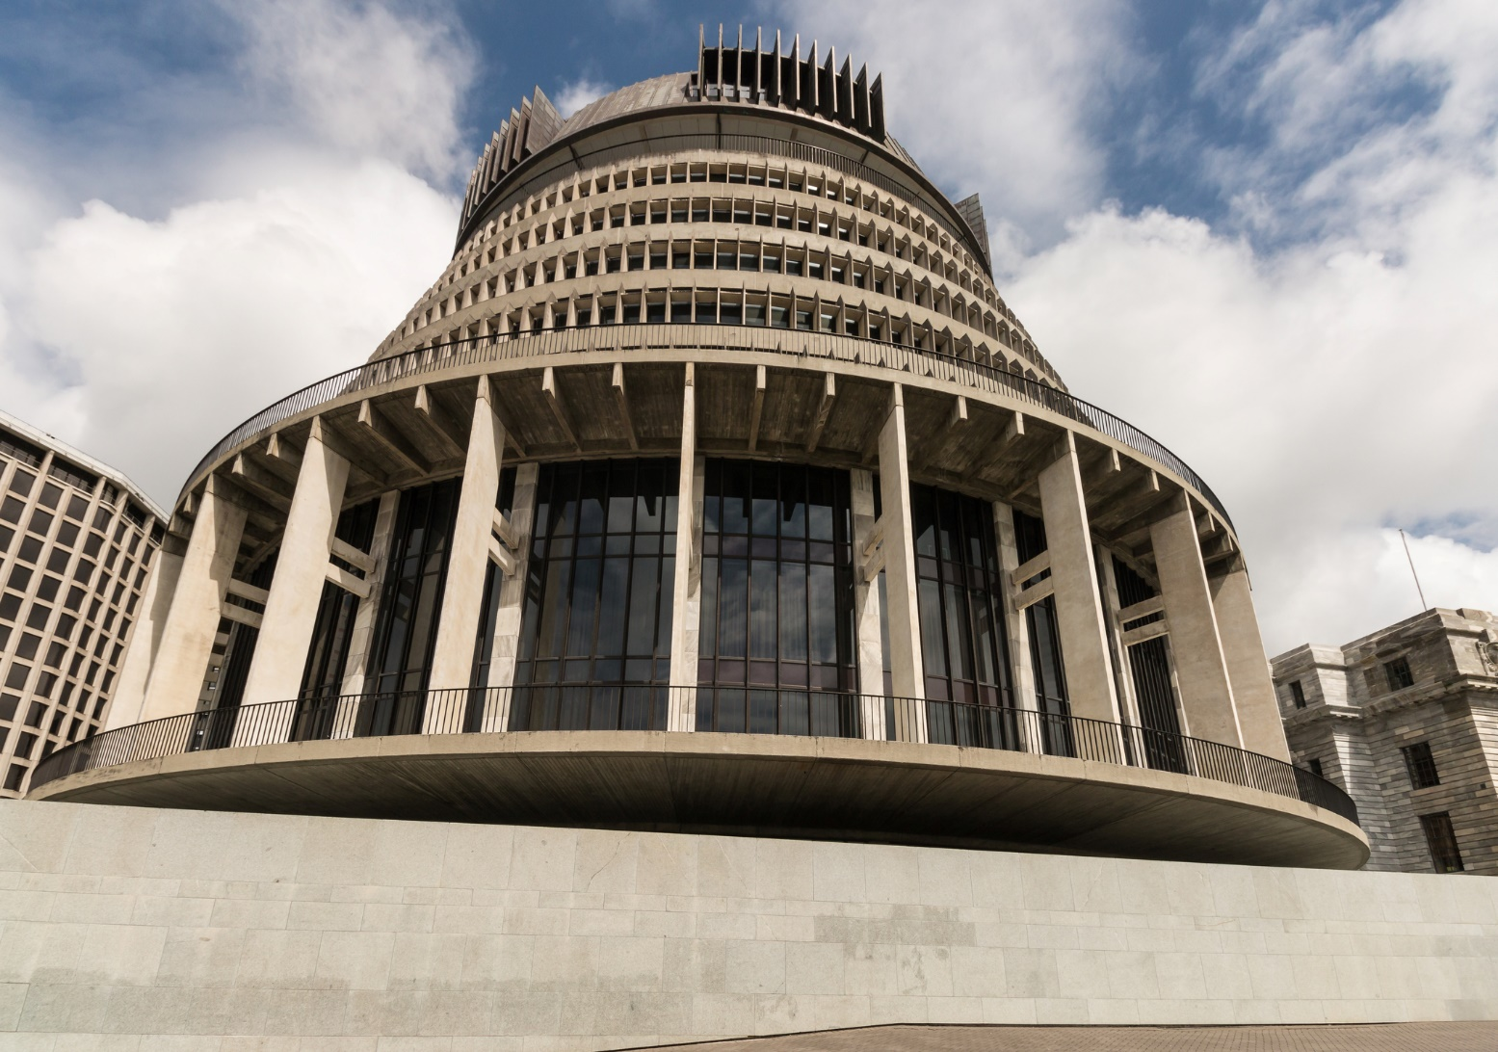
Government:
Prime Minister
Head of the government
Principal adviser to the Sovereign
and the Sovereign’s representative
Forms and maintain government
Determines portfolio allocations
and ministerial rankings
Approves the Cabinet agenda
Notes:
So the Prime Minister is the head of the government, and he or she is appointed by the Governor-General.
Question
Rachel – What are the constitutional roles of the Prime Minister?
(Note to host – look at questions to panellists on chat – let them know will answer at the end)

Slide 8
Government
Ministers
Advise the Governor-General
Take significant decisions and determine government policy collectively
Exercise statutory functions and powers
Members of Parliament
Ministers in Cabinet / Ministers outside of Cabinet / Associate Ministers / Parliamentary Under-Secretaries / Acting Ministers
Notes:
(Run through this list)
Question:
Anna – on a logistical level how does a Minister advise the Governor-General? There is an appointment ceremony when a government is formed – can you tell us a little bit about this?

Slide 9
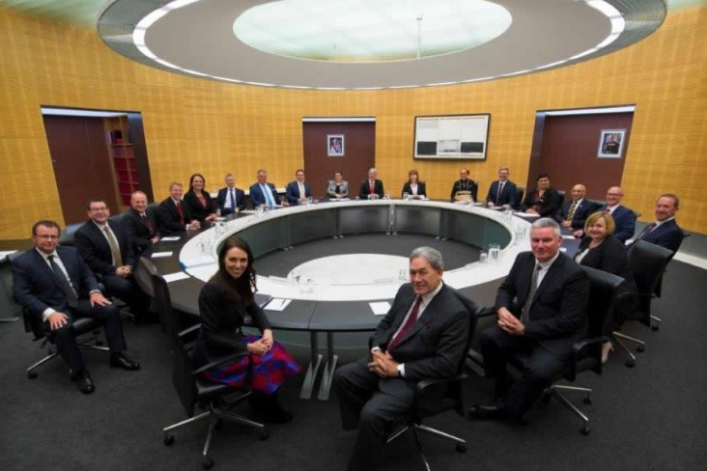
Cabinet
The central decision making body of executive government
Established by convention, not law
Comprises Ministers inside Cabinet
Notes:
So Cabinet is the central body making decisions in the Executive, and is established by convention not law
Question:
Rachel– can you tell us a little bit more about what is meant by established by convention, not law?
(Note to host – look at questions to panellists on chat – let them know will be answered at the end)

Slide 10
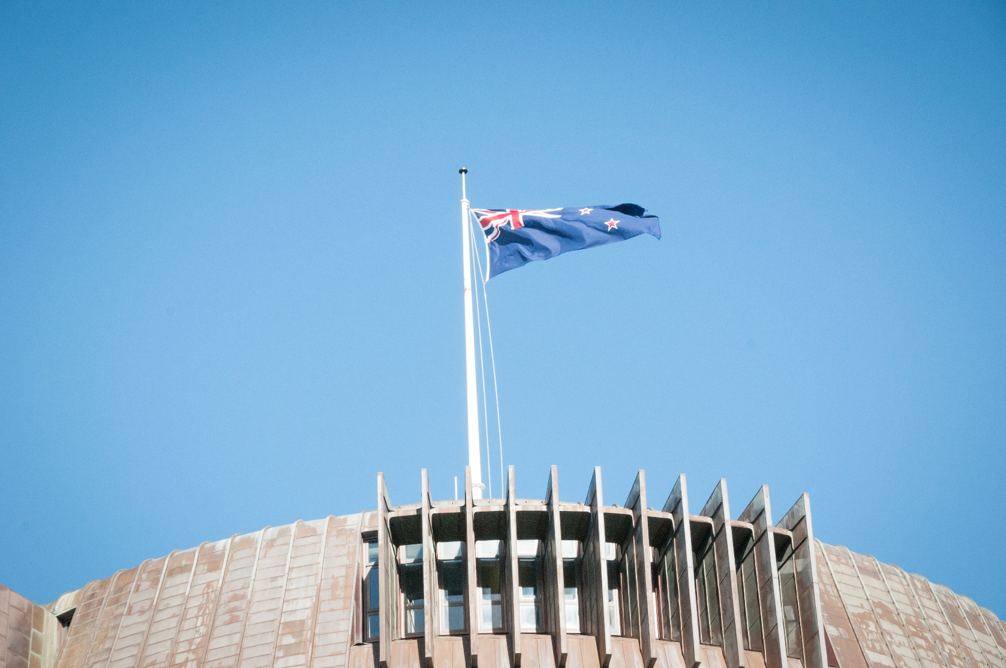
Cabinet Principles
Collective responsibility
Confidentiality
Consultation
Notes:
The Cabinet follows three important principles: Collective responsibility, Confidentiality and Consultation
Question:
Anna – Could you explain a little for us about the working of these principles and maybe about how one or two have developed?

Slide 11
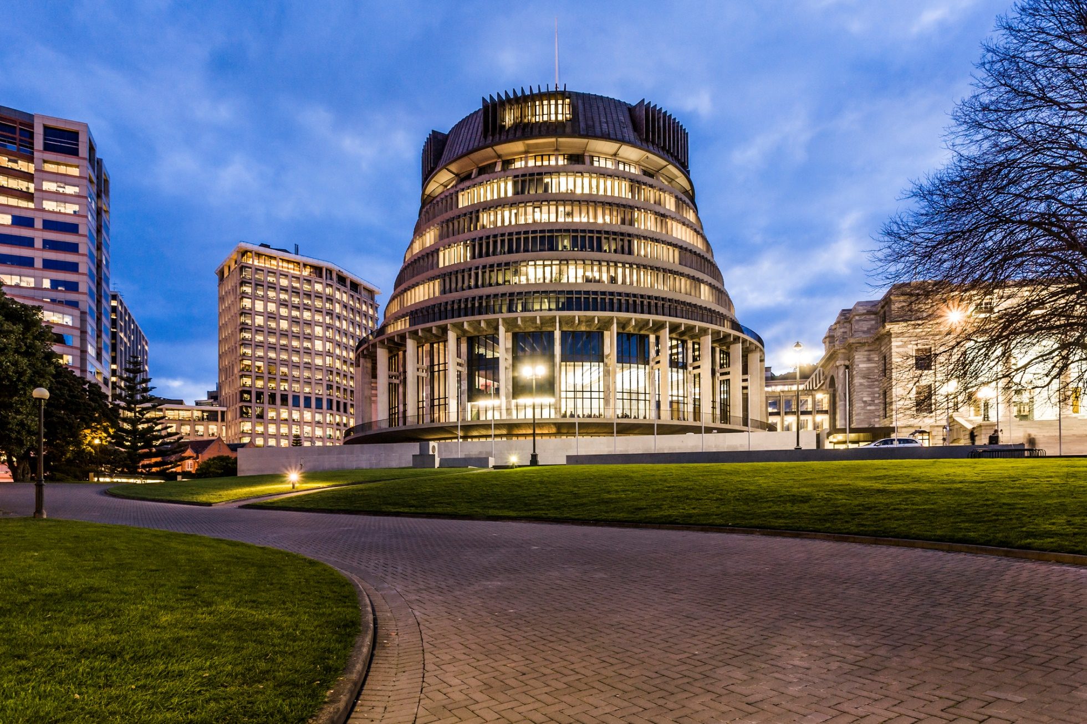
Cabinet decision-making
Department
Minister
Cabinet Committee
Cabinet
Implementation
Notes:
Rachel – could you take us through this process and just give us a quick idea of what happens at each stage, maybe also possibly timing of each stage?
(Note to host – look at questions to panellists on chat – let them know questions will be answered at the end)

Slide 12
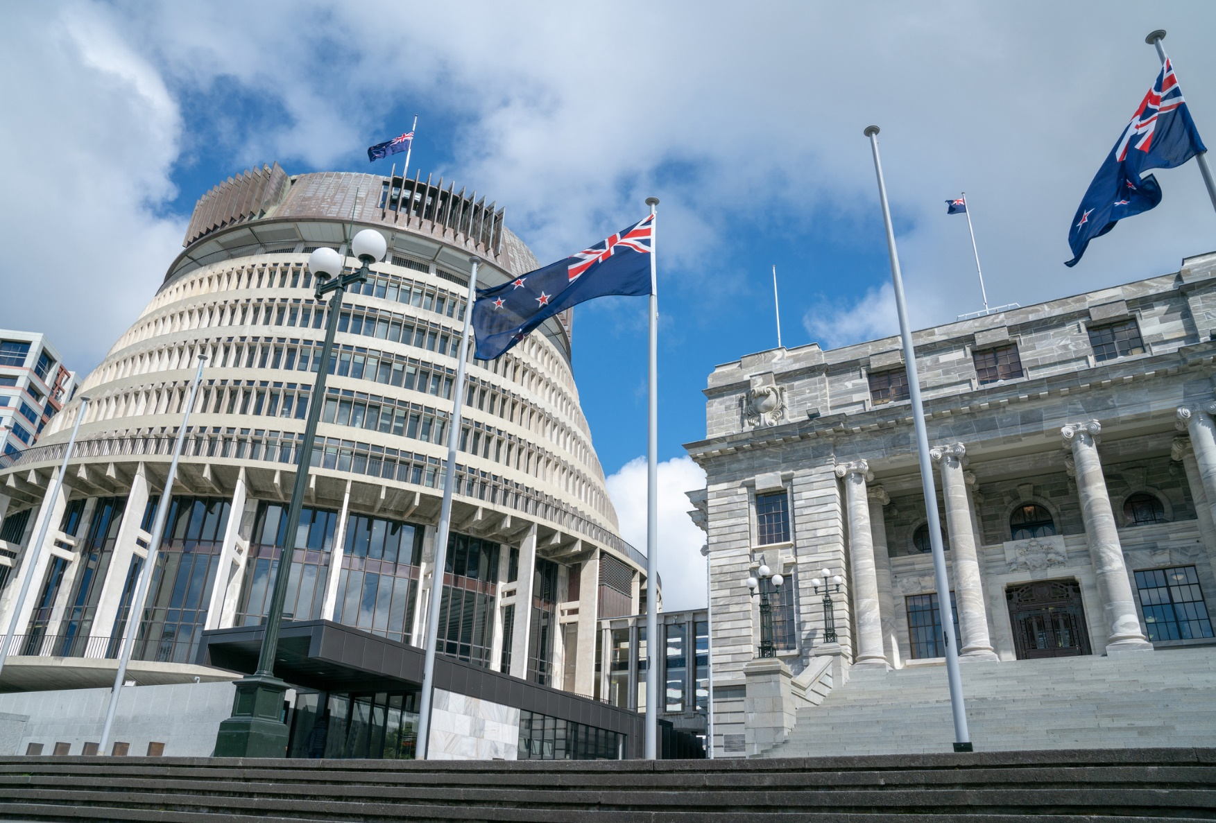
Cabinet committees
Provide the forum for
detailed discussion of issues
Departmental officials attend as required
Cover functional and subject areas
Notes:
Cabinet committees are an important part of the process outlines in the previous slide as they provide a place for issues to be discussed and debated before being taken to Cabinet.
Anna – how large are these committees and do they meet regularly throughout the year?

Slide 13
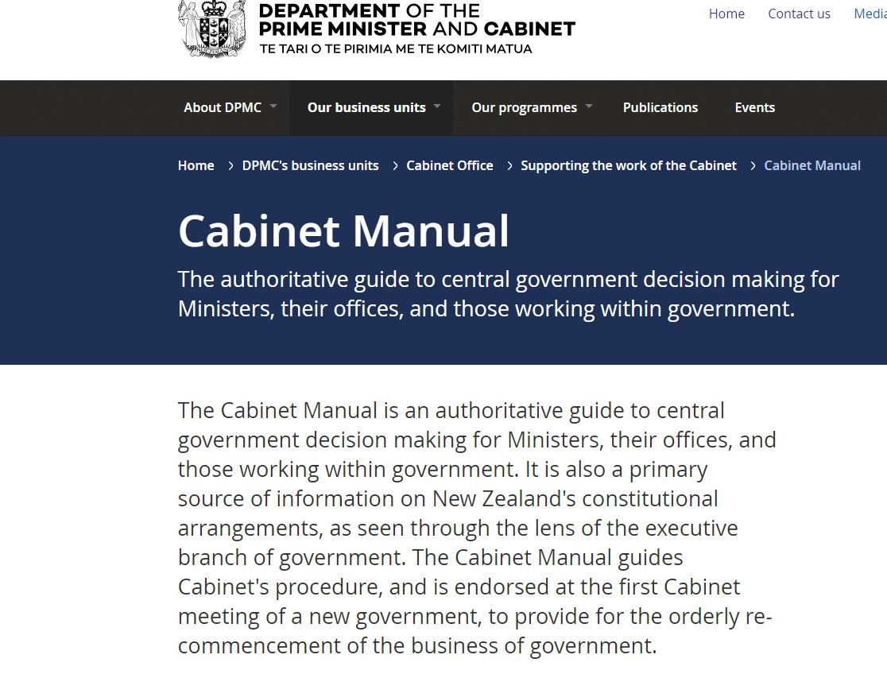
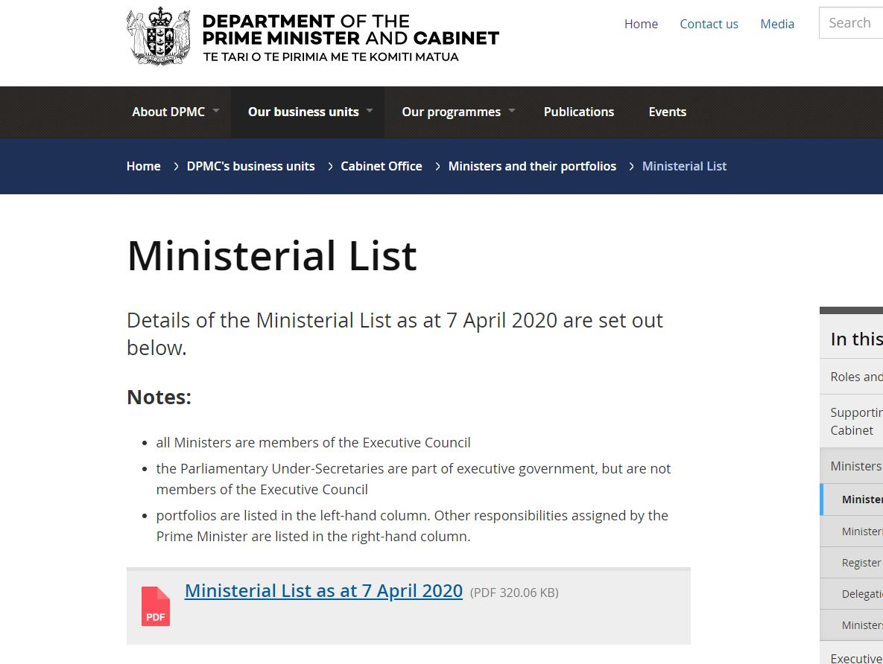
Cabinet manual
The primary authority on the conduct of Cabinet government in New Zealand
Procedure and guidance
Endorsed by successive governments as a principled and effective basis on which to operate
Notes:
The Cabinet manual provides the guidance needed for effective decision making at the Executive level.
Rachel and Anna – how long has there been the Cabinet manual? Has it evolved over time especially since the change to how our governments are formed under MMP?
(Note to host – look at questions to panellists on chat)

Slide 14
Q + A
Notes:
Questions from the chat to panelists
Further links connected to this topic
How Parliament works – including further detail on the three branches of government
https://www.parliament.nz/en/visit-and-learn/how-parliament-works/fact-sheets/pbrief7/
Government accountability to the House of Representatives
https://www.parliament.nz/en/visit-and-learn/how-parliament-works/fact-sheets/pbrief1/
A research paper by John Martin which describes the shift towards greater executive dominance in three respects important to the functioning of Parliament — parliamentary expenditure, the impact of political parties and electoral politics, and increased government control over business in the House of Representatives. https://www.parliament.nz/en/visit-and-learn/how-parliament-works/fact-sheets/shifting/

