Slide 1
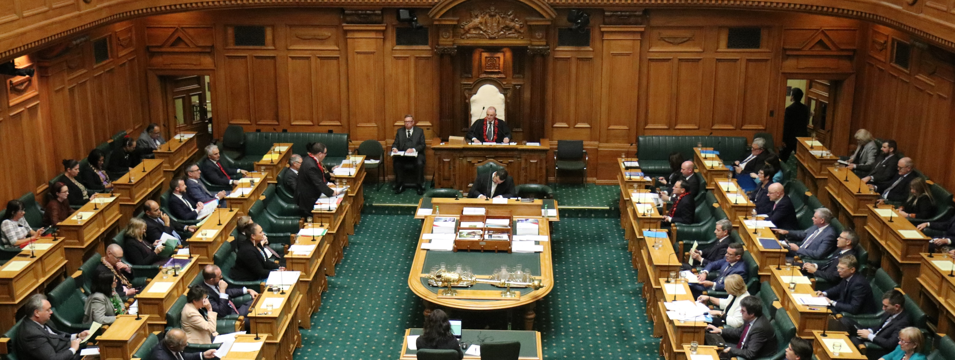
How a bill becomes law
The Legislative Process

Slide 2
How to use this tool
This tool has been developed to guide you through the legislative process, the process to turn a bill from just an idea into a law for Aotearoa New Zealand.
This tool includes interactive functions to allow you to debate and vote on an idea for a law in the classroom.

Slide 3
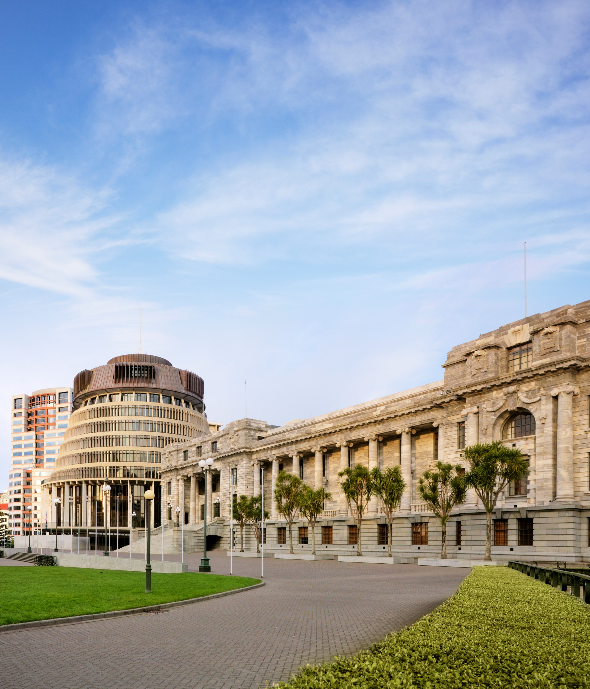
How a bill becomes law
Parliament’s main job is to create laws for Aotearoa. Bills are proposals to make a new law or to change an existing one. Only Parliament can pass a bill into a law, and to do so, it will go through several stages.

Slide 4
Legislative process
The process to pass a bill into a law is also called the legislative process. Most bills must pass through each stage, and receive the Royal Assent.
Parliament is made up of elected members, also called MPs. They make laws by examining and debating bills.
Introduction
First Reading
Select committee
Second Reading
Committee of the whole House
Third Reading
Royal Assent

Slide 5
Your idea for a bill
We will use a bill as an example to track the progress throughout the process. You can find an existing bill on the New Zealand Legislation website, or come up your own – remember it should always end with “Bill” – e.g. The Parliament Education Team Bill.
Enter the name of your bill below:

Slide 6
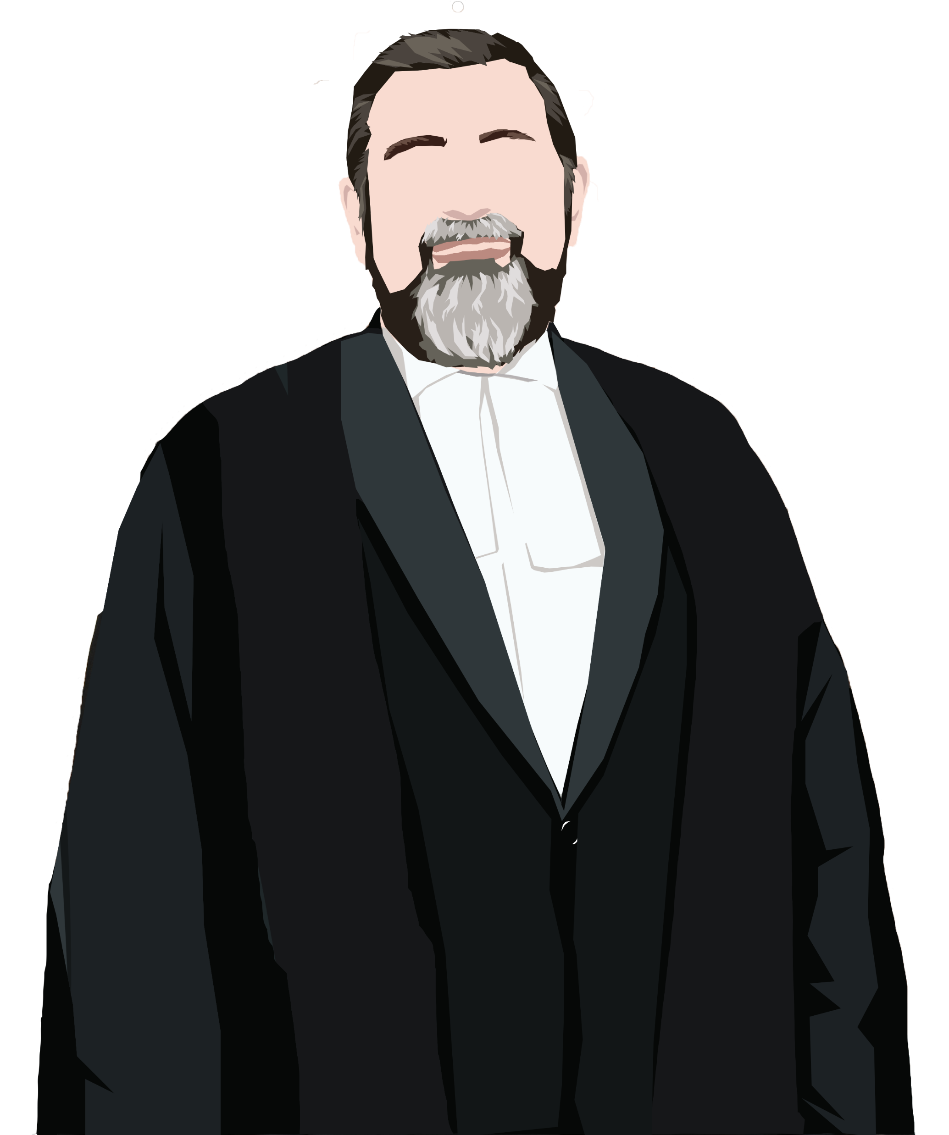
Introduction
First, the bill is introduced to all the MPs in the House of Representatives by the Clerk of the House.
It’s called a reading because, historically, not every MP in the House of Commons in England could read, so the Clerk had to read the whole bill aloud for everyone to hear.
Introduction
First Reading
Select committee
Second Reading
Committee of the whole House
Third Reading
Royal Assent

Slide 7








First Reading
The First reading is the first chance for MPs to debate the bill and share what they think about the bill. You can make a speech in English, te reo Māori, or New Zealand Sign Language.
Introduction
First Reading
Select committee
Second Reading
Committee of the whole House
Third Reading
Royal Assent

Slide 8
First Reading
Once the debate has finished, it’s time to cast the votes. A bill needs more than half the votes to move to the next stage.
Majority in favour
Majority against
Introduction
First Reading
Select committee
Second Reading
Committee of the whole House
Third Reading
Royal Assent

Slide 9
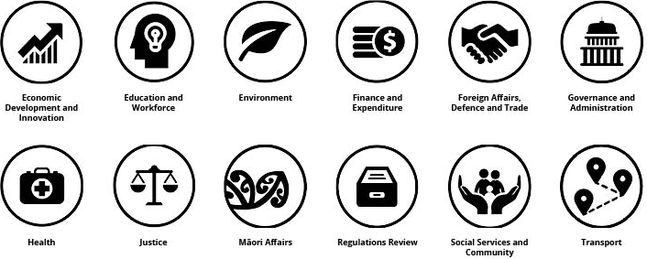
Select committee
If a bill passes its first reading it goes to a select committee. Select committees consist of MPs from across the House, who specialise in one particular subject area.
New Zealand Parliament has 12 subject committees.
Introduction
First Reading
Select committee
Second Reading
Committee of the whole House
Third Reading
Royal Assent

Slide 10
Select committee
The committee may call for submissions, meaning that anyone can share their views and ideas for the bill. The role of MPs is to scrutinise the bill, make suggested amendments, and report their findings back to the House.
Once the House receives the report, it’s time for the bill to have a second reading.
Introduction
First Reading
Select committee
Second Reading
Committee of the whole House
Third Reading
Royal Assent

Slide 11
Second Reading
In the second reading, members debate the main principles of a bill, and any changes recommended by the select committee in its report.
Introduction
First Reading
Select committee
Second Reading
Committee of the whole House
Third Reading
Royal Assent

Slide 12
Second Reading
Time to cast your votes! Remember, a bill needs more than half the votes to move to the next stage.
Majority in favour
Majority against
Introduction
First Reading
Select committee
Second Reading
Committee of the whole House
Third Reading
Royal Assent

Slide 13
Committee of the whole House
Committee of the whole House is a chance for MPs to examine the bill in detail, and propose changes or amendments. Speeches are shorter, but members get to speak more than once. There’s no time limit on these debates, and they could take several sitting days.
Once the final form of the bill is agreed it’s reprinted with its changes. The bill is then ready for the third reading.
Introduction
First Reading
Select committee
Second Reading
Committee of the whole House
Third Reading
Royal Assent

Slide 14
Third Reading
The third reading is usually a summing-up debate on a bill in it’s final form.
Introduction
First Reading
Select committee
Second Reading
Committee of the whole House
Third Reading
Royal Assent

Slide 15
Third Reading
The vote at the end of the debate is the final vote in the House to either pass the bill or reject it.
Majority in favour
Majority against
Introduction
First Reading
Select committee
Second Reading
Committee of the whole House
Third Reading
Royal Assent

Slide 16


Royal Assent
Congratulations! Your bill has passed in the House of Representatives, but it’s not a law until it’s signed by the Sovereign or their representative in New Zealand, the Governor General.
Introduction
First Reading
Select committee
Second Reading
Committee of the whole House
Third Reading
Royal Assent

Slide 17
Voted down
If a bill does not receive more than half the votes, it is voted down and it will not progress or become a law.
To try again with a new bill click here
To finish click here
Introduction
First Reading
Select committee
Second Reading
Committee of the whole House
Third Reading
Royal Assent

Slide 18
Summary
Great job! You have learnt about the process that a bill must go through to become a law.
Check out the links below for further information and resources:
Spotlight on Parliament - How a bill becomes law video
How a bill becomes law flowchart
How select committees work video
How to make a submission to a select committee
Mā te wā!

Slide 19
Glossary
Return to previous slide
Legislative Process - The process for how a bill becomes a law.
Bill – Before a law is made, it starts off as a bill. A bill is a draft that goes through different phases and becomes a law once it has been signed by the Governor General.
Law - A rule that we follow as a country.
Debate - A debate is when Members of Parliament from different parties make speeches about a bill.
Vote - After each reading in the Debating Chamber, the Members of Parliament will vote on whether they want the bill to go to the next stage to becoming a law.
Proposal - A suggestion or idea.
Stages - A step in a process.

Slide 20
Glossary
Return to previous slide
MP – Member of Parliament
Examining – To check or study something carefully
House of Representatives – The elected members of Parliament who make the laws for New Zealand.
Clerk of the House - They support the running of the House of Representatives. Their job includes announcing the agenda or plan of the day and introducing new bills to the House.
House - Shortened term for House of Representatives.
Subject committees - A type of select committee that is focussed on a subject.
Scrutinise - To check something out or to investigate.

Slide 21
Glossary
Return to previous slide
Amendments - A change or addition to improve a bill.
Report - An official, written document capturing what was covered during the meetings.
Principles - The main ideas of the bill.
Sitting day - A day when MPs (Members of Parliament) meet in the Debating Chamber. They are typically 2pm-10pm on Tuesdays and Wednesdays, and 2pm-5pm on Fridays.
Sovereign – A King, Queen, or Monarch. The British sovereign is our Head of State.
Governor General - They act on behalf of the Sovereign. Their role is to sign off new laws, and open and close Parliament.

