Slide 1
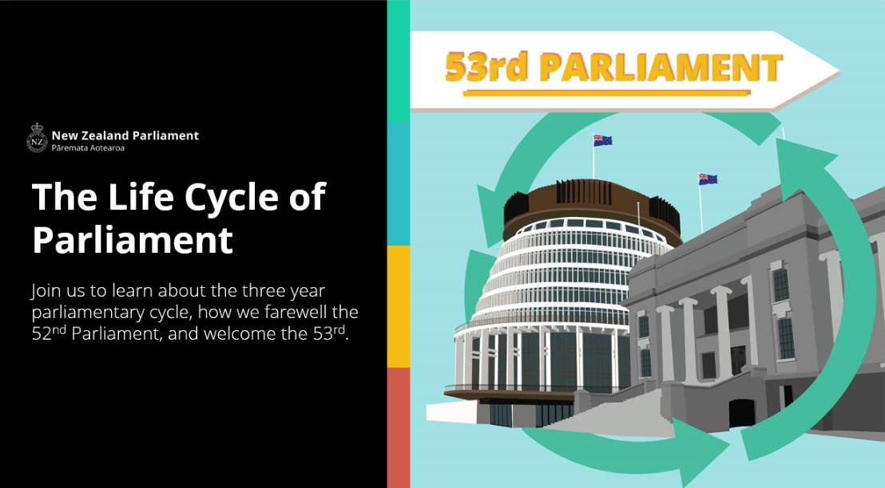

Slide 2

Notes:
https://www.tewikiotereomaori.co.nz/

Slide 3
What will we cover today?
Term of Parliament
Dissolution
Opening of Parliament
Q + A

Slide 4
Term of Parliament

Slide 5
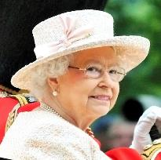
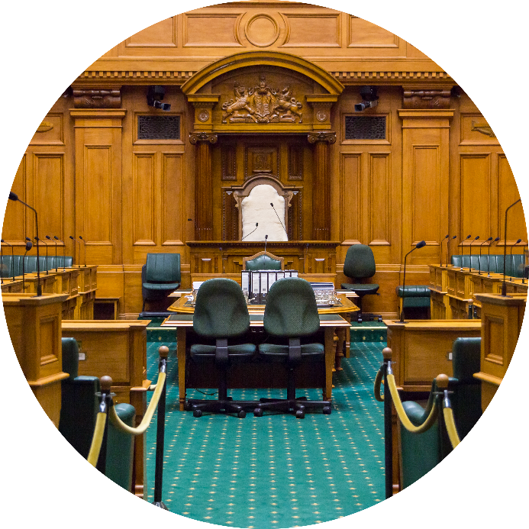
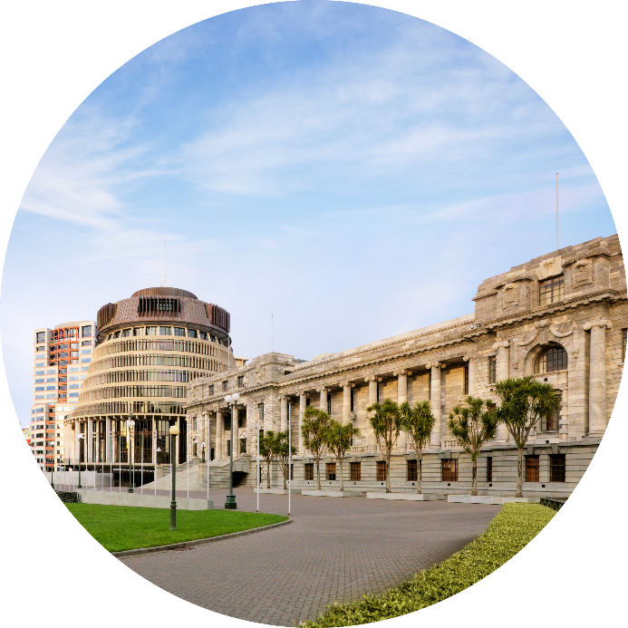
What is Parliament?
House of Representatives
Sovereign
Parliament
Notes:
https://www.parliament.nz/en/visit-and-learn/how-parliament-works/fact-sheets/pbrief7/

Slide 6
Role of the Sovereign

Slide 7
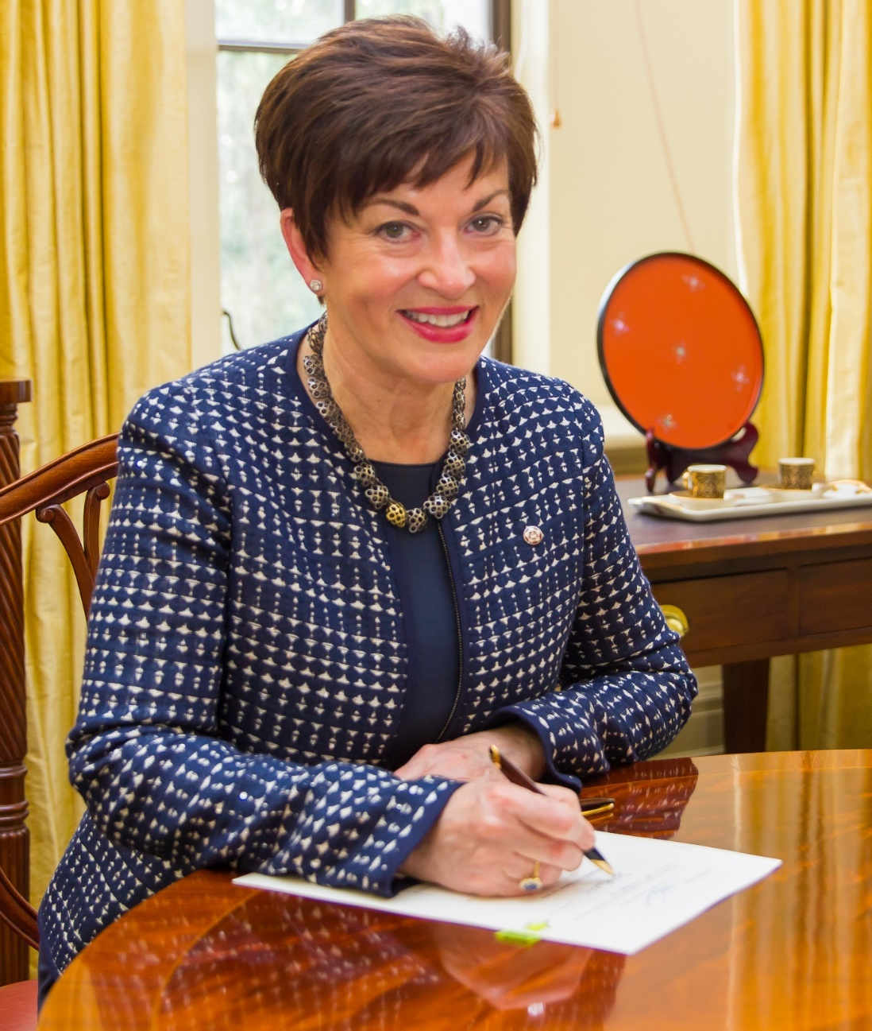
Calls for an Election
Dissolves
Summons
Appoints

Slide 8
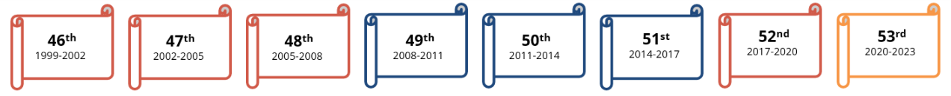

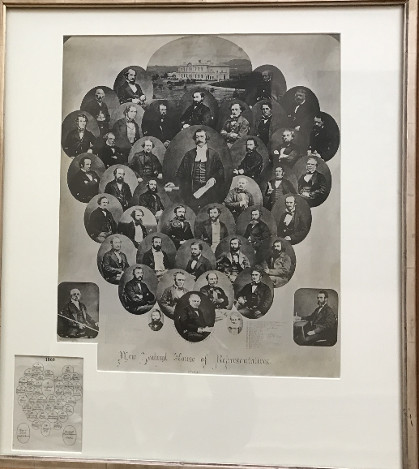
The House of Representatives is continuous…
53rd
2020-2023
Est 1854

Slide 9
Limit on term of Parliament = 3 years
From the date fixed for the return of the writ
5 years
1852-1879
4 years?
Royal Commission Referendums 1967 and 1990
3 years
Triennial Parliaments Act 1879

Slide 10
Average term of Parliaments globally
4.5 yrs
Unicameral Parliaments
Source: ipu.org
Notes:
https://data.ipu.org/compare?field=chamber%3A%3Afield_parliamentary_term&structure=unicameral__any#bar

Slide 11
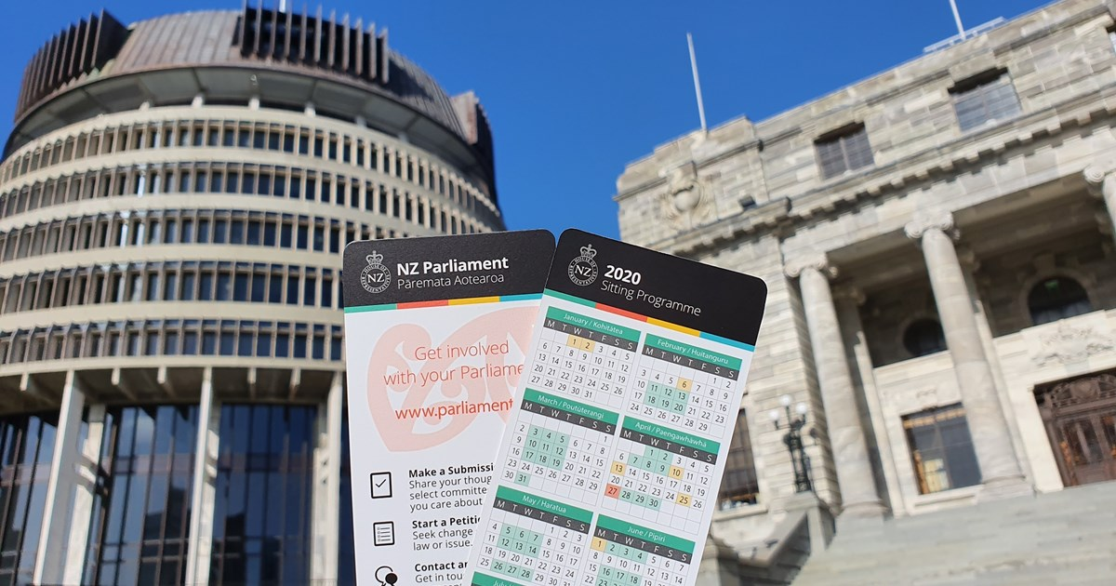
When does Parliament meet?
The Business Committee
The Business Committee is made up of Members of Parliament from all political parties. They make decisions on important procedural aspects, like when Parliament will meet in a year, or when an extended sitting will occur.
Notes:
https://www.parliament.nz/en/get-involved/features/what-does-the-business-committee-do/

Slide 12
Dissolution

Slide 13
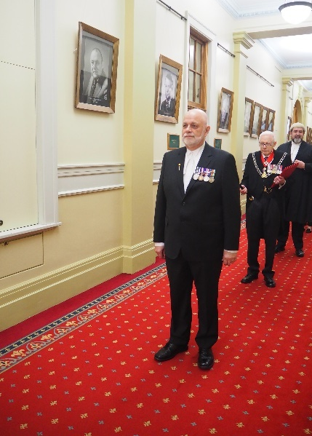
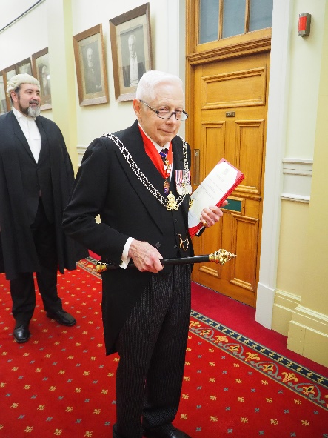
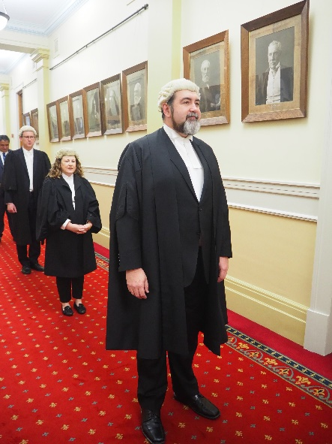
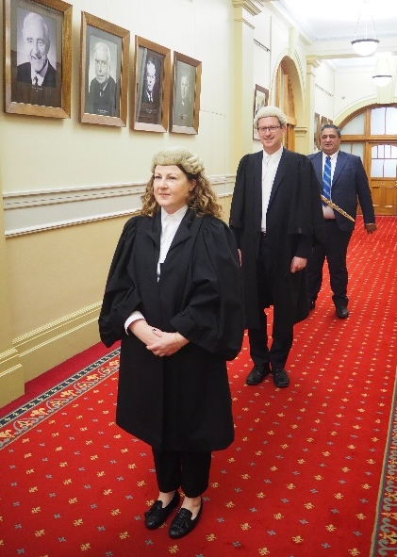
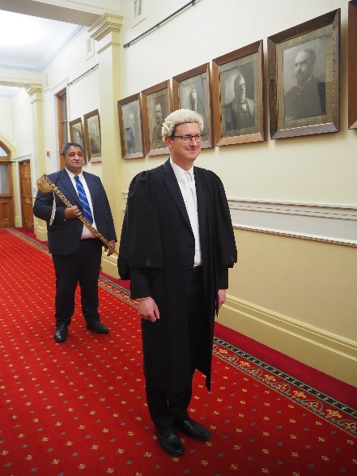
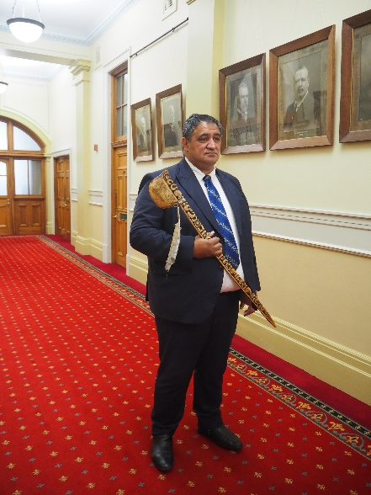
The key players
Serjeant-at-Arms
Herald of Arms
Clerk
Deputy Clerk
Principal Clerk (Procedure)
Tumu Whakarae
Witnesses

Slide 14
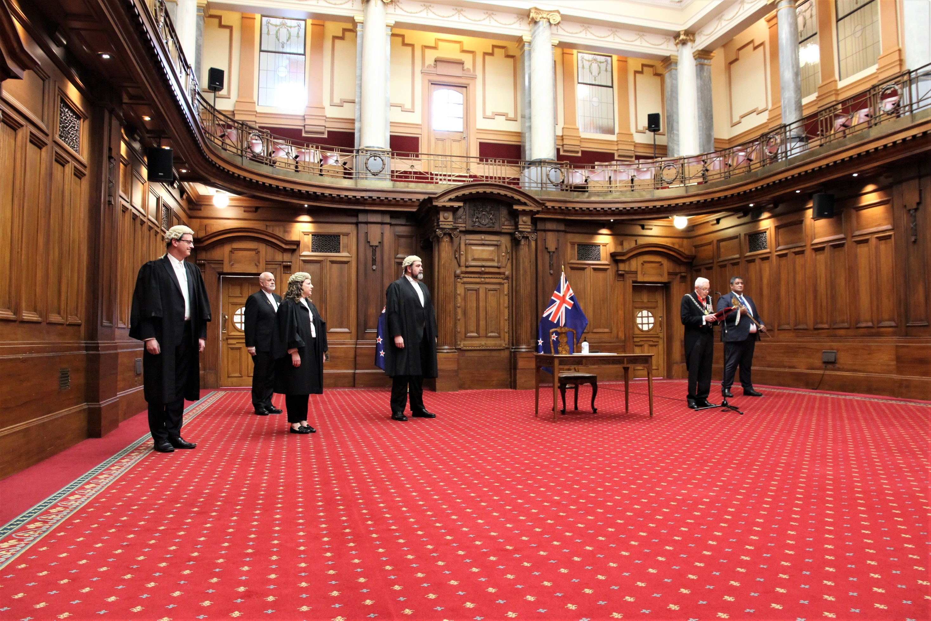
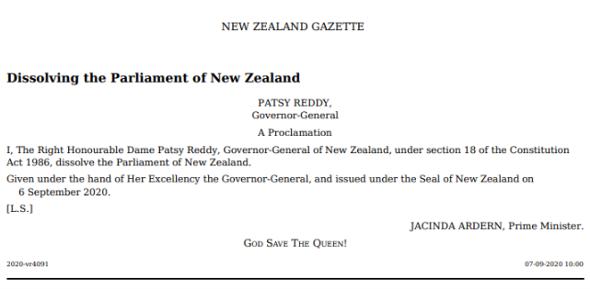
Proclamation
A proclamation is a formal document made and signed by the Governor-General and impressed with the Seal of New Zealand, and published in the New Zealand Gazette.

Slide 15

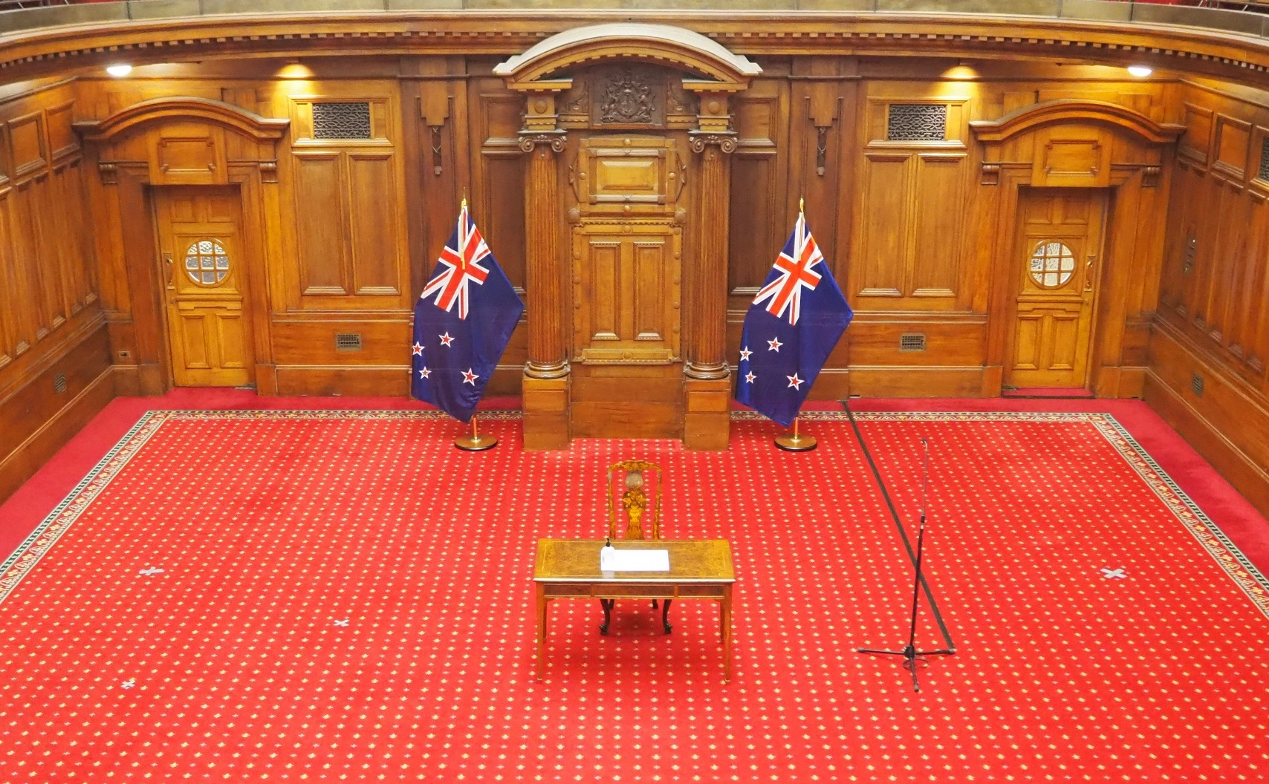
Adapting to COVID-19
The public were welcomed to watch the Dissolution if it took place outside. Unfortunately it was bad weather so took place inside Parliament House.
The ceremony was livestreamed on Parliament TV and Facebook so the public could watch.
Tape was placed on the ground in the Legislative Council Chamber to indicate where people should stand (1 metre apart!)
Everyone used their own pen and hand sanitizer was available for use.
No singing or band was used.

Slide 16
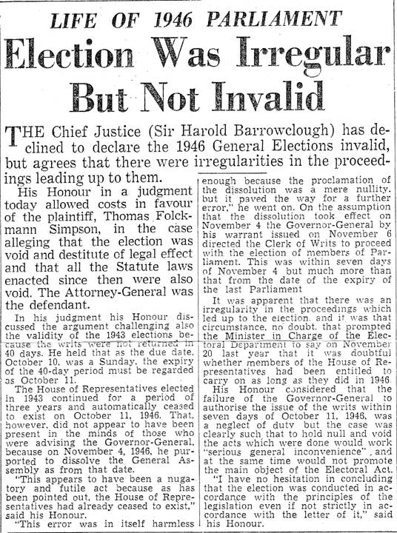
Expiration
Ending a term of Parliament by reaching its legal time-limit

Slide 17
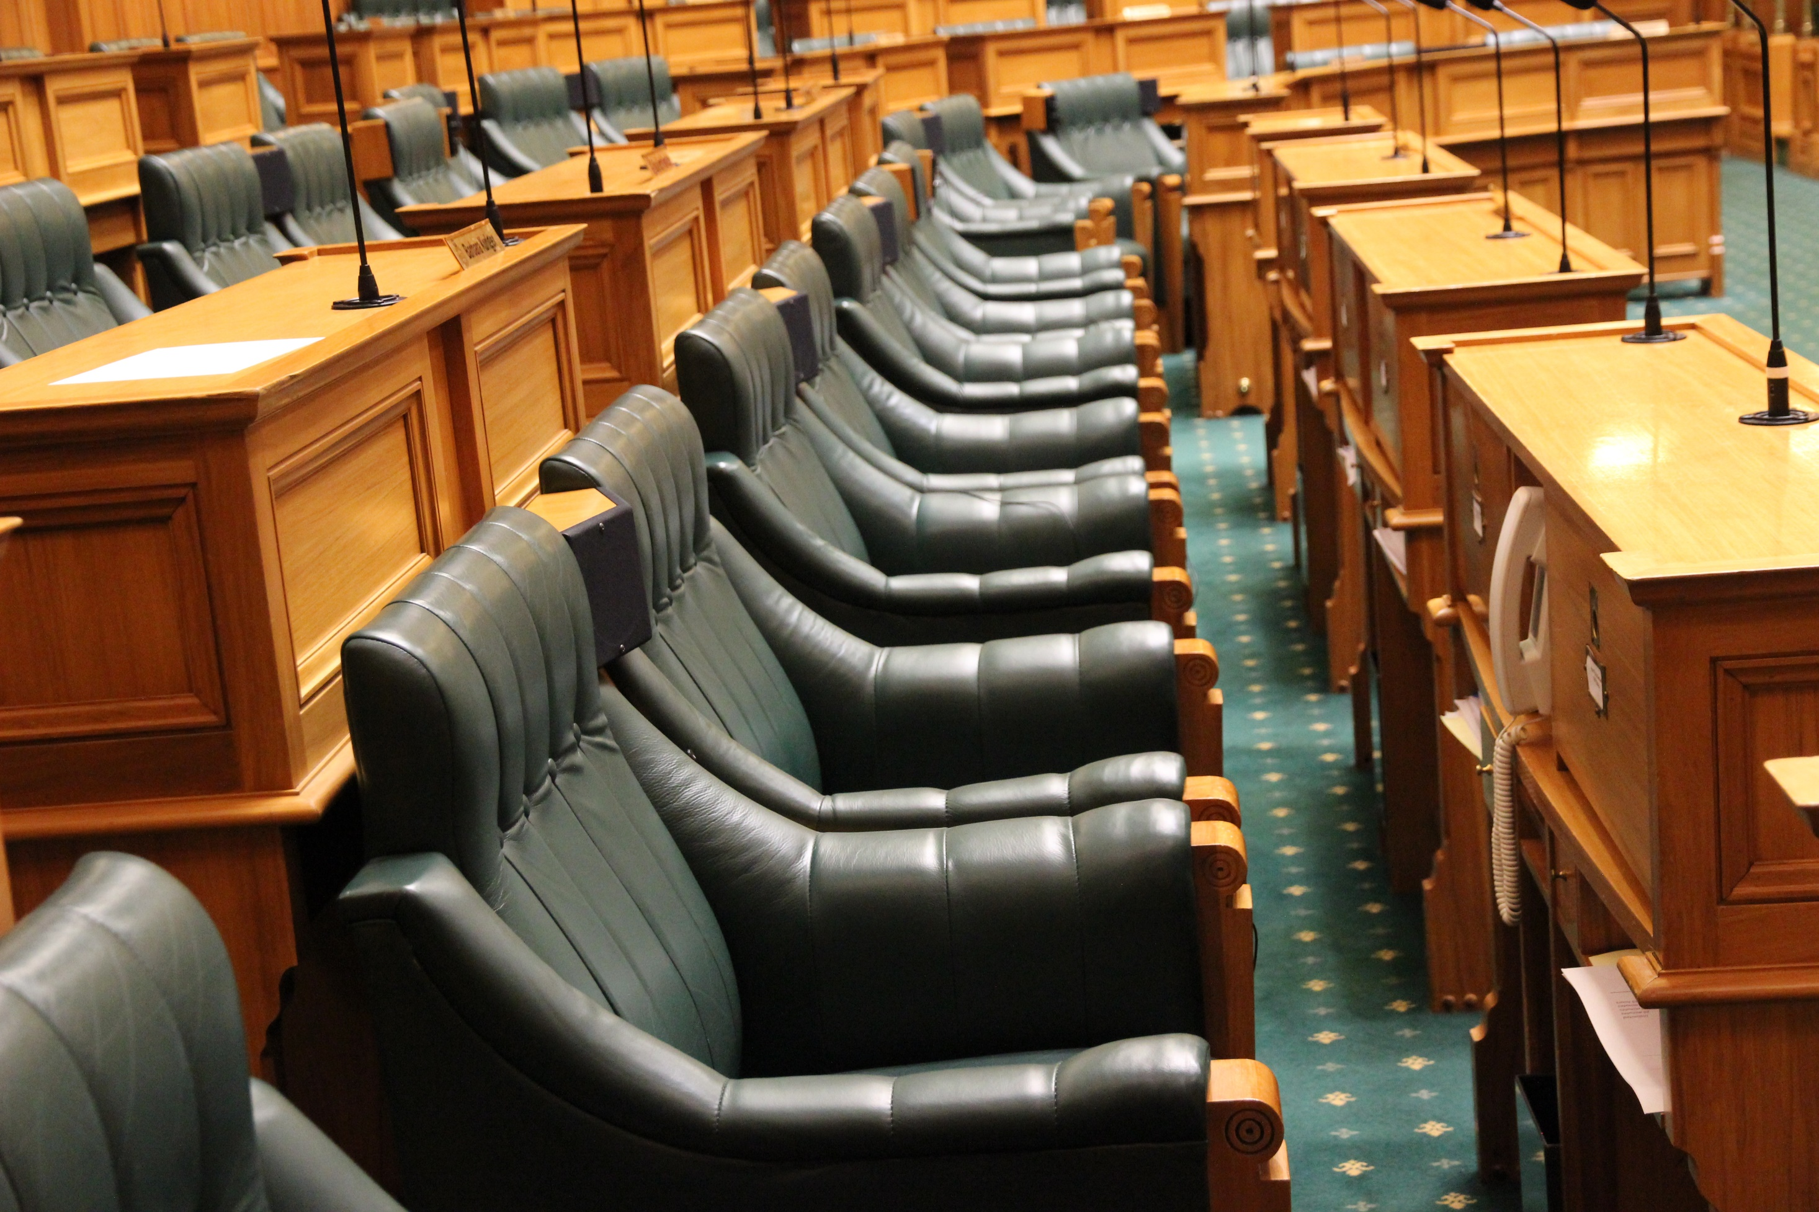
Interregnum
The period between the end of a Parliament and the opening of the new Parliament is commonly described as an “interregnum”, but it’s not a legal or official parliamentary term

Slide 18
Government Formation

Slide 19
Forming a government is a political process, negotiated by politicians.
The Governor-General recognises where the confidence of the House lies (based on parties' public statements). It is not the Governor-General's role to form the government.
Once negotiation is complete, parties usually make public statements of their intentions to form a government.
The Governor-General appoints the government. They will also accept the political decision as to who will lead the government as Prime Minister.
Notes:
https://dpmc.govt.nz/our-business-units/cabinet-office/supporting-work-cabinet/cabinet-manual/6-elections-transitions-4

Slide 20
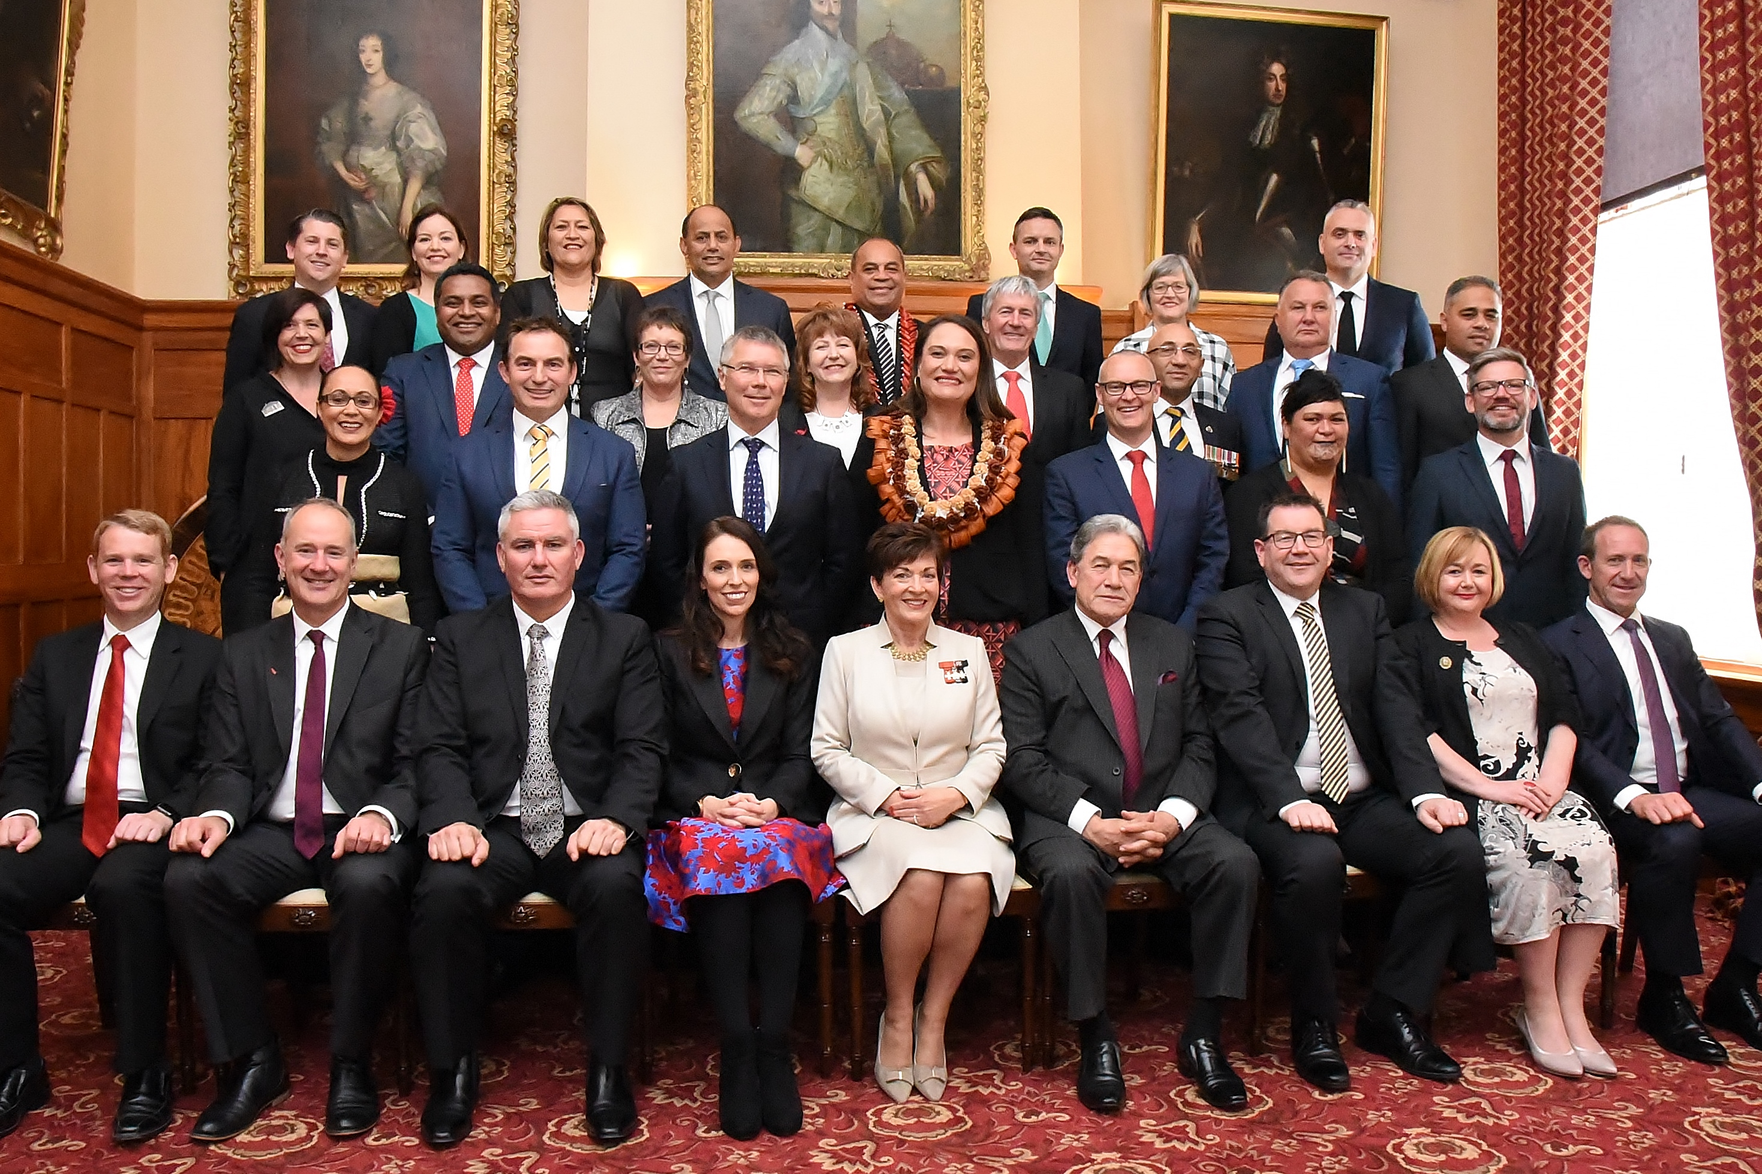
Appointment of a government
The Governor-General hosts a swearing in of the new Ministers at Government House. Ministers are also part of the Executive Council, which meets with the Governor-General every Monday (generally).

Slide 21
Opening of Parliament

Slide 22
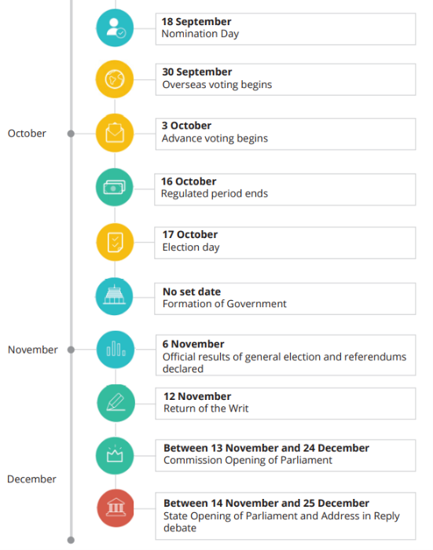
Notes:
https://www.parliament.nz/electiontimeline/index.html

Slide 23
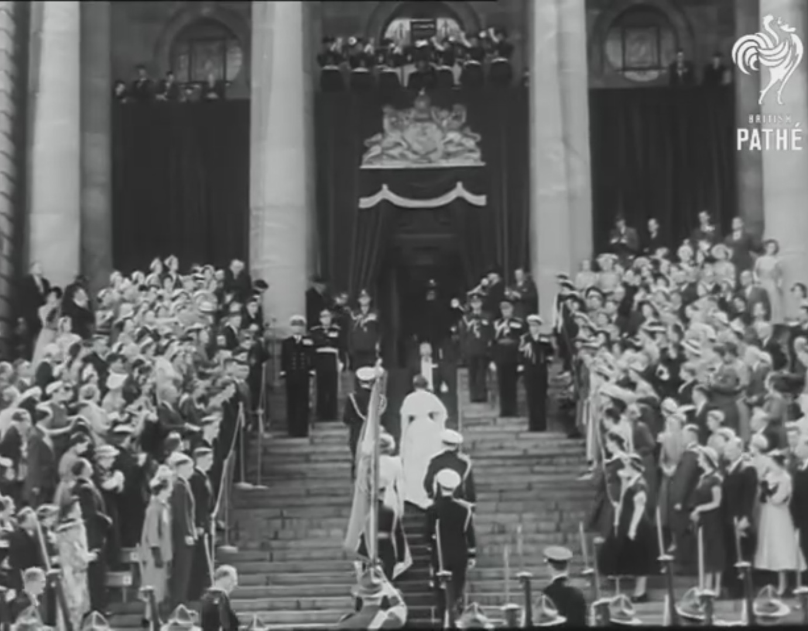
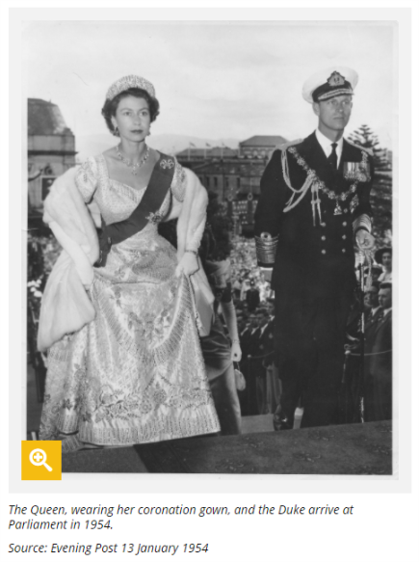
1954- The Queen opened Parliament
12 January 1954
First reigning monarch to visit New Zealand
50,000 people came to watch

Slide 24
What happens?
Day One
Commission Opening
Day One
Confirmation of Speaker
Day Two
State Opening

Slide 25
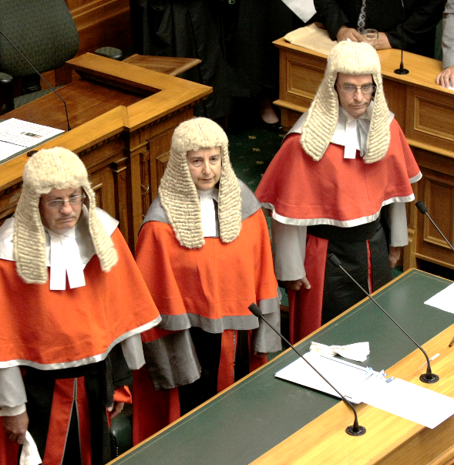
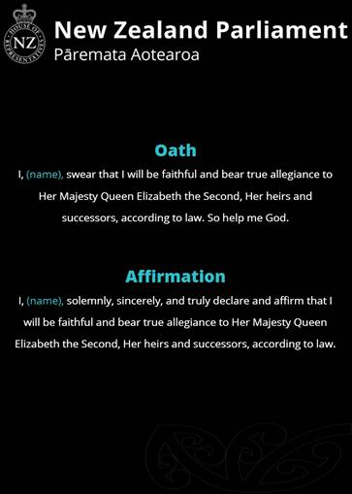

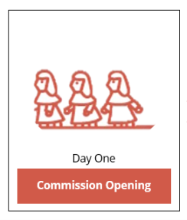

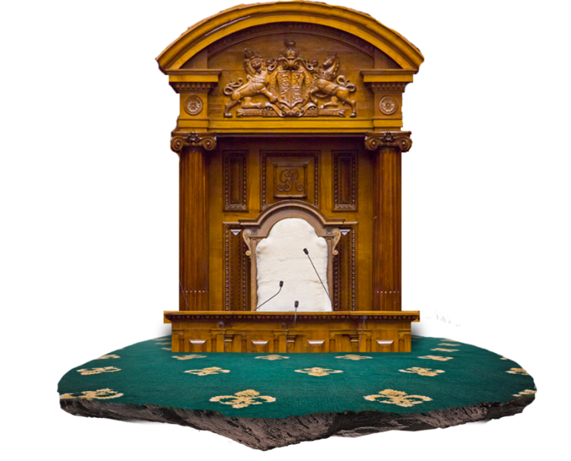


Slide 26
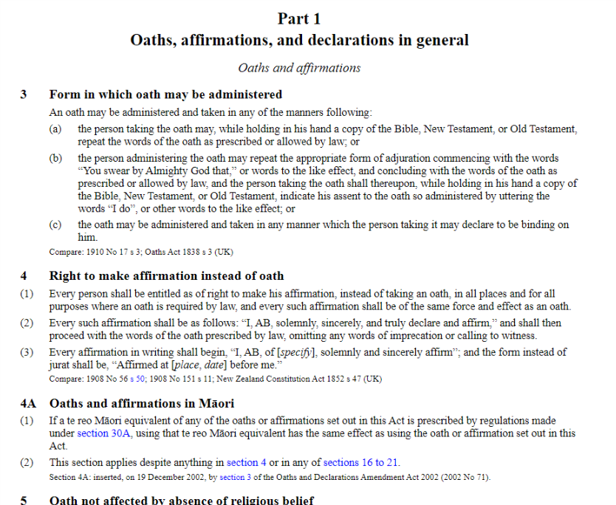
Notes:
http://www.legislation.govt.nz/act/public/1957/0088/latest/DLM314573.html

Slide 27
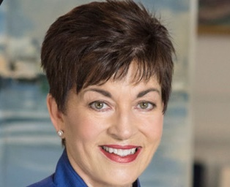
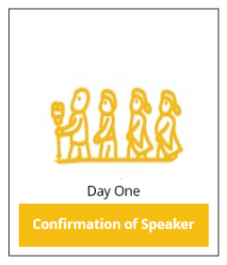


Slide 28
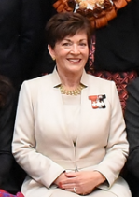
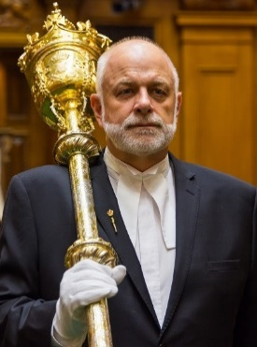
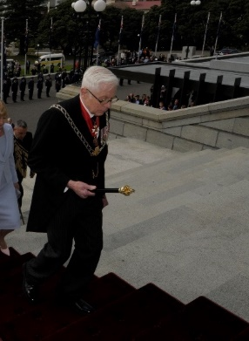
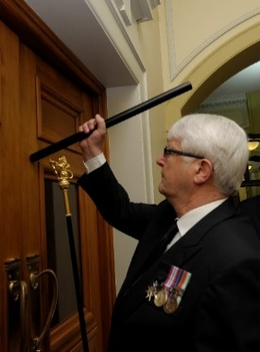
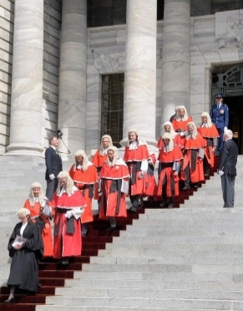
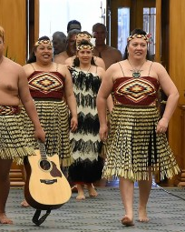
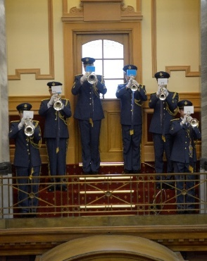
The key players
Governor-General
Serjeant-at-Arms
Herald of Arms
Usher of the Black Rod
Judiciary
Kapa Haka
NZDF

Slide 29
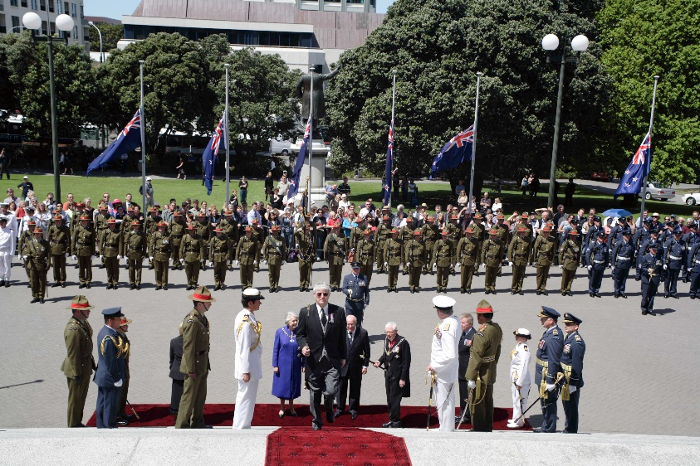
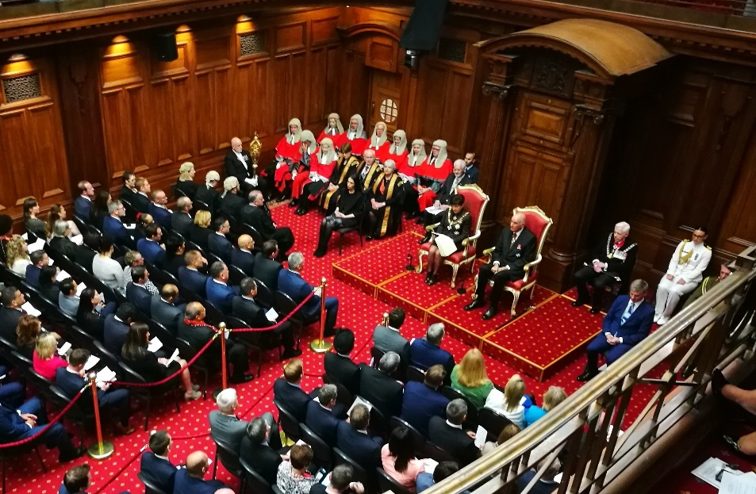
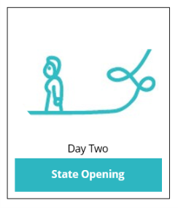


Source: Woolf Photography
Notes:
https://www.beehive.govt.nz/speech/speech-throne-2017

Slide 30



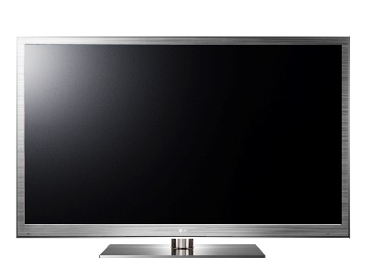

How can I be involved in the Opening of the 53rd Parliament?
In person on the Parliament lawn (State Opening)
Livestreamed on Facebook
Live on Parliament TV
Freeview 31, Sky 86, Vodafone 86
On the radio
Live on Parliament On Demand

Slide 31
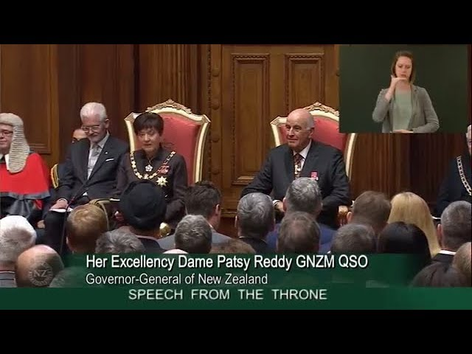

Slide 32
Q + A

Slide 33



Virtual Tour of Parliament-
Parliament XR
Download for free:
Google Play- Android
App store-iOS

Slide 34
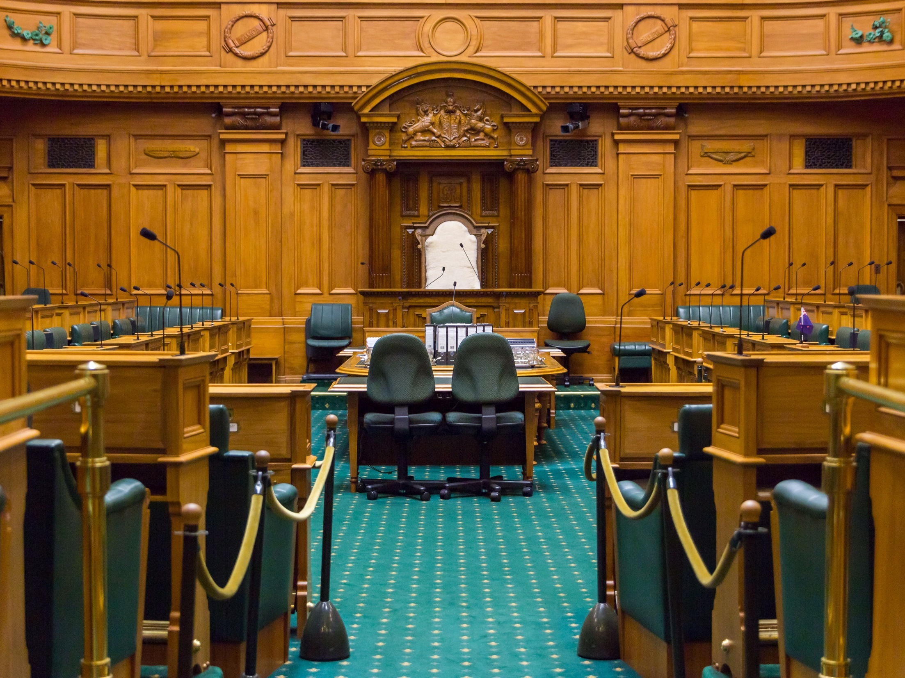

Our House is YOUR House
Find us on Twitter, Instagram, and Facebook
@nzparliament
Notes:
Remember to get in touch with the Office if you need help or want to know more.
Questions?

